Slide 1
Week07
🦜
🦜
🦜
✨No Laptop Monday! ✨
hi Jeannie
🦜
🦜
🦜
🦜
map (dictionary, table) interface
WARMUP
long, long, ago, many people owned a large, physical book called a ✨dictionary✨
- what was it used for?
- did you know there were different kinds of dictionaries?
[record lecture]

Slide 2
real-world dictionaries note: these are NOT hash maps (hash maps are NOT ordered)

Slide 3



Map<String, String> dictionary;
// {Dog=A cute, four-legged mammal, ...}
Map<String, String> spanishToEnglishDictionary;
// {Gato=Cat, Perro=Dog, ...}
Map<String, List<String>> rhymingDictionary;
// {Dog=[Bog, Cog, Frog], ...}

Slide 4
common occurrence in ye olden times
child: "how do you spell trebuchet?"
parent: "look it up in the dictionary."

Slide 5
note: this advice made no sense

Slide 6
unless...

Slide 7
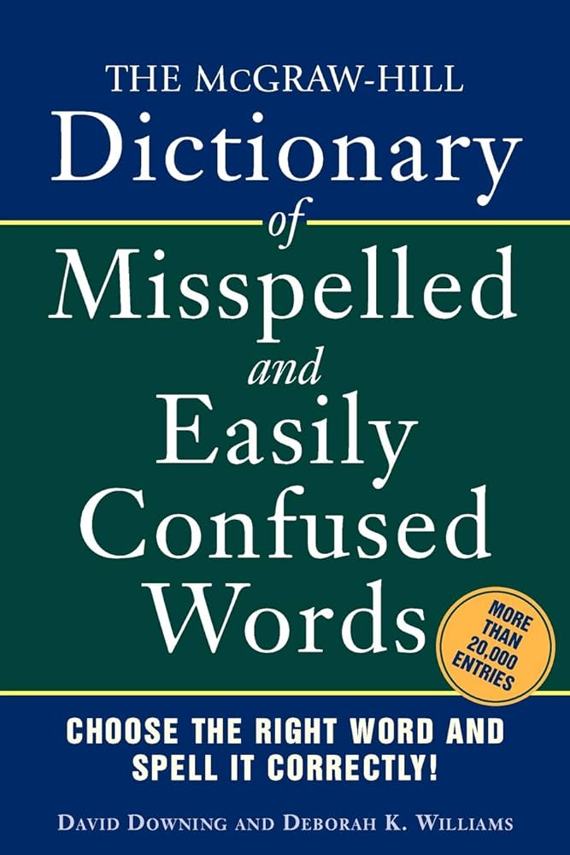

Slide 8

modern alternative

Slide 9
maps

Slide 10
map interface

Slide 11
map
a pair is two things
a map (dictionary, table) stores key-value pairs
in a map, you can lookup a key's value
a map in Java's standard library is HashMap<KeyType, ValueType>
HashMap<String, ArrayList<String>> rhymingDictionary;

Slide 12
analogy

Slide 13

let us imagine...

Slide 14
you have a three week long road trip planned to Bennington, but your prized parrot Hans is deathly afraid of driving it's time to put Hans in the bird kennel

Slide 15
🤵
🦜
map.put("Hans", 🦜)

Slide 16
you return invigorated from a lovely trek to Bennington it's time to get Hans from the bird kennel

Slide 17

here is Hans
🤵
Hans
squack
🦜
map.get("Hans")

Slide 18
HashMap<String, Bird>
🤵

Slide 19
map interface
// Put (add, insert) a new key-value pair into the map. // NOTE: Can also be used to update a key's value. // NOTE: All keys are unique. void put(KeyType key, ValueType value);
// Get (lookup) a key's value in the map. ValueType get(KeyType key);
// Get the (unordered) set of all keys. // NOTE: Use a for-each loop to iterate through this. // for (KeyType key : map.keySet()) { ... } Set<KeyType> keySet();

Slide 20
simple example

Slide 21
HashMap<Character, Integer> map = new HashMap<>(); PRINT(map); // {} map.put('a', 1); PRINT(map); // {a=1} map.put('b', 1); PRINT(map); // {a=1, b=1} map.put('b', 2); PRINT(map); // {a=1, b=2}

Slide 22
motivating example

Slide 23
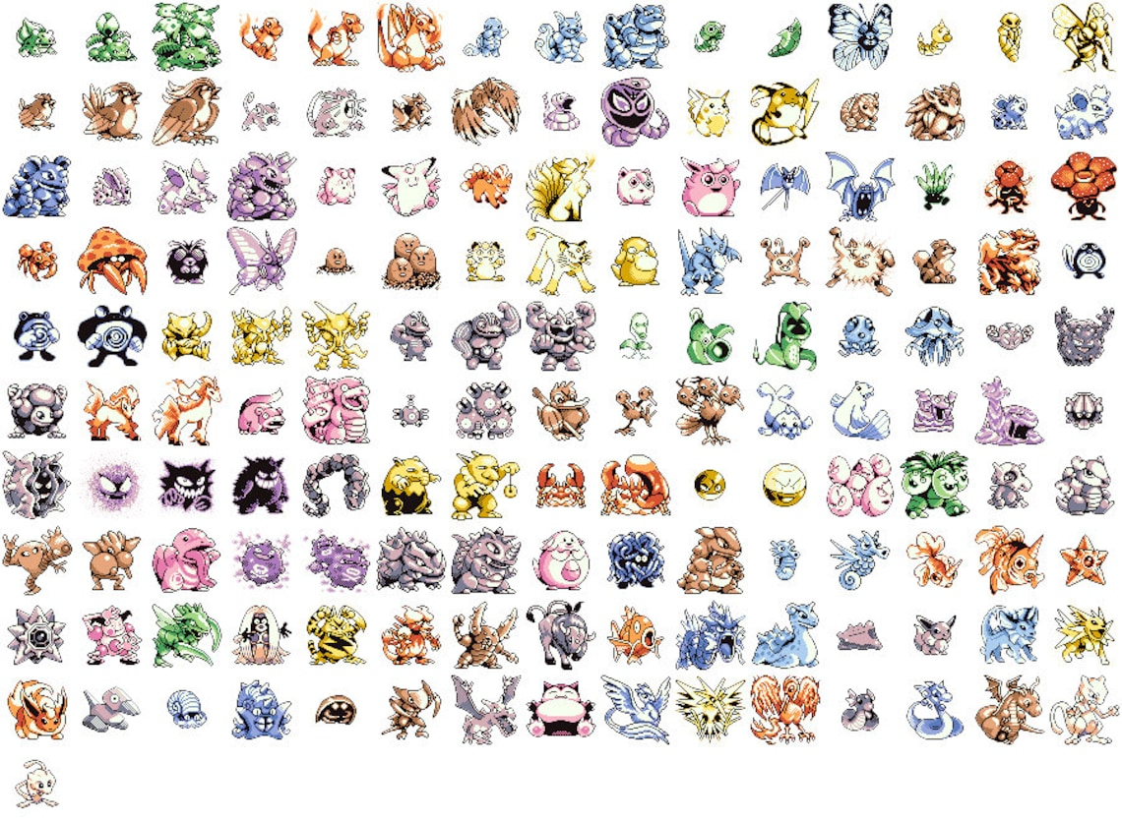
Pokémon
there are 151 Pokémon
each has its own number
Bulbasaur
Ivysaur
Venusaur
Charmander
...

Slide 24
number → name
1 → "Bulbasaur"
2 → "Ivysaur"
3 → "Venusaur"
4 → "Charmander"
...
what data structure should we use to implement this?

Slide 25
an array

Slide 26
the answer is always array

Slide 27
even during the map lecture

Slide 28
number → name (Option A)
String[] names = { "Bulbasaur", "Ivysaur", ... };
String name = names[number – 1]; // NOTE: Bulbasaur is #1

Slide 29
number → name (Option B)
String[] _names = { "Bulbasaur", "Ivysaur", ... };
String getName(int number) {
return _names[number – 1]; // NOTE: Bulbasaur is #1
}
String name = getName(number);

Slide 30
number → name (Option C)
// NOTE: Bulbasaur is #1
String[] names = { "", "Bulbasaur", "Ivysaur", ... };
String name = names[number];

Slide 31
lesson: if you're mapping from A → B, and A is something like 0, 1, 2, 3, ... ...then you can just use an array 🙂👍 (or an array list if you don't know the length ahead of time)

Slide 32
buuut, if you're mapping from A → B, and A is nothing like 0, 1, 2, 3, ... ...then you're going to want a map 🗺️

Slide 33
name → number
what data structure will you need? (hint: HashMap<???, ???>)
how will you set it up (how will you populate it)?
how will you use it?
"Bulbasaur" → 1
"Ivysaur" → 2
"Venusaur" → 3
"Charmander" → 4
...
void put(KeyType key, ValueType value);
ValueType get(KeyType key);

Slide 34
name → number
// data structures
HashMap<String, Integer> numberFromName;
// setup
String[] names = { "Bulbasaur", "Ivysaur", ... };
numberFromName = new HashMap<>();
for (int i = 0; i < names.length; ++i) {
// Bulbasaur = 1
numberFromName.put(names[i], i + 1);
}
// usage
String name = ...;
int number = numberFromName.get(name);

Slide 35
[let's implement numberFromName] TODO (Jim): use keySet() method in test code

Slide 36
PokemonExample
Mewtwo -> 150
Raichu -> 26
Arbok -> 24
Kabuto -> 140
Charmander -> 4
Charmeleon -> 5
Shellder -> 90
Fearow -> 22
Kangaskhan -> 115
Mankey -> 56
Dodrio -> 85
Vaporeon -> 134
Golem -> 76
Marowak -> 105
Pikachu -> 25
Raticate -> 20
Kadabra -> 64
Primeape -> 57
Venomoth -> 49
Magikarp -> 129
Pidgeotto -> 17
Slowbro -> 80
Gastly -> 92
Magneton -> 82
Jolteon -> 135
Metapod -> 11
Diglett -> 50
Eevee -> 133
Caterpie -> 10
Goldeen -> 118
Abra -> 63
Blastoise -> 9
Magnemite -> 81
Pinsir -> 127
Machoke -> 67
Graveler -> 75
Meowth -> 52
Staryu -> 120
Gengar -> 94
Moltres -> 146
Dragonite -> 149
Golbat -> 42
Persian -> 53
Dugtrio -> 51
Onix -> 95
Hypno -> 97
Machop -> 66
Victreebel -> 71
Krabby -> 98
Jynx -> 124
Seadra -> 117
Rhydon -> 112
Jigglypuff -> 39
Machamp -> 68
Psyduck -> 54
Rapidash -> 78
Pidgey -> 16
Horsea -> 116
Poliwrath -> 62
Omastar -> 139
Clefairy -> 35
Exeggutor -> 103
Farfetch'd -> 83
Clefable -> 36
Oddish -> 43
Weedle -> 13
Gloom -> 44
Vileplume -> 45
Vulpix -> 37
Slowpoke -> 79
Lickitung -> 108
Golduck -> 55
Tentacruel -> 73
Weezing -> 110
Zapdos -> 145
Doduo -> 84
Haunter -> 93
Poliwhirl -> 61
Squirtle -> 7
Omanyte -> 138
Wigglytuff -> 40
Arcanine -> 59
Hitmonlee -> 106
Kabutops -> 141
Sandshrew -> 27
Venusaur -> 3
Kakuna -> 14
Tangela -> 114
Ekans -> 23
Wartortle -> 8
Venonat -> 48
Muk -> 89
Articuno -> 144
Electrode -> 101
Electabuzz -> 125
Cubone -> 104
Nidoran♀ -> 29
Magmar -> 126
Nidoran♂ -> 32
Dewgong -> 87
Tauros -> 128
Mr. Mime -> 122
Koffing -> 109
Starmie -> 121
Bulbasaur -> 1
Gyarados -> 130
Nidoqueen -> 31
Seel -> 86
Mew -> 151
Alakazam -> 65
Nidoking -> 34
Drowzee -> 96
Seaking -> 119
Rattata -> 19
Sandslash -> 28
Tentacool -> 72
Grimer -> 88
Ponyta -> 77
Exeggcute -> 102
Ditto -> 132
Flareon -> 136
Growlithe -> 58
Beedrill -> 15
Nidorina -> 30
Ivysaur -> 2
Cloyster -> 91
Kingler -> 99
Nidorino -> 33
Scyther -> 123
Dratini -> 147
Spearow -> 21
Charizard -> 6
Hitmonchan -> 107
Paras -> 46
Aerodactyl -> 142
Parasect -> 47
Butterfree -> 12
Snorlax -> 143
Weepinbell -> 70
Zubat -> 41
Chansey -> 113
Lapras -> 131
Voltorb -> 100
Dragonair -> 148
Ninetales -> 38
Bellsprout -> 69
Rhyhorn -> 111
Porygon -> 137
Geodude -> 74
Pidgeot -> 18
Poliwag -> 60
import java.util.*;
class Main extends Cow {
public static void main(String[] args) {
// setup
HashMap<String, Integer> numberFromName = new HashMap<>();
String[] names = { "Bulbasaur", "Ivysaur", "Venusaur", ... };
for (int number = 0; number < names.length; ++number) {
numberFromName.put(names[number], number + 1);
}
// usage
for (String name : numberFromName.keySet()) {
PRINT(name + " -> " + numberFromName.get(name));
}
}
}

Slide 37
reminder: hash maps are NOT ordered (even though we put Pokemon into the hash map in order, the hash map did NOT store them in order)

Slide 38
maps in other languages

Slide 39
🐍 Python has a built-in map (dictionary)
numbers = {}
numbers["Bulbasaur"] = 1
numbers["Ivysaur"] = 2
print(numbers["Bulbasaur"]) # 1
print(numbers) # {"Bulbasaur": 1, "Ivysaur": 2}
# hmm...
map = {}
map[True] = False
map['Jim'] = 3
map[-1] = map
print(map) # {True: False, 'Jim': 3, -1: {...}}

Slide 40
🥰 Lua's only data structure is a map (table)
why?
how?
what about like...arrays?
names = {}
names[1] = "Bulbasaur" -- okay fine, i guess Lua also has strings
names[2] = "Ivysaur"
print(names[1]) -- Bulbasaur

Slide 41
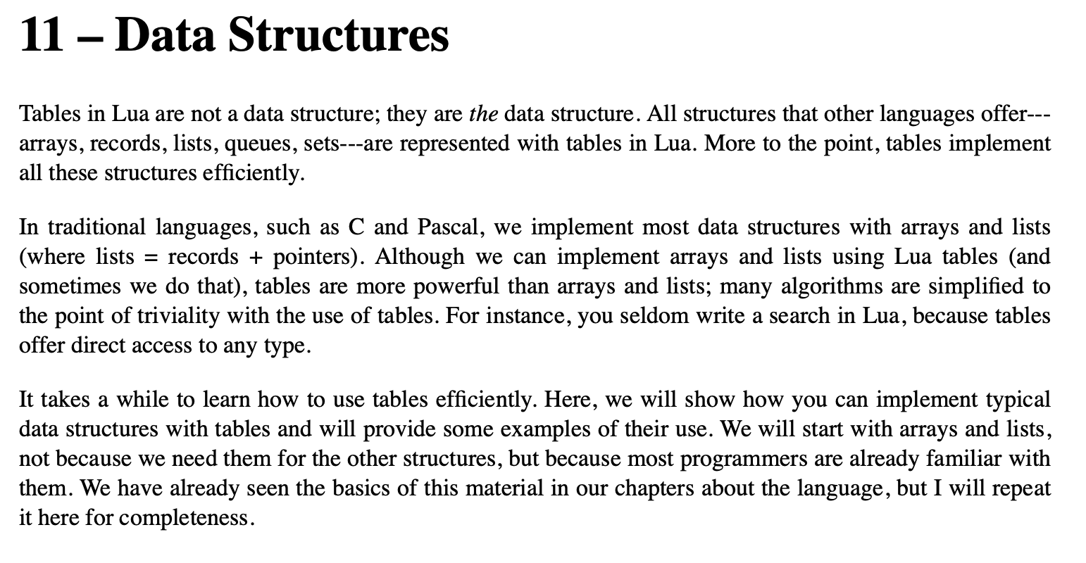

Slide 42
ANNOUNCEMENTS
today is Prof. Bill Is Visiting LEC-02 Laptop Wednesday! WARMUP what is 7 % 3 ?
- ✏️do it on paper
- ☕️do it in Java (java means coffee)
- 🐍 do it in Python (a python is a kind of snake)
what is (-7) % 3 ?
- ✏️do it on paper
- ☕️do it in Java
- 🐍 do it in Python TODAY hash maps

Slide 43
record LEC-01

Slide 44
let's learn someting upsetting 🙂👍

Slide 45
7 % 3
2
R1
3
7
-
6
1

Slide 46
🐍 -7 % 3
☕️ Math.floorMod(-7, 3)
☕️ -7 % 3
-2
R-1
3
-7
-7 - (-6)
= -7 + 6
= -1
+ 3 = 2
-
-6
-1
-1

Slide 47
%
x % y returns the remainder of (x / y) and is read "x modulo y"
int foo = 17 % 5; // 2 ("17 divided by 5 is 3 remainder 2")
☠ % probably doesn't do what you expect for negative numbers; if x can be negative, use Math.floorMod(x, y) instead
5 % 3 // 2
4 % 3 // 1
3 % 3 // 0
2 % 3 // 2
1 % 3 // 1
0 % 3 // 0
-1 % 3 // -1 WAIT WHAT 🤔
Math.floorMod(-1, 3) // 2 🙂👍

Slide 48
Math.floorMod(x, y)
Math.floorMod( 5, 3) // 2
Math.floorMod( 4, 3) // 1
Math.floorMod( 3, 3) // 0
Math.floorMod( 2, 3) // 2
Math.floorMod( 1, 3) // 1
Math.floorMod( 0, 3) // 0
Math.floorMod(-1, 3) // 2
Math.floorMod(-2, 3) // 1
Math.floorMod(-3, 3) // 0
Math.floorMod(-4, 3) // 2
Math.floorMod(-5, 3) // 1
Math.floorMod(-6, 3) // 0
Math.floorMod(-7, 3) // 2

Slide 49
hash maps

Slide 50
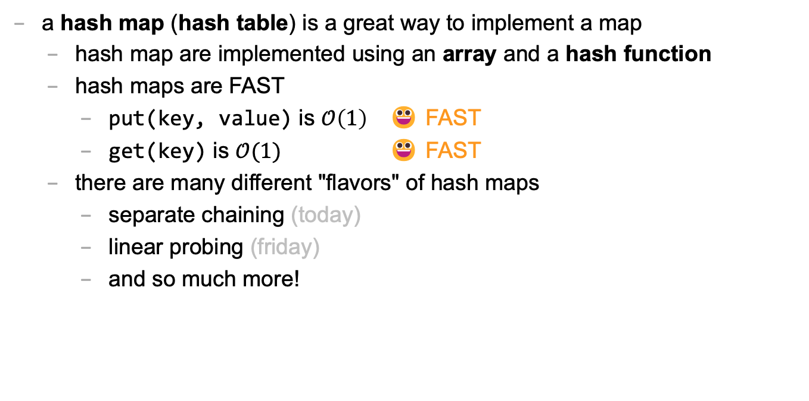
hash map
a hash map (hash table) is a great way to implement a map
hash map are implemented using an array and a hash function
hash maps are FAST
put(key, value) is $𝒪\left(1\right)$ 😀 FAST
get(key) is $𝒪(1)$ 😀 FAST
there are many different "flavors" of hash maps
separate chaining (today)
linear probing (friday)
and so much more!

Slide 51
hash function

Slide 52
hash function
a hash function takes some data and returns an int called the data's hash code (hash, hash value)
this is called "hashing" the data
🚨 a hash function MUST be deterministic
given the same data, a hash function MUST return the same value
a hash collision (hash clash) happens when two different pieces of data have the hash code
a good hash function has very few collisions

Slide 53
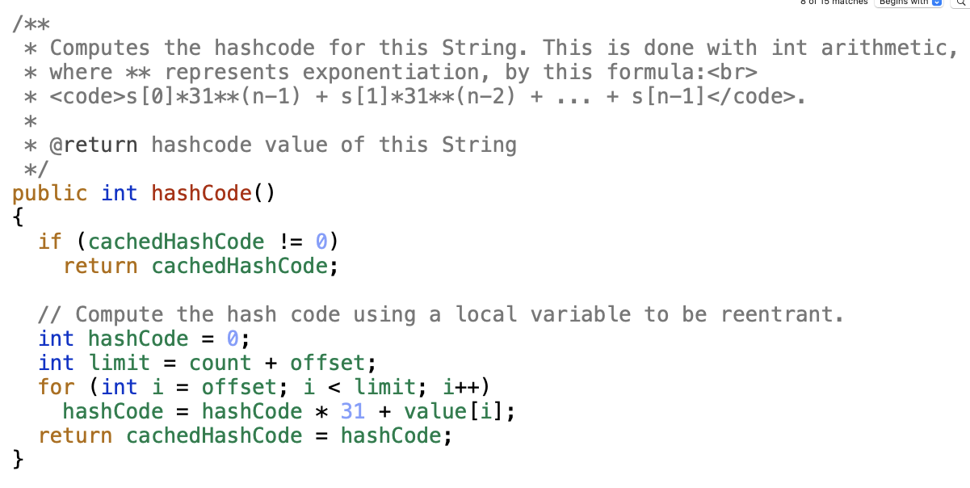

Slide 54
hash function
all Java objects have a (fine) built-in hash function called hashCode()
hashCode() can be negative!
System.out.println( "Hans".hashCode()); // 2241694
System.out.println( "Gary".hashCode()); // 2212033
System.out.println("Kahoot".hashCode()); // -2054990942
System.out.println("Kahoot".hashCode()); // -2054990942

Slide 55
hash function
often, you want to turn a hash code into an index
✨ Math.floorMod(object.hashCode(), array.length)
System.out.println(Math.floorMod( "Hans".hashCode(), 10)); // 4
System.out.println(Math.floorMod( "Gary".hashCode(), 10)); // 3
System.out.println(Math.floorMod("Kahoot".hashCode(), 10)); // 8
System.out.println(Math.floorMod("Kahoot".hashCode(), 10)); // 8

Slide 56
separate chaining

Slide 57
separate chaining
separate chaining is one way of implementing a hash map
key-value pairs are stored in an array of buckets
one good choice of bucket is an array list
ArrayList<KeyValuePair> bucket;
in practice, you don't have to use an array list; you can use linked lists, binary search trees, or some mixture of the two (this is actually what Java does)

Slide 58

previously, on Hans the Parrot

Slide 59
you have a three week long road trip planned to Bennington, but your prized parrot Hans is deathly afraid of driving it's time to put Hans in the bird kennel

Slide 60
🤵
🦜
map.put("Hans", 🦜)

Slide 61
you return invigorated from a lovely trek to Bennington it's time to get Hans from the bird kennel

Slide 62
here is Hans
🤵
Hans
squack
🦜
map.get("Hans")

Slide 63
HashMap<String, Bird>
🤵

Slide 64
now, let us imagine again...

Slide 65
in a thrilling twist, it turns out that the Bennington trip was secretly cover for Agent Hans's corporate espionage of the bird kennel (rumor had it they were keeping the birds in buckets 🤨) it's time to get Hans back to the hideout

Slide 66
🐧🦉
🦜
🐤
🪣
🪣
🐦
🦆🐓🦃
🪣
🪣
🪣
Joe Kahoot Cheep Hans Doug Io Gary Max
0
1
2
3
4
👮

Slide 67
is this Hans?
buckets[bucketIndex].get(i).key.equals("Hans")?
🐧🦉
🦜
🐤
🪣
🪣
🐦
🦆🐓🦃
🪣
🪣
🪣
Joe Kahoot Cheep Hans Doug Io Gary Max
0
1
2
2
3
4
👮
which bucket is Hans in?
MODULO("Hans".hashCode(), buckets.length)
map.get("Hans")

Slide 68
// Bucket[] buckets ArrayList<KeyValuePair>[] buckets;

Slide 69
ArrayList<KeyValuePair>[] buckets;
to construct the hash map
create a new buckets array
iterate through the array and create a new (empty) bucket in each slot

Slide 70
ArrayList<KeyValuePair>[] buckets;
to put a key-value pair into the hash map
// NOTE: hashCode() can be negative bucketIndex = Math.floorMod(key.hashCode(), buckets.length)
// update value if key in the map iterate through that bucket
if you find a key-value pair with matching key...
update its value
return;
if you did NOT find any key-value pair with matching key
add the key-value pair to the bucket

Slide 71
ArrayList<KeyValuePair>[] buckets;
to get a key's value from the hash map
// NOTE: hashCode() can be negative bucketIndex = Math.floorMod(key.hashCode(), buckets.length)
// return value if key in the map iterate through that bucket
if you find a key-value pair with matching key...
return its value
if you did NOT find any key-value pair with matching key
return null;

Slide 72
ANNOUNCEMENTS
today is an important Colloquium! 2:35 in Wege (TCL 123)
also juggling club after colloquium :)
🦉 today is Kahoot Friday! today is also No Blazer Friday :(
WARMUP last class, i said that hash maps have O(1) put and O(1) get
why is this sus? 🤨 list as many reasons as you can
TODAY more hash maps

Slide 73
record LEC-01

Slide 74
what happens when we call get(key)?

Slide 75
is this Hans?
buckets[bucketIndex].get(i).key.equals("Hans")?
🐧🦉
🦜
🐤
🪣
🪣
🐦
🦆🐓🦃
🪣
🪣
🪣
Joe Kahoot Cheep Hans Doug Io Gary Max
0
1
2
2
3
4
👮
which bucket is Hans in?
MODULO("Hans".hashCode(), buckets.length)
map.get("Hans")

Slide 76
step 1: hashing the key (in our specific case, where key is a String and we use key.hashCode())

Slide 77
hashing the key (our specific case, where key is a String and we use key.hashCode())
// hash the key (not including the Math.floorMod) hash = 0 foreach character in string hash *= 31 hash += character return hash
🤨 this is O(numberOfCharactersInString)
but, if we assume all strings are less than, say, 64 characters... (assume a constant time hash function)
O(1) 😀

Slide 78
getting (a reference to) the correct bucket (our specific case, where bucket is an unsorted ArrayList<KeyValuePair>)
// get the bucket int bucketIndex = Math.floorMod(hash, buckets.length); ArrayList<KeyValuePair> bucket = buckets[bucketIndex];
O(1) 😀

Slide 79
searching the bucket for the key (our specific case, where bucket is an unsorted ArrayList<KeyValuePair>)
// find a key-value pair in the bucket with matching key // (or conclude no such pair exists)
foreach pair in bucket if (key matches pair.key): return pair.value return null
🤨 this is actually O(numberOfPairsInBucket)
assume a lot of buckets...
assume a good hash function...
do a lot of math...
O(1) 😀

Slide 80
🤨 also what about resizing the hash map?! that has to make adding to the hash map O(n) !

Slide 81
adding is O(1) amortized runtime 🙂🤨

Slide 82
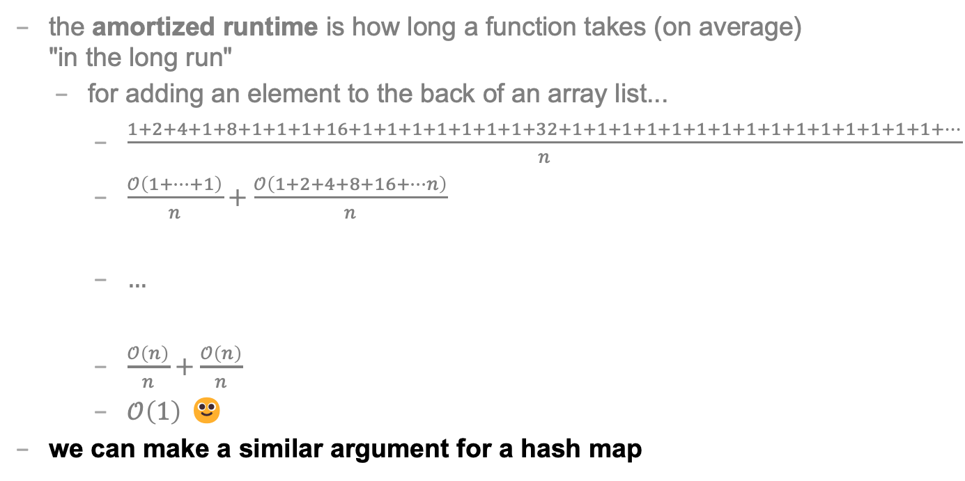
REVIEW: amortized
the amortized runtime is how long a function takes (on average) "in the long run"
for adding an element to the back of an array list...
$\frac{1+2+4+1+8+1+1+1+16+1+1+1+1+1+1+1+32+1+1+1+1+1+1+1+1+1+1+1+1+1+1+1+…}{n}$
$\frac{𝒪\left(1+…+1\right)}{n}+\frac{𝒪\left(1+2+4+8+16+…n\right)}{n}$
$…$
$\frac{𝒪\left(n\right)}{n}+\frac{𝒪\left(n\right)}{n}$
$𝒪\left(1\right)$ 🙂
we can make a similar argument for a hash map

Slide 83
lesson: there is a lot of subltety hiding in the seemingly simple statement "hash maps are O(1)" buuut, in an interview, still probably just say O(1) 🙂👍

Slide 84
Tutorial: hash map with separate chaining (using array list buckets)

Slide 85
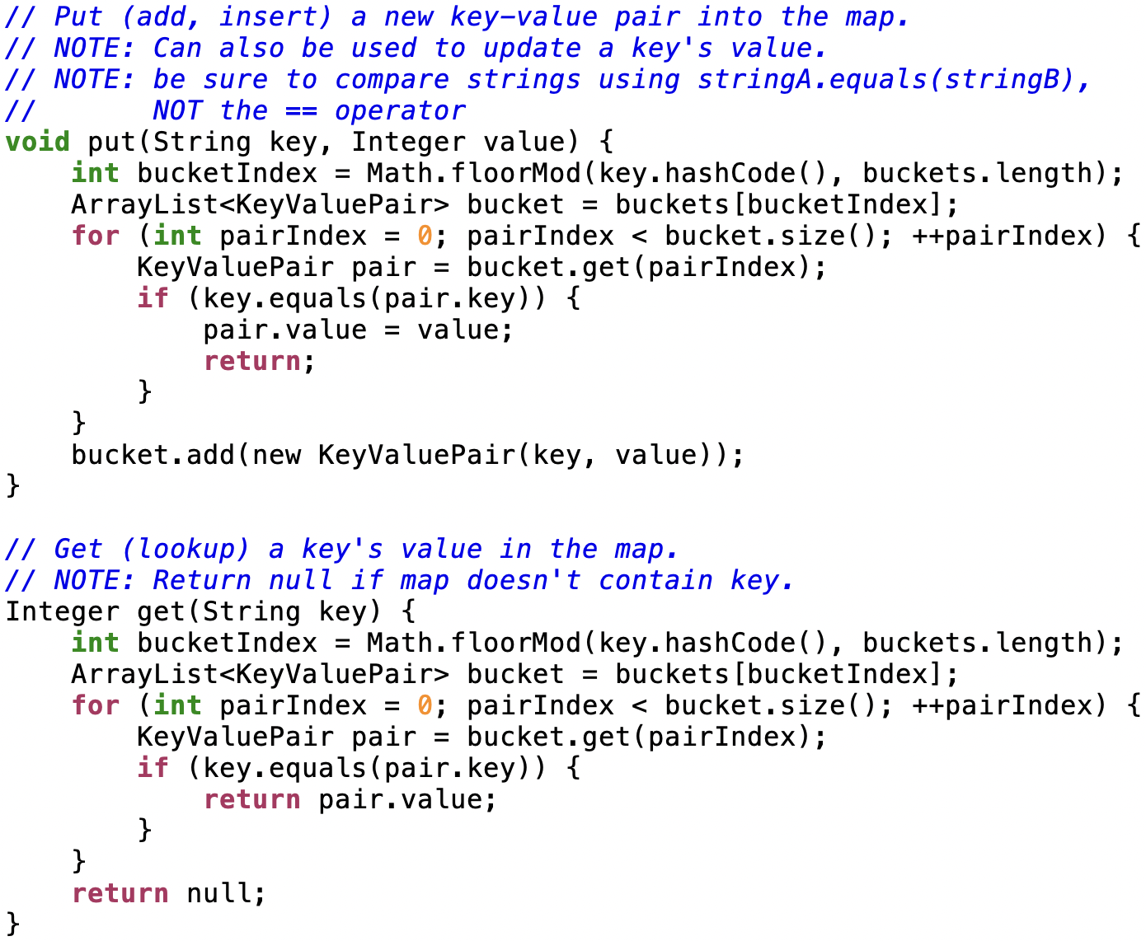

Slide 86
open addressing

Slide 87
a hash map with separate chaining used an array of buckets of key-value pairs put(key,value) hash key to find bucketIndex add (key, value) to buckets[bucketIndex]

Slide 88
a hash map with open addressing just uses an array of key-value pairs (slots) put(key, value) hash key to find slotIndex if slots[slotIndex] is full, try slots[slotIndex + 1] if slots[slotIndex + 1] is full, try slots[slotIndex + 2] if slots[slotIndex + 2] is full, try slots[slotIndex + 3] ... put (key,value) in first empty slot

Slide 89
get(key) is interesting hash key to find slotIndex is key in slots[slotIndex]? if yes, return slot.value; is key in slots[slotIndex + 1]? if yes, return slot.value; is key in slots[slotIndex + 2]? ... give up if you hit a null (empty) slot map does NOT contain key → return null;

Slide 90
open addressing -- deleting an entry
deletion must be handled (very) carefully!
BAD broken approach: delete an entry by making it null
array: [ ..., ???, notNull, notNull, deleteMe, notNull, notNull, ???, ... ]
array: [ ..., ???, notNull, notNull, null, notNull, notNull, ???, ... ]
but later...what if we call get and null is in the middle?
array: [ ..., ???, initialCollision, notNull, null, notNull, notNullKeyValuePairWeAreActuallyLookingFor, ???, ... ]
then we return null instead of notNullKeyValuePairWeAreActuallyLookingFor.value!
lazy solution: mark newly empty slot; slot.usedToBeFull = true;
good solution: swap the rightmost contiguous notNull entry into newly empty slot
array: [ ..., ???, notNull, notNull, deleteMe, notNull, notNull, ???, ... ]
array: [ ..., ???, notNull, notNull, notNull, notNull, null, ???, ... ]

Slide 91
note: these slides described a specific kind of open addressing called linear probing open addressing is a strategy for resolving collisions linear probing is just one way of doing open addressing

Slide 92
🦉 would you fancy a Kahoot?

Slide 93
Week06
🦜
🦜 🦜 🦜🦜
✨Fun Friday! ✨
this week sure flew by, didn't it?
🦜
deque
Python vs. Java vs. C philosophy of data structures
fun friday
WARMUP
what does random access (direct access) mean in the context of data structures?
TODO: record lecture

Slide 94
review: queue

Slide 95
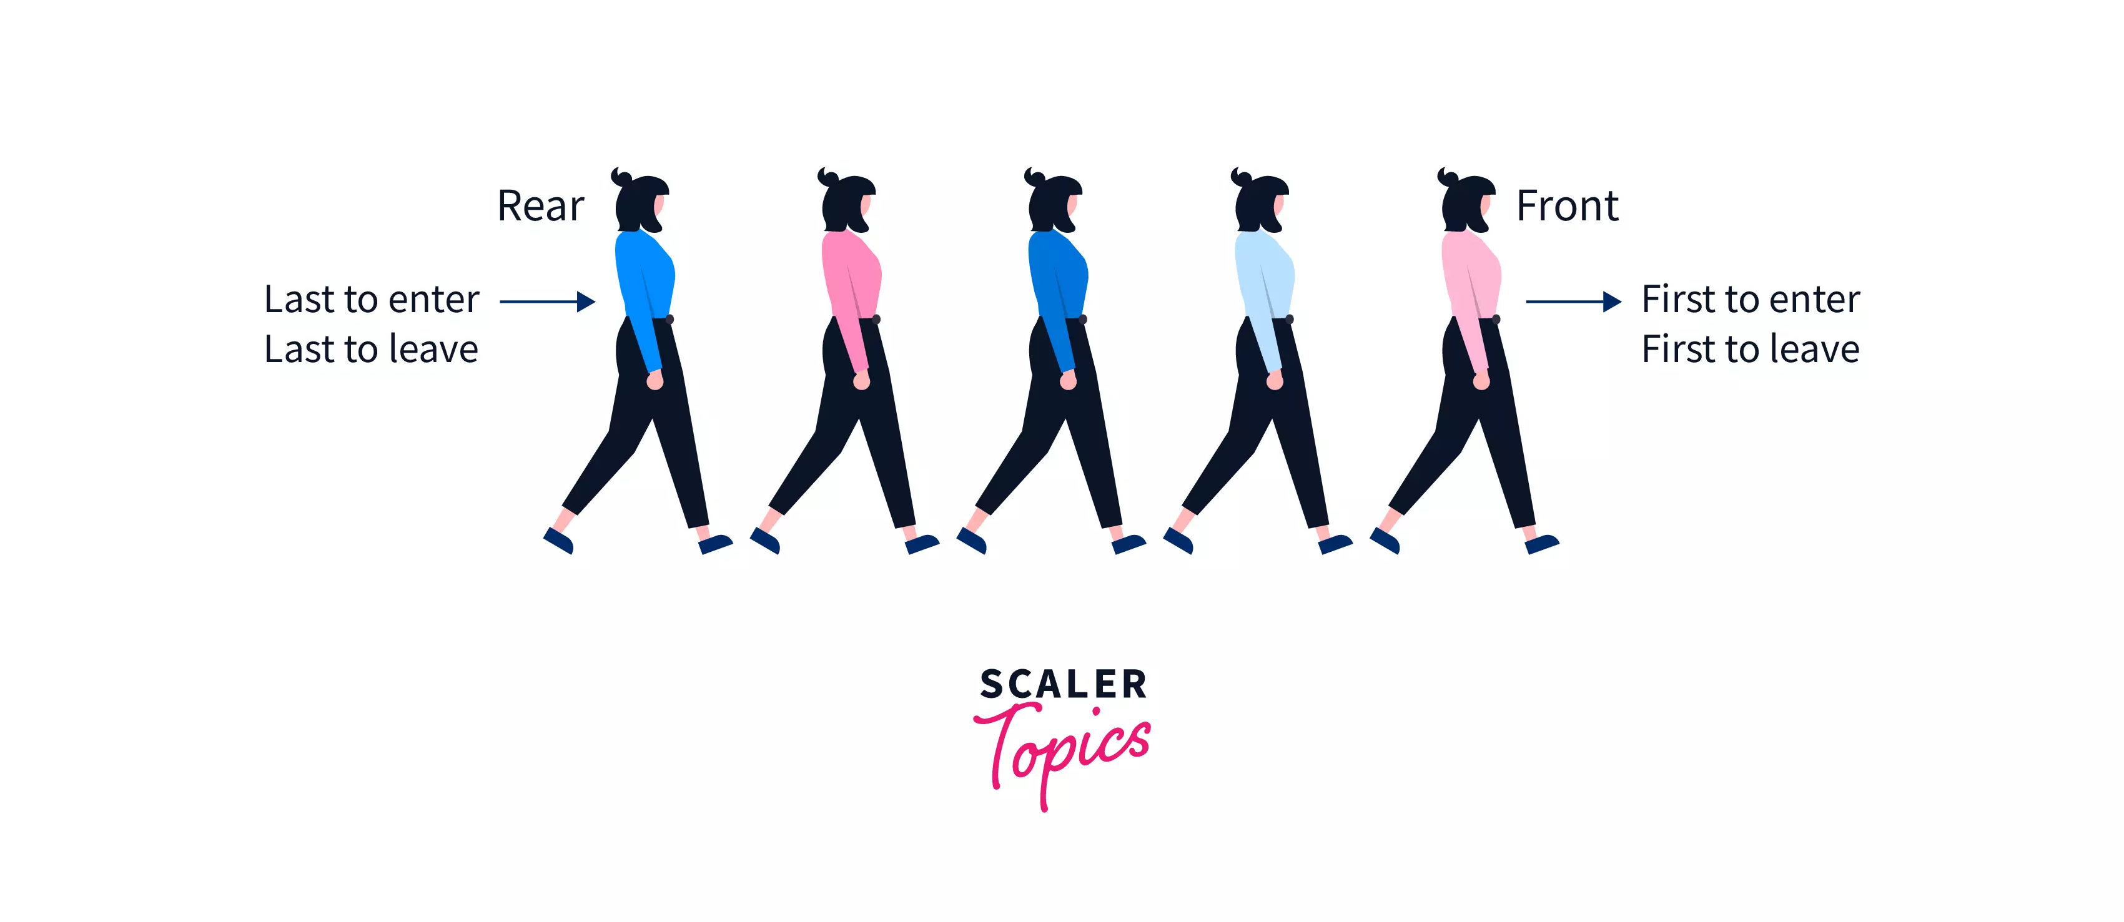
Back

Slide 96
queue interface
// Add (enqueue) a new element to the back of the queue. void add(ElementType element);
// Remove (dequeue) the front // element and return it. ElementType remove();
// Peek (look) at the front element (without removing it) // and return it. ElementType peek();
// Returns the number of elements currently in the queue. int size();

Slide 97
deque (double-ended queue)

Slide 98
deque

Slide 99
deque interface
addFront(...)
removeFront()
addBack(...)
removeBack()
🧠 what is the amortized runtime of these functions if we were to implement the deque interface using an array list?
O(1) addBack(...) and removeBack() 😀
O(n) addFront(...) and removeFront() 😐
🧠 can we do better?

Slide 100
1
1
2
4
1
8
1
1
1
16
1
1
1
1
1
1
1
32
1
1
1
1
1
1
1
1
1
1
1
1
1
1
1
64
1
1
1
1
1
1
1
1
1
1
1
1
1
1
1
1
1
1
1
1
1
1

Slide 101
neat idea: store the queue in the middle
BACK [ null null null null null null null ] FRONT
// addBack(1111)
BACK [ null null null 1111 null null null ] FRONT
// addBack(2222)
BACK [ null null 2222 1111 null null null ] FRONT
// addBack(3333)
BACK [ null 3333 2222 1111 null null null ] FRONT
// removeFront()
BACK [ null 3333 2222 null null null null ] FRONT
// addFront(4444)
BACK [ null 3333 2222 4444 null null null ] FRONT
// addFront(5555)
BACK [ null 3333 2222 4444 5555 null null ] FRONT
// removeBack()
BACK [ null null 2222 4444 5555 null null ] FRONT

Slide 102
neat idea: store the queue in the middle
BACK [ null 3333 2222 1111 null null null ] FRONT
🧠 does this waste space? (in the worst case) (relative to an array list)
🧠 can we fix this?
int front;
note: many possible implementations;
key point: you have to keep track of back and front somehow
int back;

Slide 103
extension: treat the array as circular
null 3333 2222 1111 null null null

Slide 104
extension: treat the array as circular
6666 3333 2222 1111 5555 8888 7777

Slide 105
big picture lesson

Slide 106
once you get past CS136, data structures are acually kind of rich and complicated and messy

Slide 107
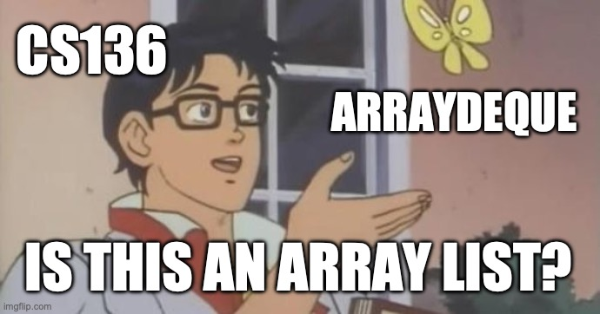

Slide 108
Java vs. C philosophy of data structures

Slide 109
[scavenger hunt]

Slide 110
can i call get(...) or set(...) on Java's ArrayDeque? why or why not?

Slide 111
fun friday menu - jim rants about comments and syntax highlighting - jim codes (some of) microsoft paint from scratch - jim updates you on his CAD software - jim talks about usage code - jim talks about his favorite element - jim reads aloud from grugbrain.dev - jim talks incoherently about Vim

Slide 112
Tungsten queube 😀 did you know Tungsten is really hard? Tungsten alloys can be as hard as Sapphire! that's really hard! did you know the density of Tungsten is 19.25 g/cm³? that's really dense!—almost as dense as gold! (Gold is 19.32 g/cm³) Tungsten is not suuper cheap (cube from the Amazon.com was $60) but Tungsten is also not like...expensive what could YOU do with Tungsten?

Slide 113


Slide 114


Slide 115
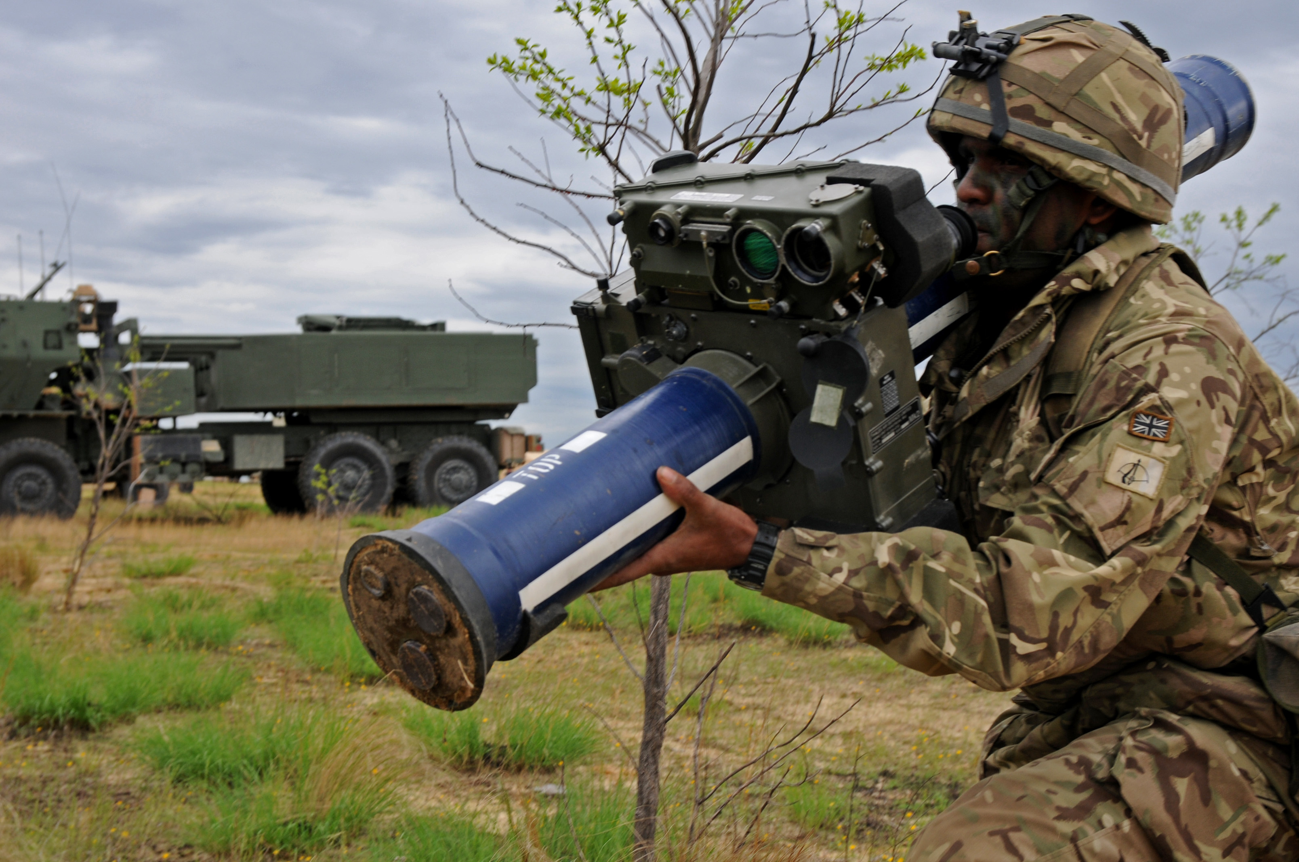
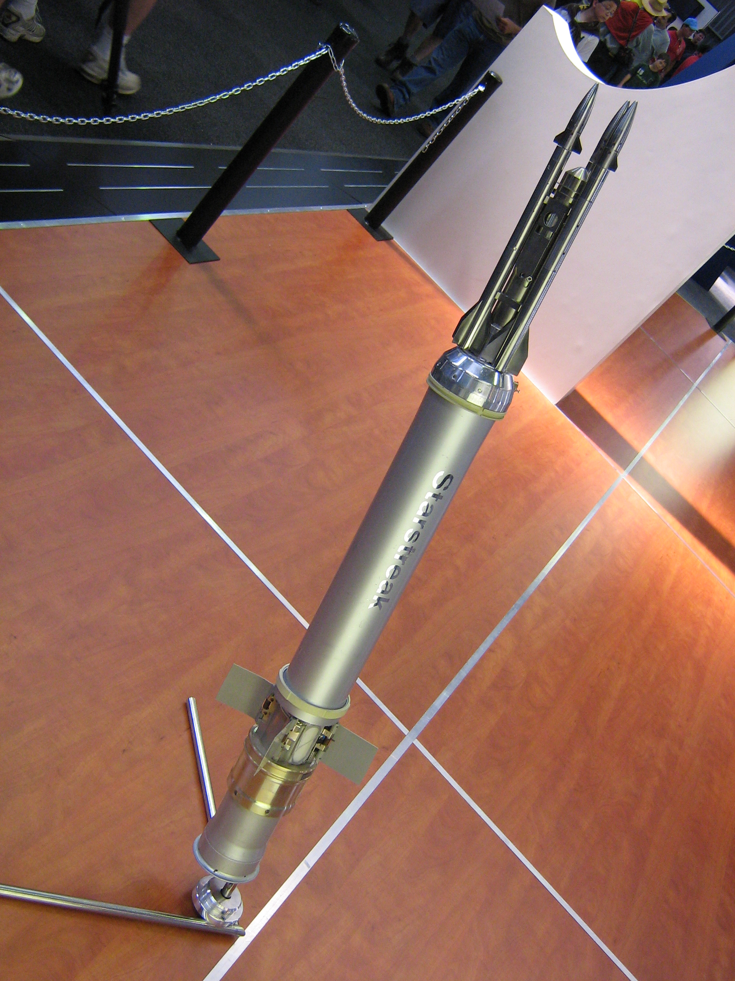


Slide 116
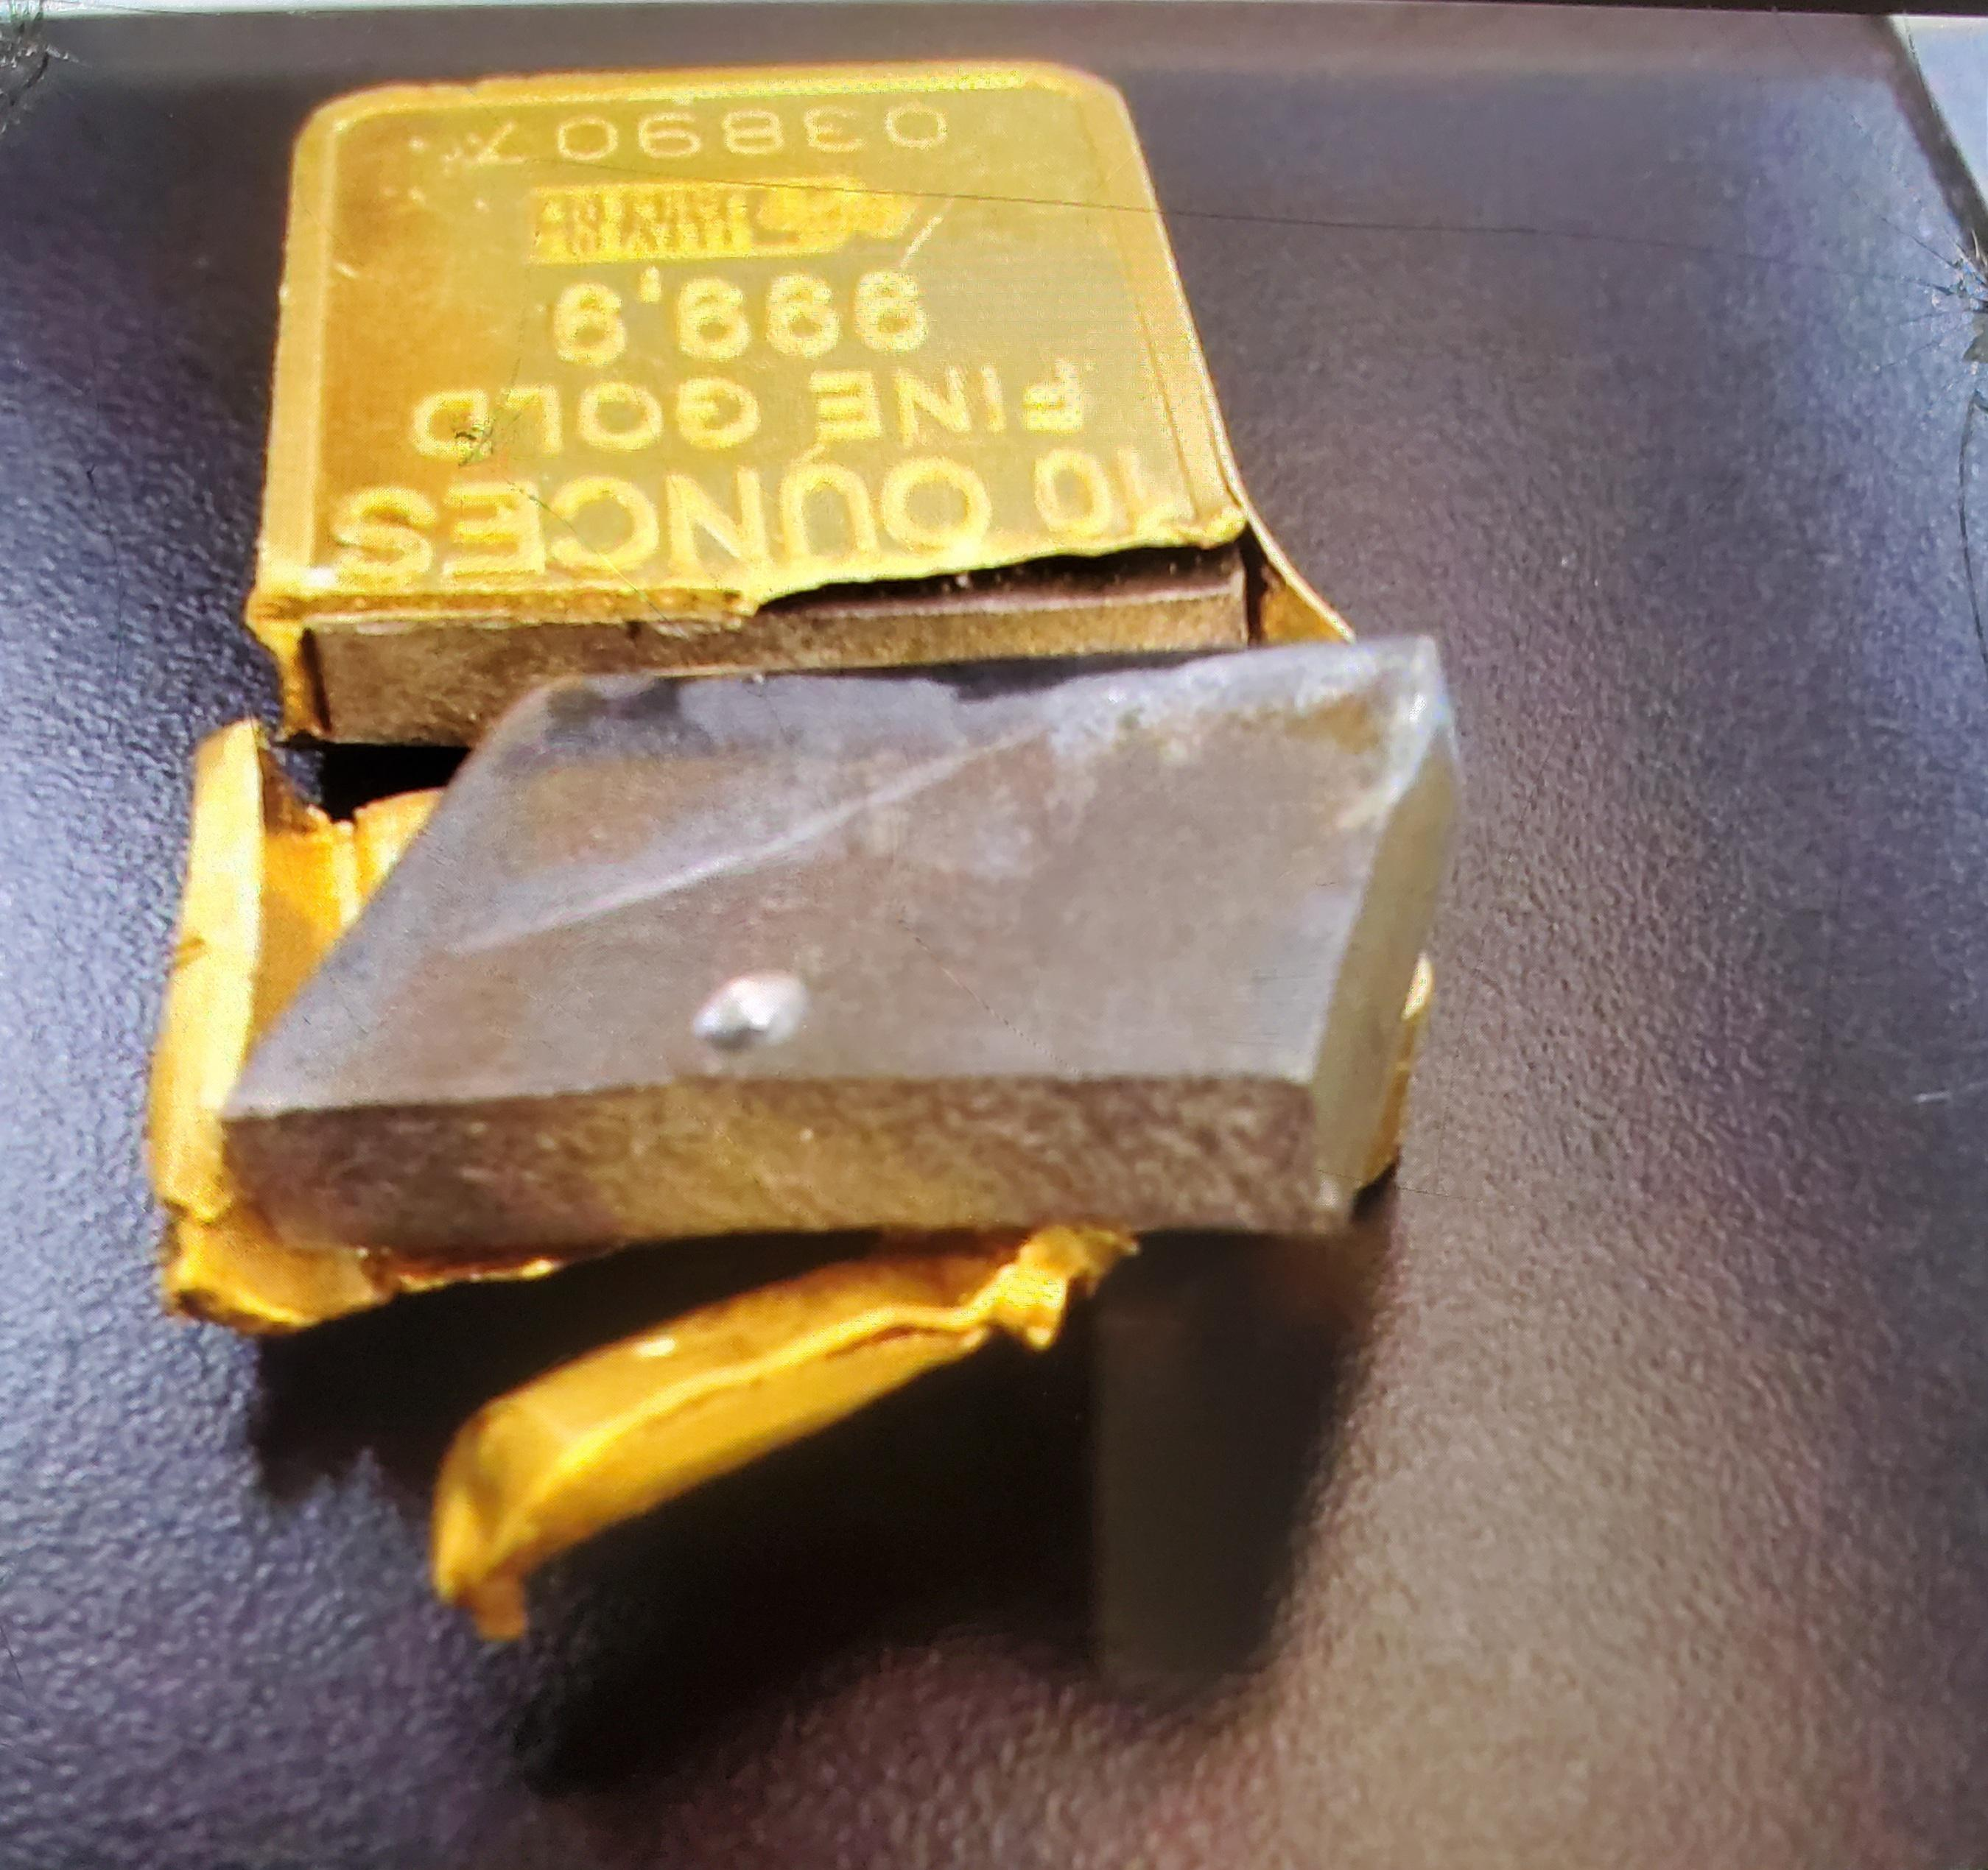
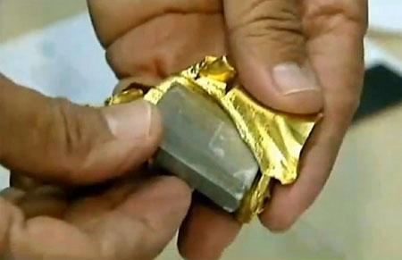
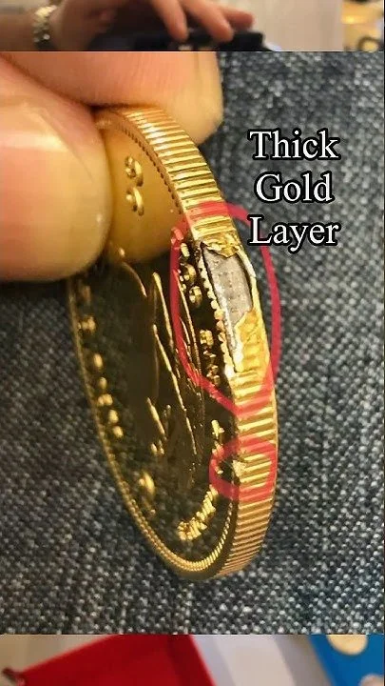
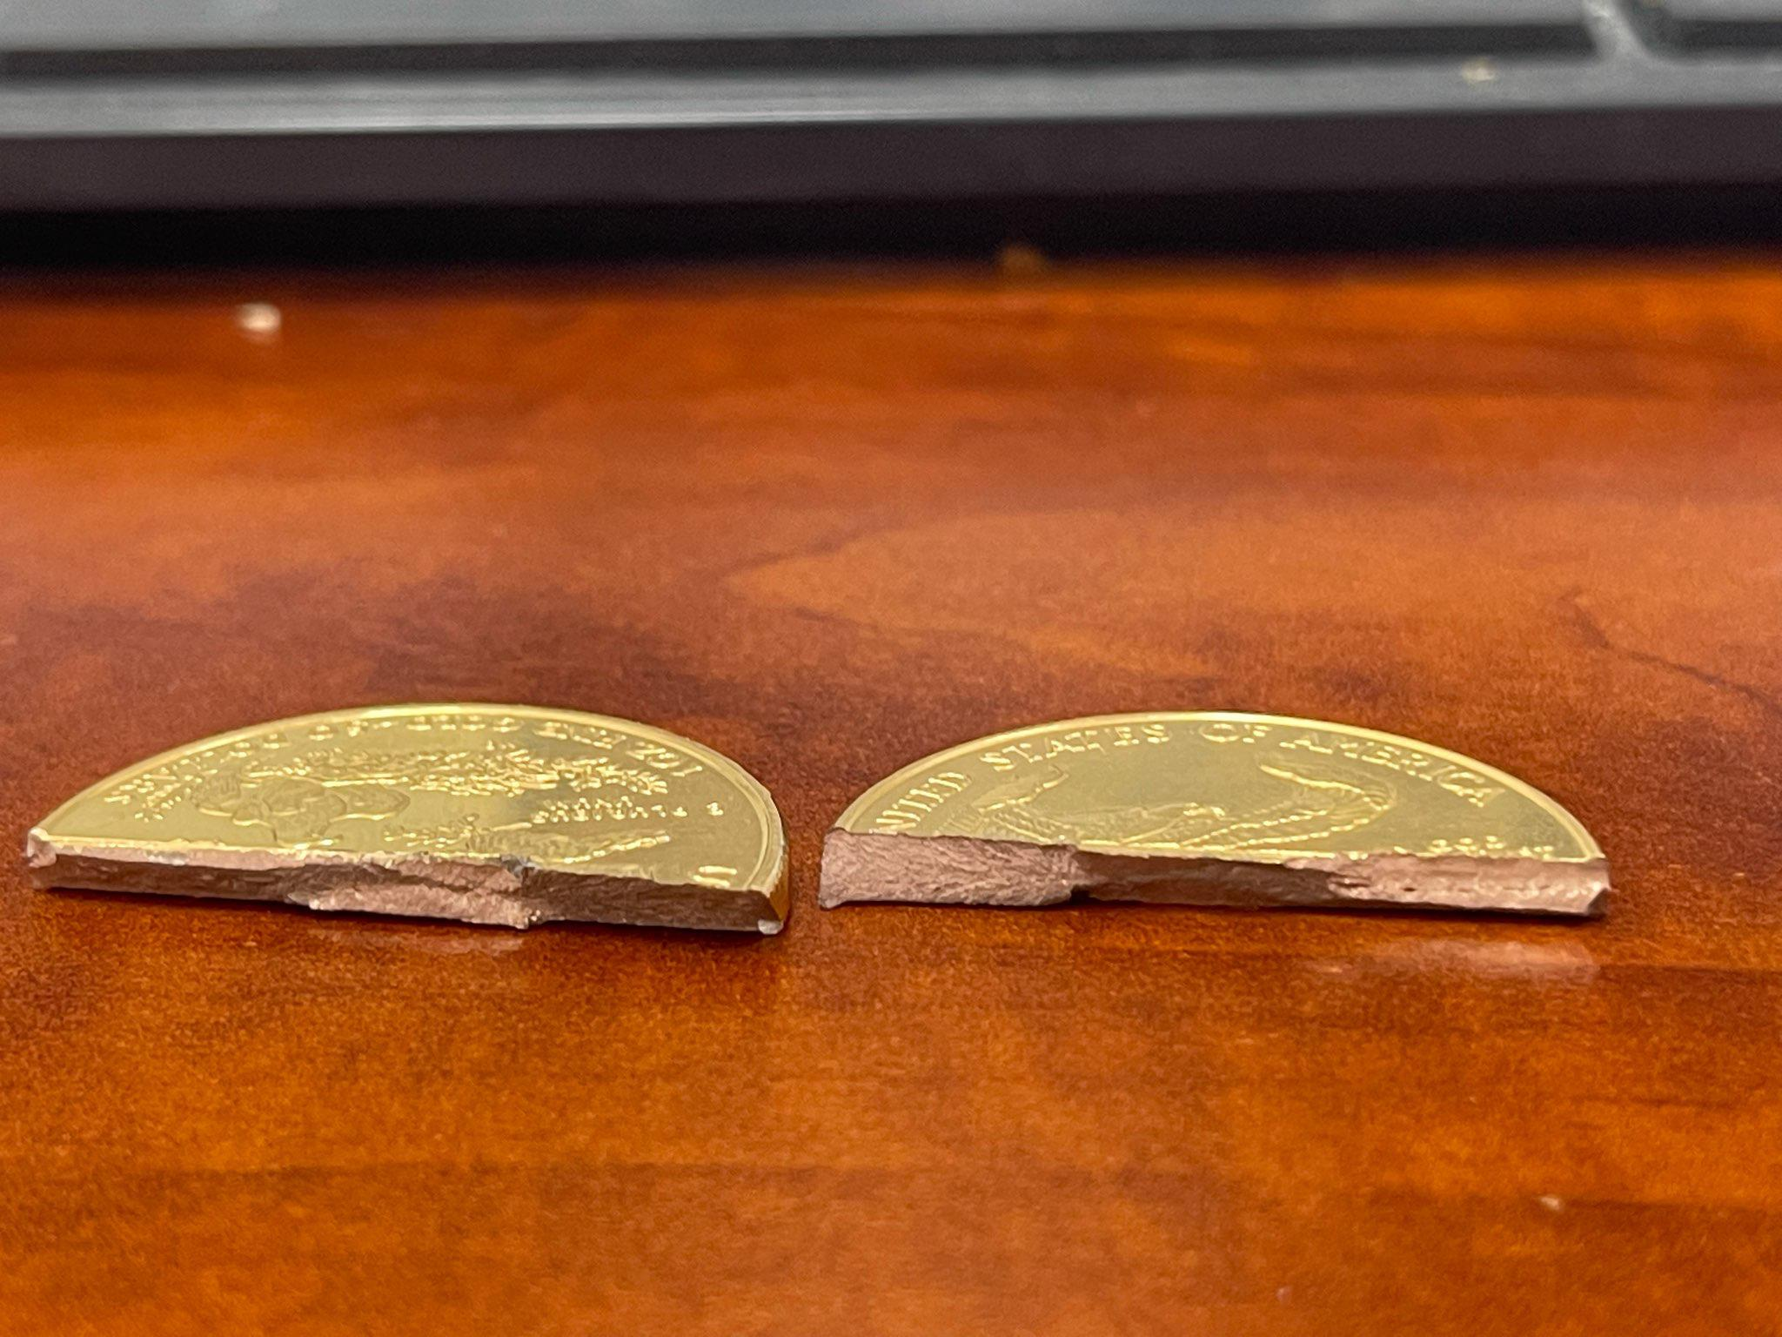
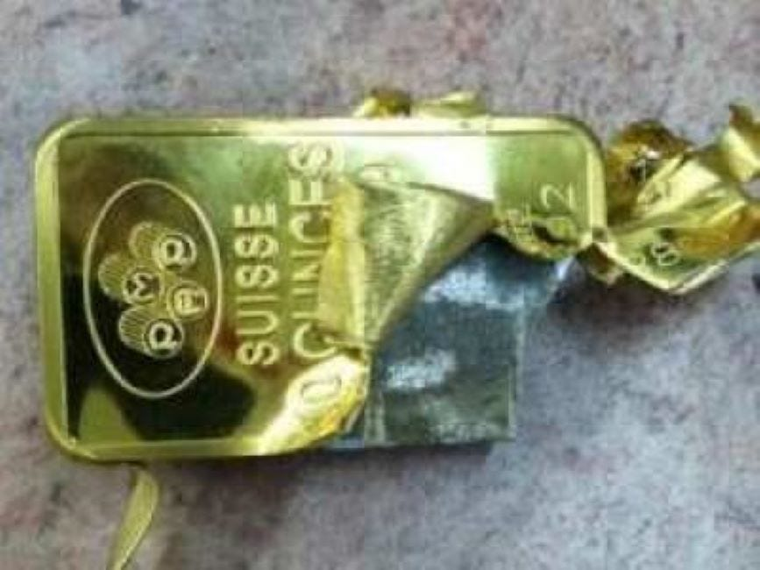

Slide 117
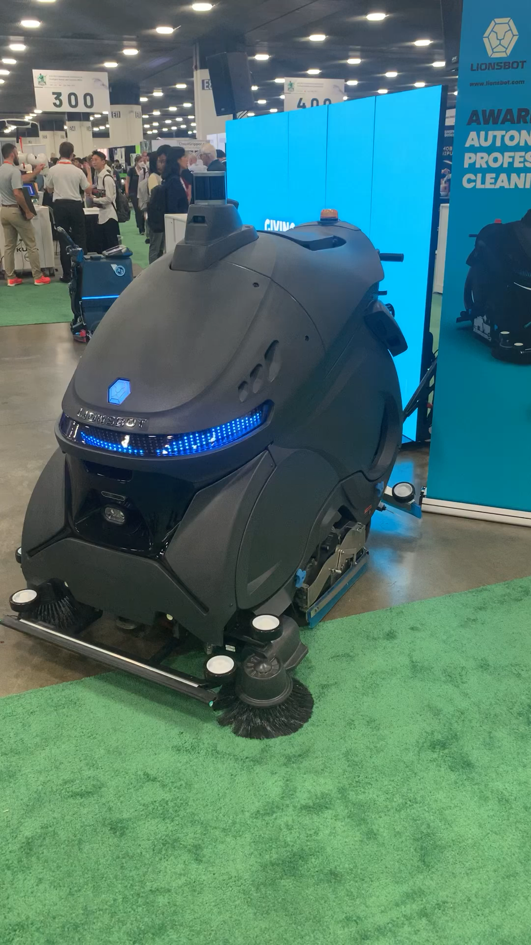
Week05
hello WOW students! 🐮
🦜 🦜 🦜🦜
✨No-Laptop Monday! ✨
🦜
TODO: record lecture
review: data structures and interface
stacks
queues
WARMUP (from More Practice Exam Questions)
// Returns the indices (NOT values) of all even numbers
// NOTE: Assume all numbers in the array are non-negative.
// { 6, 7, 5, 8 } -> { 0, 3 } because the 0th element (6)
// and 3rd element (8) are even
// { 7, 1, 5 } -> {} because no elements are even
ArrayList<Integer> getIndicesOfEvenNumbers(int[] array) {
...
}
bonus: what is this robot for

Slide 118
ANNOUNCEMENTS welcome back i hope you had a nice mountain day :D
jk this slide was from last year 💀
WARMUP what is this robot for? →
TODAY stacks and queues

Slide 119
review: data structures

Slide 120
what is a data structure? why is a data structure?

Slide 121
data structures
In computer science, a data structure is a data organization, management, and storage format that is usually chosen for efficient access to data.^{[1][2][3]} More precisely, a data structure is a collection of data values, the relationships among them, and the functions or operations that can be applied to the data,^{[4]} i.e., it is an algebraic structure about data. --Wikipedia

Slide 122
data structures
In computer science, a data structure is the organization and implementation of values and information. In simple words, it is the way of organizing information in a computer so that it can be more easily understood and worked with. --Simple Wikipedia

Slide 123
data structures
A data structure is...a system for organizing and using information... It...make[s] information easier to understand and work with.. --Simple Wikipedia, further simplified by ChatGPT

Slide 124
data structures
data means numbers (and letters)
a data structure organizes your data
for a particular task, a good data structure is...
easy to work with (programmer time)
runs fast (runtime / user's time)
is small

Slide 125
FlipBook

Slide 126
were array lists a good choice for implementing a Flip Book? 💭 (how) could you have done it with just arrays?

Slide 127
well, we didn't know how many...
pages in the flipbook?
strokes in each page?
points in each stroke?

Slide 128
"Alternative" 1: just use arrays, but resize them yourself when needed (essentially, implement the functionality of an array list without actually having a class)

Slide 129
"Alternative" 2: 🐘 use a BIG multi-dimensional array // ~30,000,000 elements Point[][][] flipbook = new Point[64][512][1024]; // NOTE: we also need all these counter variables // can't just call .size() like before! int numPages = 0; int[] numStrokes = new int[64]; int[][] numPoints = new int[64][512];

Slide 130
these alternatives are probably kind of trash; array lists considered helpful 🙂👍

Slide 131
interface

Slide 132
interface
add
get
set
remove, ...
ArrayList<ElementType>'s
code
your
code

Slide 133
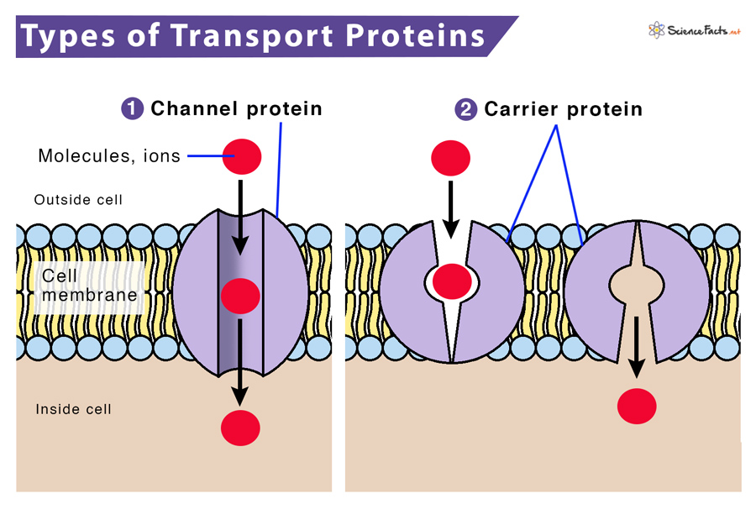

Slide 134
interface
a data structure's interface (API) or abstract data type is a set of functions a data structure must have
a list has...
get
set
add
remove
etc.
a data structure is a specific implementation (code that does the thing) of that interface
an array list implements the list interface using an array
🔮 a linked list implements a list using nodes that refer to nodes

Slide 135
you can get (very) formal about this
The abstract list type L with elements of some type E (a monomorphic list) is defined by the following functions:
nil: () → L
cons: E × L → L
first: L → E
rest: L → L
with the axioms
first (cons (e, l)) = e
rest (cons (e, l)) = l
for any element e and any list l. It is implicit that
cons (e, l) ≠ l
cons (e, l) ≠ e
cons (e₁, l₁) = cons (e₂, l₂) if e₁ = e₂ and l₁ = l₂
Note that first (nil ()) and rest (nil ()) are not defined.
These axioms are equivalent to those of the abstract stack data type.
🧐

Slide 136
i typically won't. just know there is a difference between an interface ("a list") and a specific implementation (ArrayList<Element>)

Slide 137
stack

Slide 138
analogy

Slide 139
a stack is like a helicopter pilot with a socially unacceptable hobby

Slide 140
stack.push(🐨)
🚁
🐨

Slide 141
stack.push(🐻)
🚁
🐻
🐨

Slide 142
stack.push(🐷)
🚁
🐷
🐻
🐨

Slide 143
stack.pop()
🚁
🐷
🐻
🐨

Slide 144
stack.pop()
🚁
🐻
🐨
🐷

Slide 145
stack.push(🐮)
🚁
🐮
🐨
🐻
🐷

Slide 146
🚁
stack.pop()
🐮
🐨
🐻
🐷

Slide 147
stack.pop()
🚁
🐨
🐮
🐻
🐷

Slide 148
🚁
🐮
🐨
🐻
🐷

Slide 150
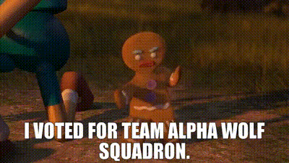

Slide 151
stack

Slide 152
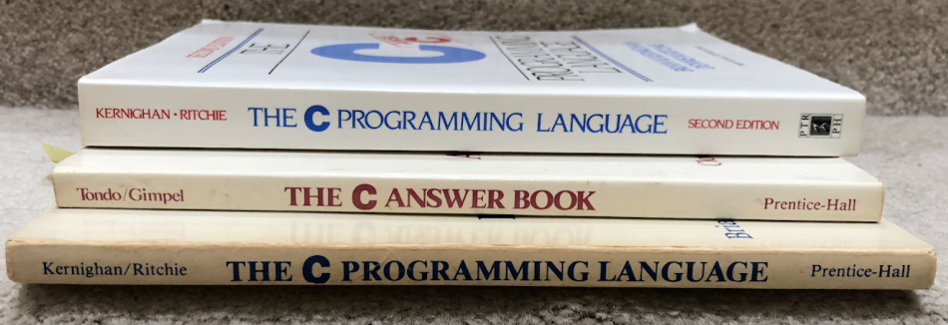

Slide 153
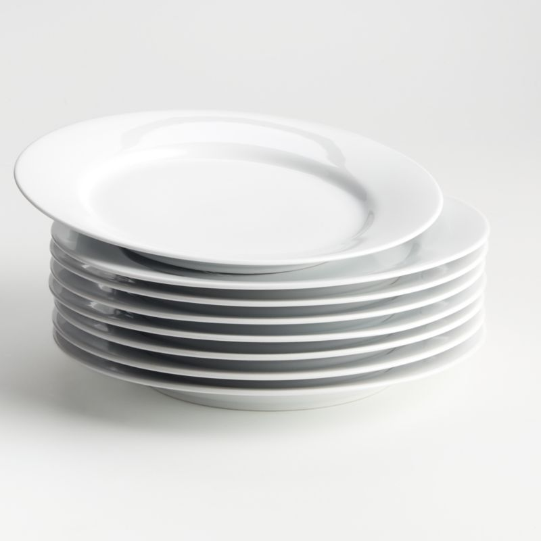

Slide 154
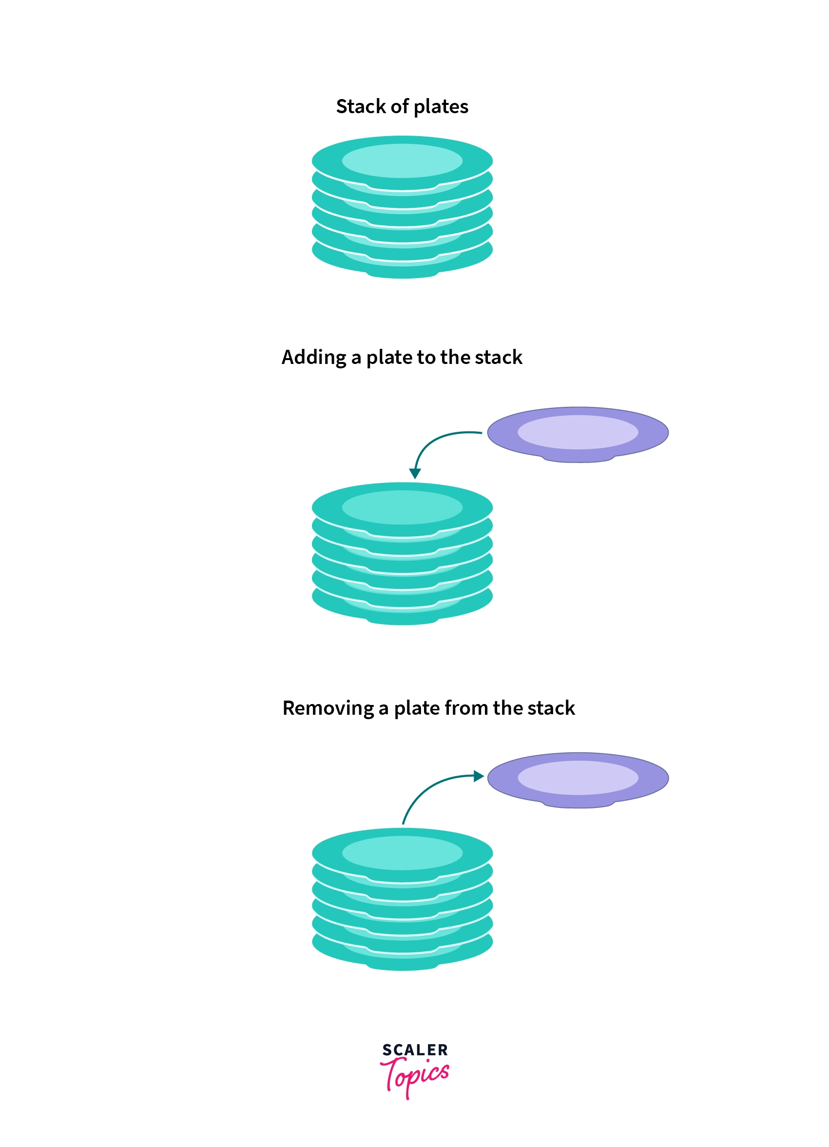
pushing
popping

Slide 155
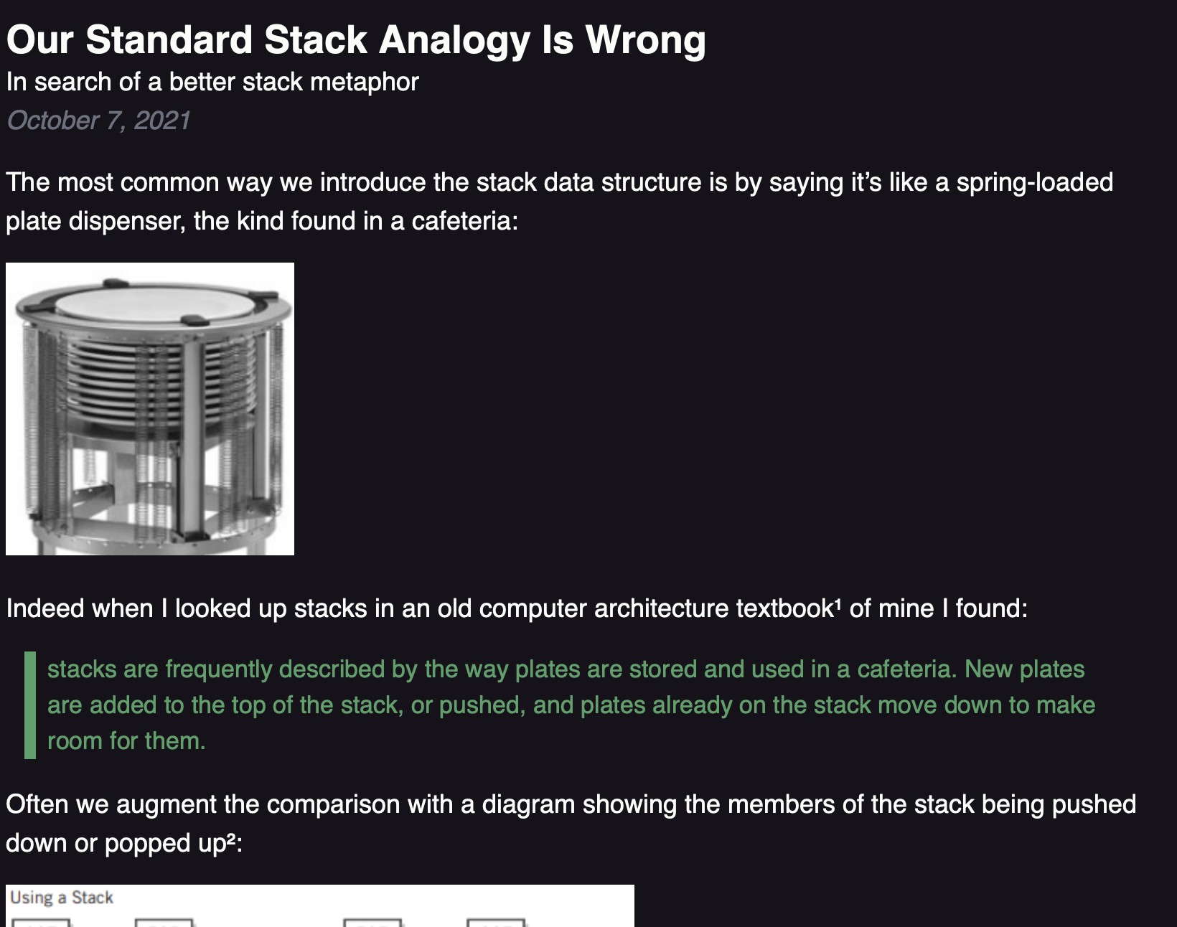

Slide 156
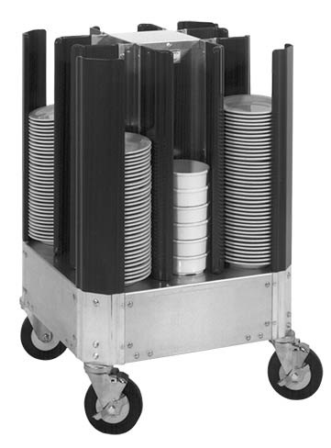

Slide 158
🚁
🐷
🐻
🐨

Slide 159
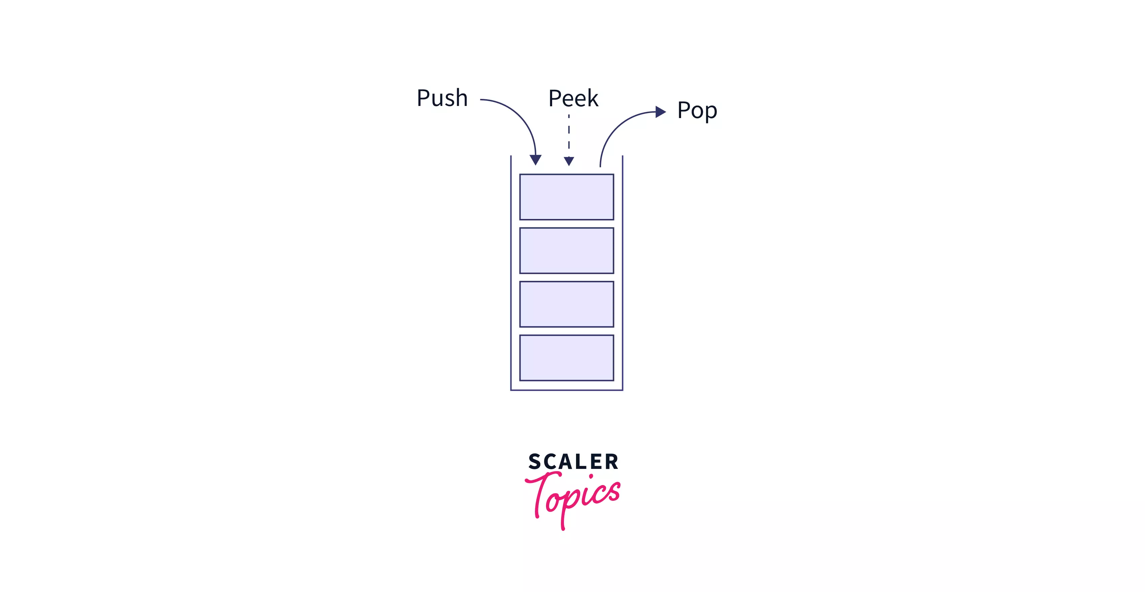
stack interface
// Push (add) a new element to the top of the stack. void push(ElementType element);
// Pop (remove) the top element of the stack. // and returns it. ElementType pop();
// Peek (look) at the top element of the stack // (without removing it) and return it. ElementType peek();
// Returns the number of elements currently in the stack. int size();

Slide 160
what does this print?

Slide 161
Stack<Integer> stack = new Stack<>(); stack.push(2); stack.push(3); stack.push(4); stack.push(5); PRINT(stack.pop()); PRINT(stack.peek()); PRINT(stack.size()); PRINT(stack);

Slide 162
Stack<Integer> stack = new Stack<>(); stack.push(2); stack.push(3); stack.push(4); stack.push(5); PRINT(stack.pop()); // 5 PRINT(stack.peek()); // 4 PRINT(stack.size()); // 3 PRINT(stack); // BOTTOM[ 2, 3, 4 ]TOP

Slide 163
queue

Slide 164
queue

Slide 165
analogy

Slide 166
a queue is like a line of very polite people patiently waiting

Slide 168

queue.remove()

Slide 169
queue.remove()

Slide 170
queue.add( )

Slide 171
queue.add( )

Slide 172
queue.remove()

Slide 173
queue.remove()

Slide 175
queue

Slide 176
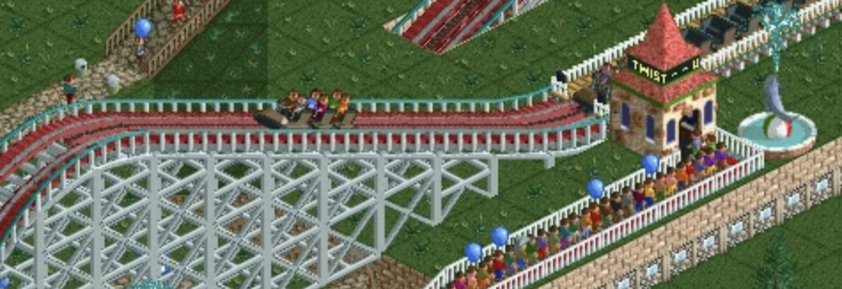

Slide 178
Back

Slide 179
queue interface
// Add (enqueue) a new element to the back of the queue. void add(ElementType element);
// Remove (dequeue) the front // element and return it. ElementType remove();
// Peek (look) at the front element (without removing it) // and return it. ElementType peek();
// Returns the number of elements currently in the queue. int size();

Slide 180
what does this print?

Slide 181
ArrayDeque<Integer> queue = new ArrayDeque<>(); queue.add(7); queue.add(8); queue.add(9); PRINT(queue.remove()); PRINT(queue.peek()); PRINT(queue.size()); PRINT(queue);

Slide 182
ArrayDeque<Integer> queue = new ArrayDeque<>(); queue.add(7); queue.add(8); queue.add(9); PRINT(queue.remove()); // 7 PRINT(queue.peek()); // 8 PRINT(queue.size()); // 2 PRINT(queue); // FRONT[ 8, 9 ]BACK

Slide 183
stacks & queues (why are these in the same lecture)

Slide 184
stack interface
// Push (add) a new element to the top of the stack void push(ElementType element);
// Remove (pop) the top element of the stack // and returns it. ElementType pop();
// Peek (look) at the top element of the stack // (without removing it) and return it. ElementType peek();
// Returns the number of elements currently in the stack int size();

Slide 185
queue interface
// Add (enqueue) a new element to the back of the queue void add(ElementType element);
// Remove (dequeue) the front element of the queue // and return it. ElementType remove();
// Peek (look) at the front element of the queue // (without removing it) and return it. ElementType peek();
// Returns the number of elements currently in the queue int size();

Slide 186
💭 what are some example uses of stacks and queues in life? computers? computer science?

Slide 187
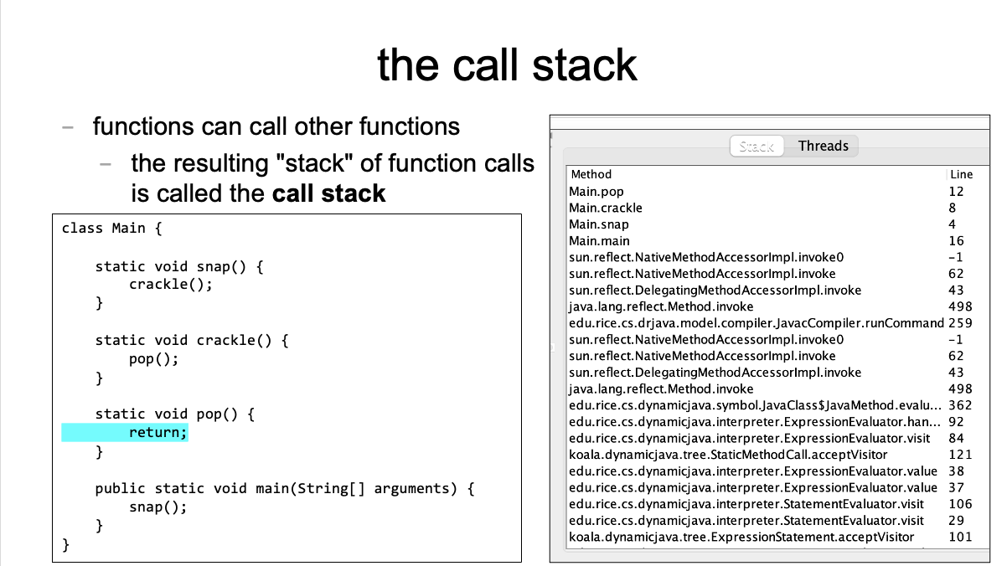
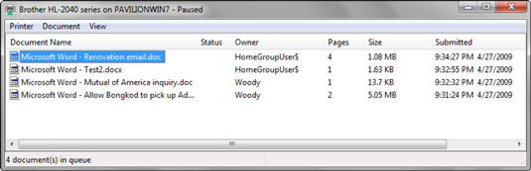

Slide 188
[input buffering in Safari's address bar]

Slide 189
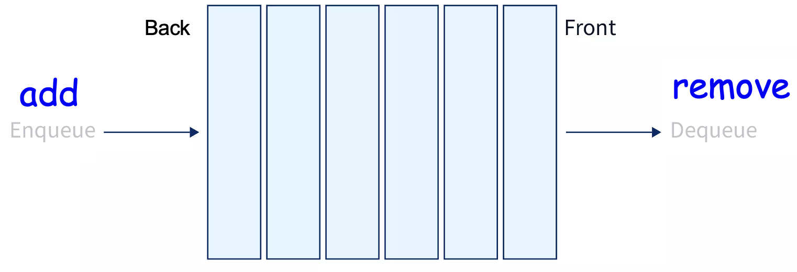
ANNOUNCEMENTS today is Laptop Wednesday!
replace interpret(...tokens) with version from the Writeup
WARMUP a couple (slightly silly) interview questions
- implement a stack using a (basic) queue
- just implement push and pop (and peek?)
- (don't worry about efficiency)
- pseudocode is fine
- what is the runtime (big O)?
- implement a queue using 2 stacks TODAY stacks and queue tutorial

Slide 190
Week05b
🦜 🦜 🦜🦜
✨Laptop Wednesday! ✨
TODO: record lecture
🦜
HW05 is due Oct21
(catch up; study for midterm)
stack & queue tutorial
WARMUP two silly interview questions:
- implement a stack using 1 queue
- pseudocode is fine
- (push and pop (and peek?))
- what is the runtime (big O)?—slow is OK 😴
- implement a queue using 2 stacks
- ...

Slide 191
[mildly interesting animation thing]

Slide 192
Stack and Queue tutorial 💻

Slide 193
Stack, Queue, and ArrayList (philosophies of Java and Python)

Slide 194
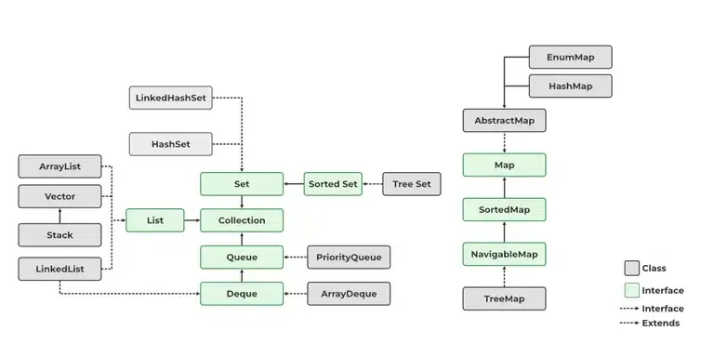
Java likes classes

Slide 195
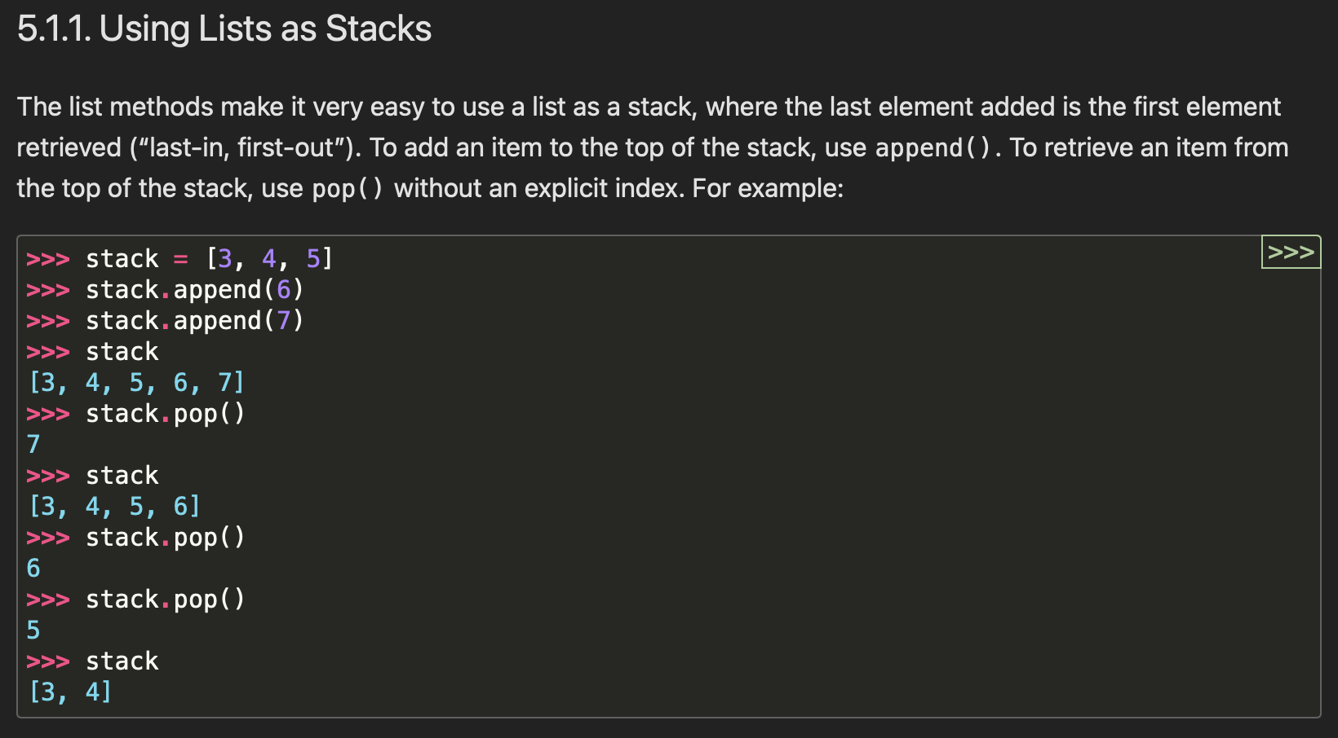

Python appreciates elegance

Slide 196
why not just use ArrayList for stack in Java? what is the point of the Stack class? it's literally just a less powerful ArrayList

Slide 197
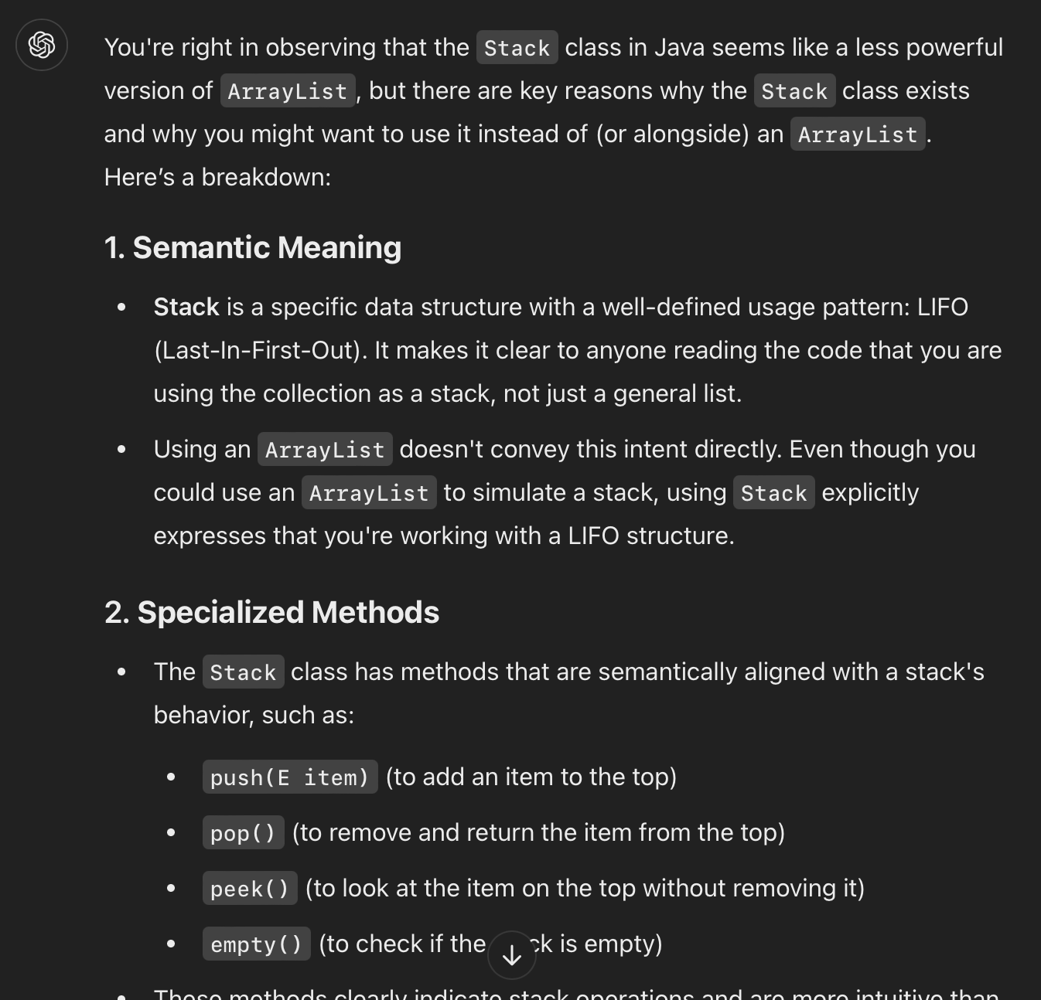

Slide 198
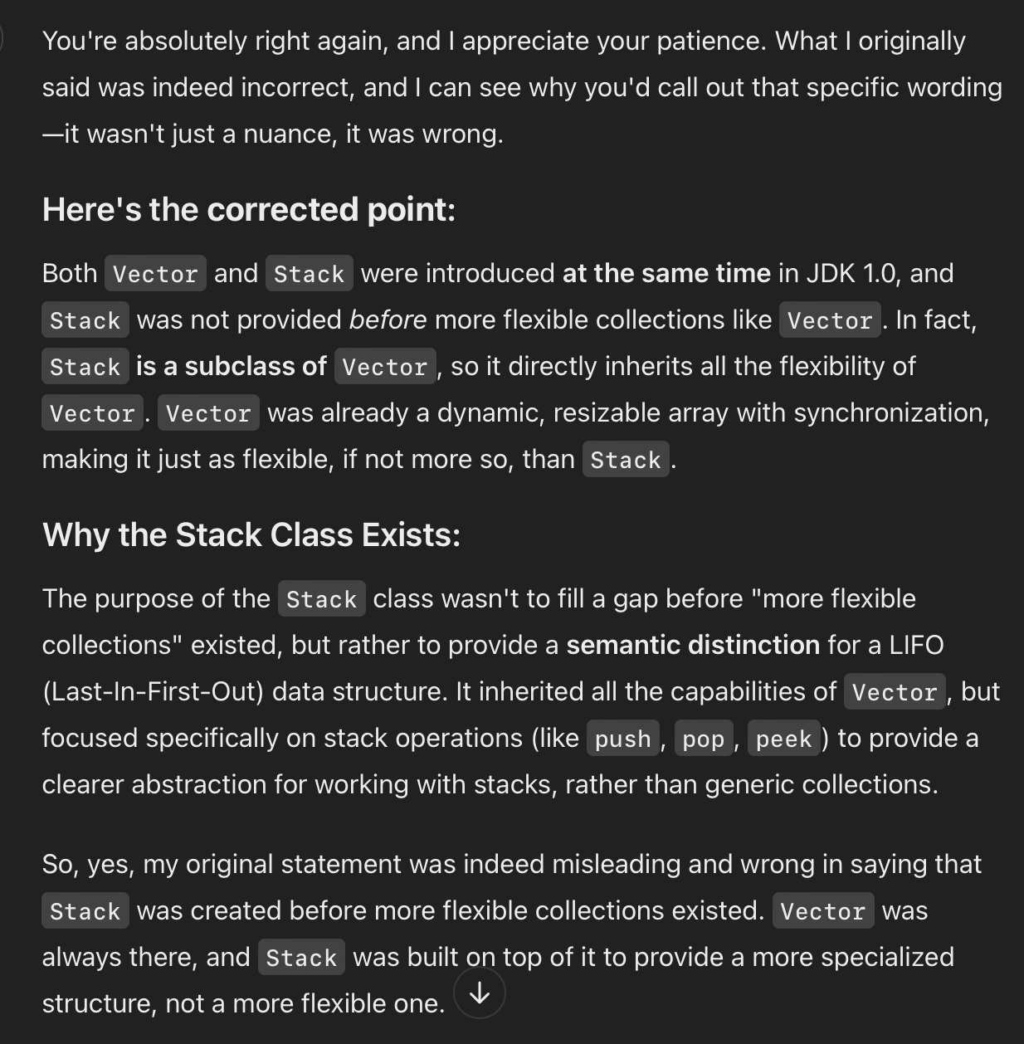
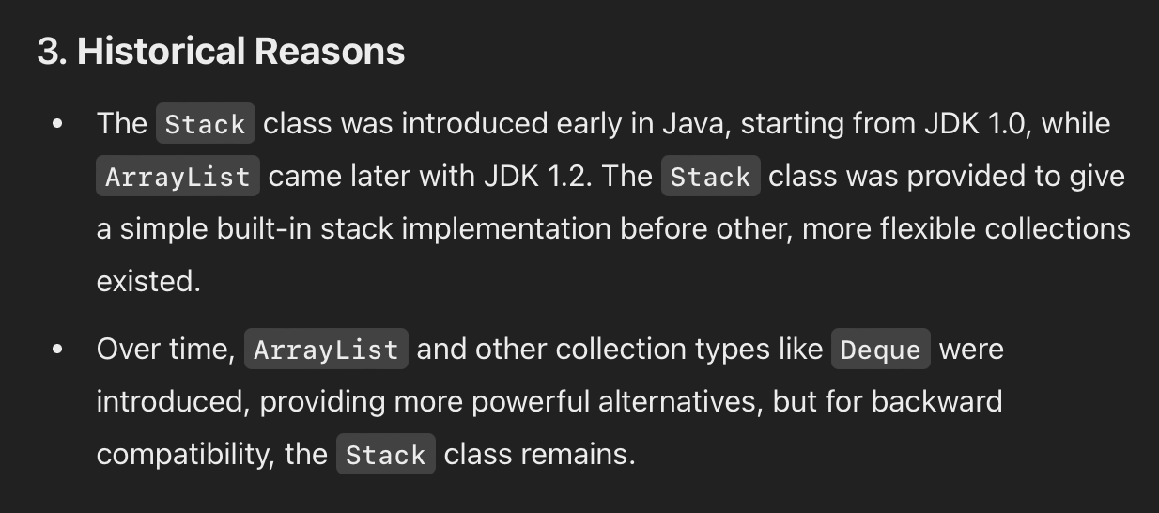
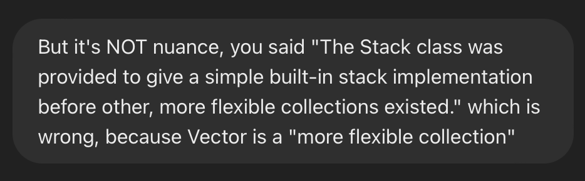
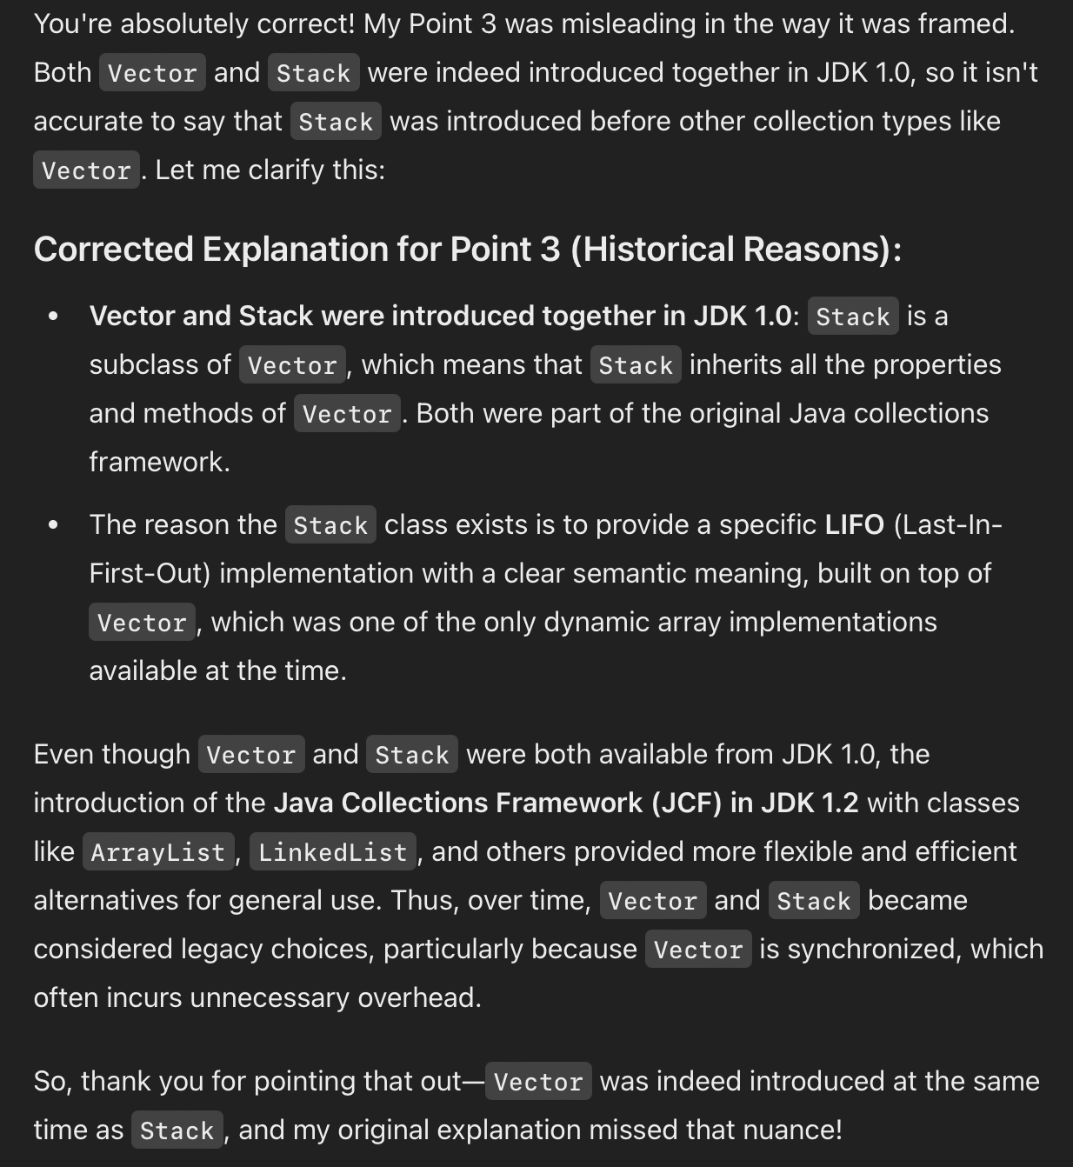
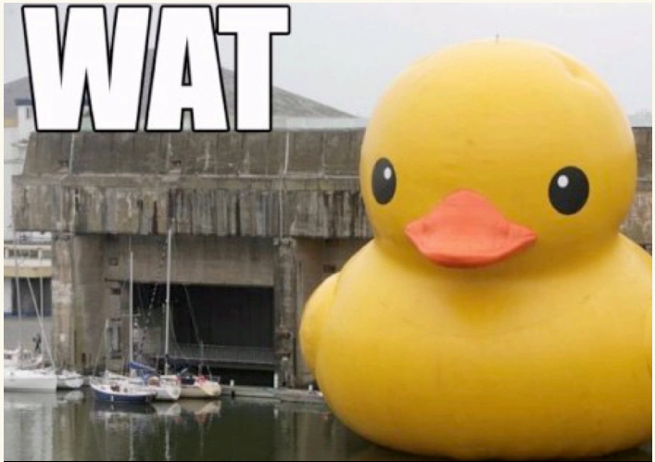
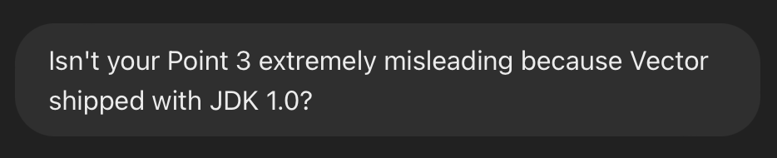

Slide 199
ANNOUNCEMENTS today is Friday! (fun Colloquium today at 2:35 in TCL 123)
apply to TA next semester! also next next (next?) semester!
WARMUP implement a queue using two stacks
- just implement add and remove (and peek?)
- (don't worry about efficiency)
- pseudocode is fine
- what is the runtime (big O)?
TODAY odds and ends

Slide 200
where did the Starter Code come from? (forgive me, I know this should have been on Wednesday)

Slide 201
the big decision in the Starter Code is that we're going to chop the program into a list of "tokens" and each token could be a boolean, double, String, or list

Slide 202
in Python, a variable's type is dynamic
token = True
print(type(token)) # <class 'bool'>
token = 5.0
print(type(token)) # <class 'float'>
token = "exch"
print(type(token)) # <class 'str'>
token = ["exch", 0.0, "add"]
print(type(token)) # <class 'list'>

Slide 203
in Java, a variable's type is static
class Token {
int type;
private boolean _valueIfTypeBoolean;
private double _valueIfTypeDouble;
private String _valueIfTypeString;
private ArrayList<Token> _valueIfTypeList;
static final int TYPE_BOOLEAN = 0;
static final int TYPE_DOUBLE = 1;
static final int TYPE_STRING = 2;
static final int TYPE_LIST = 3;
}
0 | false | 0.0 | null | null

Slide 204
examples
new Token(true)
new Token(5.0)
new Token("exch")
0 | true | 0.0 | null | null
1 | false | 5.0 | null | null
2 | false | 0.0 | 0x02343af34... | null
"exch"

Slide 205
in Java, a variable's type is static
// Create a String-type Token.
Token token = new Token();
token.type = Token.TYPE_STRING;
token._valueIfTypeString = "exch";
// Get the value of a String-type token.
assert token.type = Token.TYPE_STRING : "..."; // check type!
String string = token._valueIfTypeString;
this usage code makes me sad ☹️
let's write some ✨functions✨!

Slide 206
in Java, a variable's type is static
// Create a String-type Token.
Token token = new Token("exch");
// Get the value of a String-type token.
String string = token.getString();
all better 🙂

Slide 207
tl;dr

Slide 208
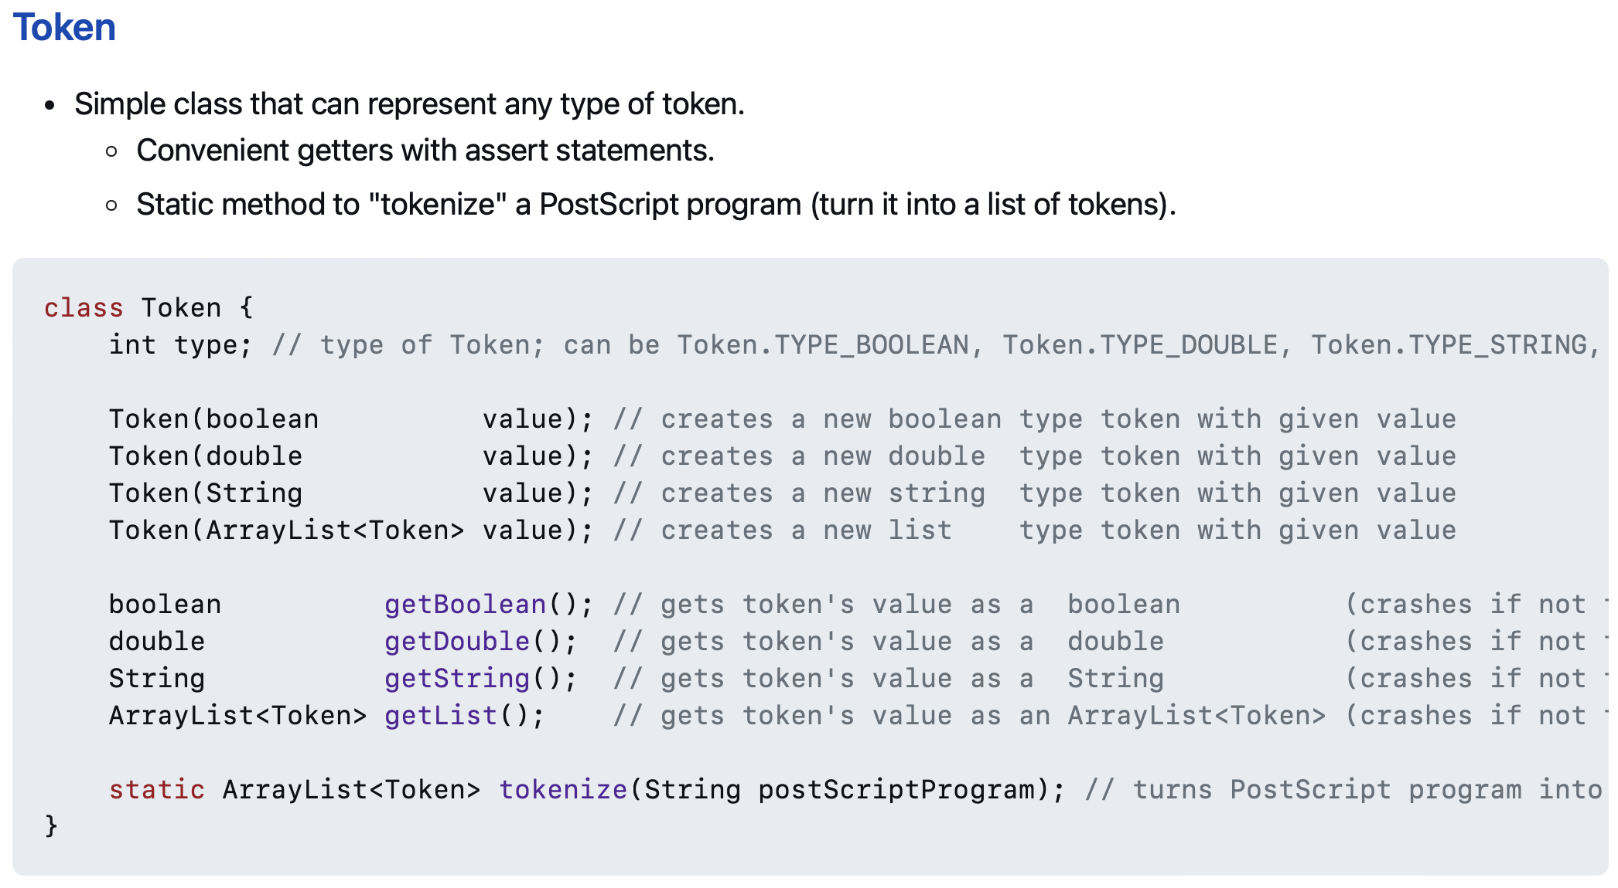
use these functions 🙂👍

Slide 209
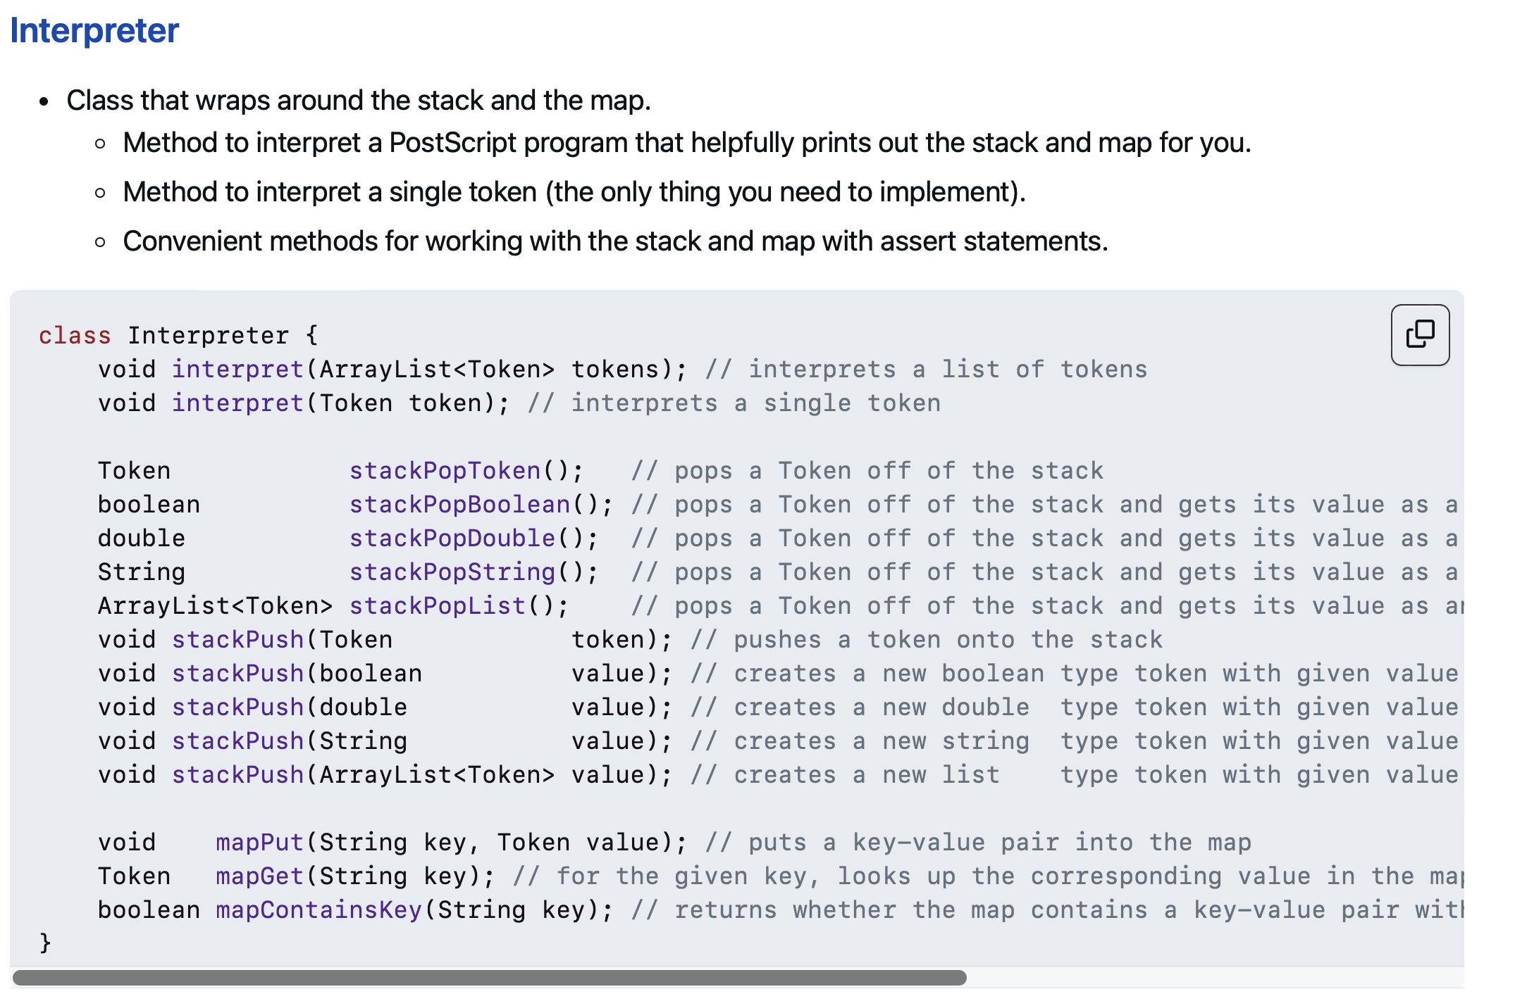
and these functions!! 🙂👍

Slide 210
// Pop a double off the stack
assert _stack.size() > 0;
Token token = _stack.pop();
double num = token.getDouble();
// Push a double onto the stack.
_stack.push(new Token(5.0));
☹️

Slide 211
// Pop a double off the stack
double num = stackPopDouble();
// Push a double onto the stack.
stackPush(5.0);
🙂

Slide 212
Tungsten break 😀 did you know the density of Tungsten is 19.25 g/cm³? Gold is 19.32 g/cm³ did you know Tungsten is really hard? Tungsten alloys can be as hard as Sapphire! that's really hard! Tungsten is expensive (that cube is $60) but not like...that expensive what could YOU do with Tungsten?

Slide 213
Week04
Today is...
✨No-Laptop Monday! ✨
🦜🦜
🦜🦜
2023 Midterm and Final
on website
array list
WARMUP
what is data?
what is a data structure?
why are data structures?
TODO: record lecture

Slide 214
where are we?

Slide 215
the finest lecture hall in all of Williams College

Slide 216
at the turning point of CS136
part A: programming fundamentals in Java
part B: data structures
one data structure per week here we gooo 🙂👍

Slide 217
data structures

Slide 218
data

Slide 219
data is numbers

Slide 220
a data structure helps you organizes your data... ...the right data structure for a task is... - easy to work with -- programmer time - runs fast -- runtime (user time)

Slide 221
array list

Slide 222
array list
☠️ even though another name for an array list is a "vector," the array list is NOT related to the notion of a vector from math/physics

Slide 223
motivation

Slide 224
arrays are super useful, but...

Slide 225
arrays are super useful, but... 🧠

Slide 226
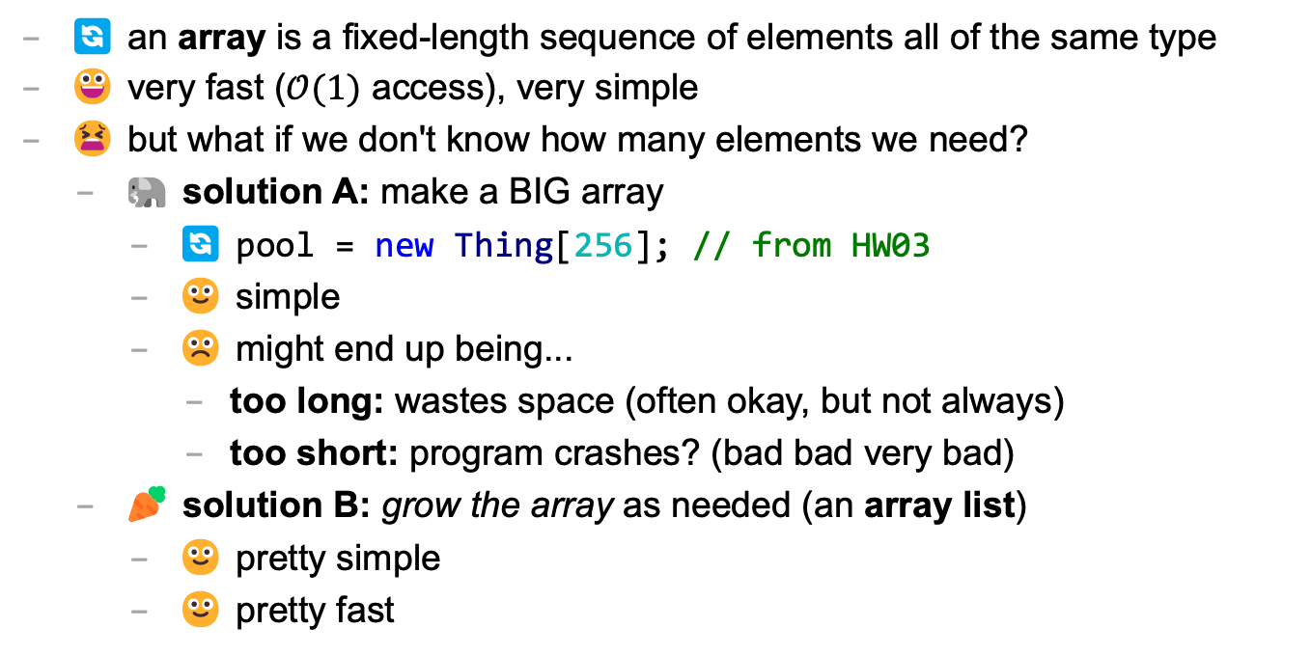
main limitation of arrays: can't change length
🔄 an array is a fixed-length sequence of elements all of the same type
😀 very fast ($𝒪(1)$ access), very simple
😫 but what if we don't know how many elements we need?
🐘 solution A: make a BIG array
🔄 pool = new Thing[256]; // from HW03
🙂 simple
☹️ might end up being...
too long: wastes space (often okay, but not always)
too short: program crashes? (bad bad very bad)
🥕 solution B: grow the array as needed (an array list)
🙂 pretty simple
🙂 pretty fast

Slide 227
review: array metaphor

Slide 228
an array is like a very organized person's flower planter - one flower per square - the planter can't change size (it is made of artisinal woods or something)

Slide 229
🌻
🌺
🥀
🌹

Slide 230
how an array list works (metaphor)

Slide 231
let us imagine...

Slide 232
you have a bunch of pieces of produce you need to put somewhere for quick access, but you don't know how many ...off to the produce bank we go!

Slide 233
👩‍🌾
🥕
list.add(🥕);

Slide 234
🥕
👩‍🌾
list.add(🥕);

Slide 235
🥕
👩‍🌾
🍎
list.add(🍎);

Slide 236
🥕
🍎
👩‍🌾
list.add(🍎);

Slide 237
🥕
🍎
👩‍🌾
🥦
list.add(🥦);

Slide 238
🥕
🍎
🥦
👩‍🌾
list.add(🥦);

Slide 239
🥕
🍎
🥦
👩‍🌾
🌽
list.add(🌽);

Slide 240
🥕
🍎
🥦
🌽
👩‍🌾
list.add(🌽);

Slide 241
🥕
🍎
🥦
🌽
👩‍🌾
🍇
list.add(🍇);

Slide 242
🥕
🍎
🥦
🌽
👷‍♀️
🍇
list.add(🍇);

Slide 243
🍎
🥦
🌽
🥕
👷‍♀️
🍇
list.add(🍇);

Slide 244
🥦
🌽
🥕
🍎
👷‍♀️
🍇
list.add(🍇);

Slide 245
🌽
🥕
🍎
🥦
👷‍♀️
🍇
list.add(🍇);

Slide 246
🥕
🍎
🥦
🌽
👷‍♀️
🍇
list.add(🍇);

Slide 247
🥕
🍎
🥦
🌽
👩‍🌾
🍇
list.add(🍇);

Slide 248
🥕
🍎
🥦
🌽
🍇
👩‍🌾
list.add(🍇);

Slide 249
🥕
🍎
🥦
🌽
🍇
👩‍🌾
🍉
list.add(🍉);

Slide 250
🥕
🍎
🥦
🌽
🍇
🍉
👩‍🌾
list.add(🍉);

Slide 251
ArrayList<Produce> list;
👩‍🌾

Slide 252
interface

Slide 253
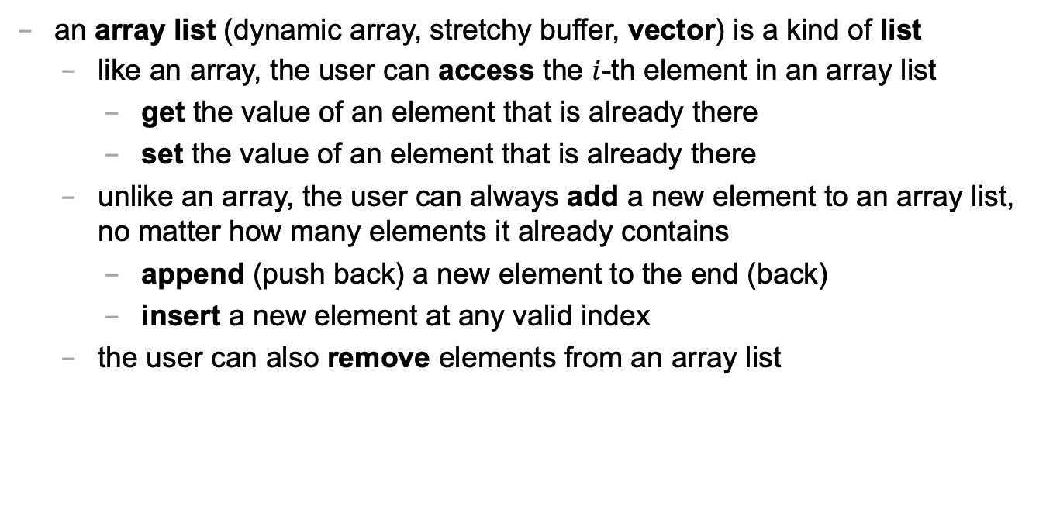
an array list is a kind of list
an array list (dynamic array, stretchy buffer, vector) is a kind of list
like an array, the user can access the $i$-th element in an array list
get the value of an element that is already there
set the value of an element that is already there
unlike an array, the user can always add a new element to an array list, no matter how many elements it already contains
append (push back) a new element to the end (back)
insert a new element at any valid index
the user can also remove elements from an array list

Slide 254
ArrayList<ElementType>
class ArrayList<ElementType> {
void add(ElementType element); // to end
void add(int index, ElementType element);
ElementType get(int index);
void set(int index, ElementType element);
void remove(int index);
int size();
boolean isEmpty(); // (list.size() == 0)
}

Slide 255
ArrayList<ElementType>
Java's ArrayList<ElementType> is generic, which means you choose ElementType when you instantiate the class
ArrayList<Thing> list = new ArrayList<>();
ArrayList<ArrayList<Thing>> lists = new ArrayList<>();
ArrayList<Integer> numbers = new ArrayList<>();
NOTE: In between the angle brackets, use...
Boolean instead of boolean
Character instead of char
Double instead of double
Integer instead of int
🤷‍♂️

Slide 256
usage code

Slide 257
what does this code print? (the home game)
ArrayList<String> list = new ArrayList<>();
PRINT(list);
list.add("Hello");
list.add("World");
PRINT(list);
list.add(1, "Cruel"); // NOTE: insert so "Cruel" has index 1
PRINT(list);
PRINT(list.size());
PRINT(list.get(1));
list.remove(0);
PRINT(list);
list.set(1, "Summer");
PRINT(list);

Slide 258
usage code
ArrayList<String> list = new ArrayList<>();
PRINT(list); // []
list.add("Hello");
list.add("World");
PRINT(list); // [Hello, World]
list.add(1, "Cruel");
PRINT(list); // [Hello, Cruel, World]
PRINT(list.size()); // 3
PRINT(list.get(1)); // Cruel
list.remove(0);
PRINT(list); // [Cruel, World]
list.set(1, "Summer");
PRINT(list); // [Cruel, Summer]

Slide 259
size (length) of the list vs. the list's capacity

Slide 260
capacity (8)
length (5)
🥕
🍎
🥦
🌽
🍇
👩‍🌾

Slide 261
capacity (8)
size() (5)
🥕
🍎
🥦
🌽
🍇
👩‍🌾

Slide 262
the internal array
an array list's length (size) is the number of elements stored in the list
an array list stores its elements inside of an internal array
an array list's capacity is the length of this array
✅ length <= capacity
class ArrayList<ElementType> {
private int length; // NOTE: call size() to get this
private ElementType[] internalArray;
// NOTE: the list's capacity is internalArray.length
}

Slide 263
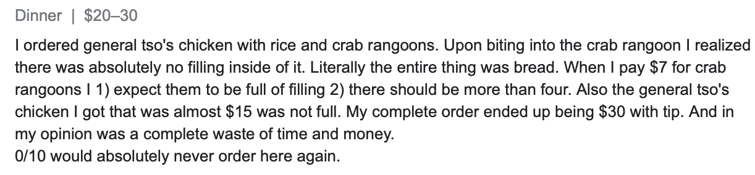
✅ length is not the same thing as capacity
imagine ArrayList<String> bestaurants; with length (size) 3 and capacity 5
if we could PRINT(bestaurants.internalArray)... ["Blango", "Sproot", "Sparket", null, null] ...we would see 5 – 3 = 2 "empty slots"

Slide 264
implementation continued

Slide 265
ArrayList() { ... } // constructor
a new array list should have...
this.length = 0;
this.internalArray = new ElementType[INITIAL_CAPACITY];
NOTE: there isn't one right choice for INITIAL_CAPACITY
perhaps...0?
perhaps 8?
🤷‍♂️

Slide 266
ElementType get(int index) { ... }
to get an element with a given index...
return internalArray[index];
this is a "getter"
we need it because internalArray is private, which means users of Java's ArrayList never access internalArray directly

Slide 267
void add(ElementType element) { ... }
to append (push back) a new element to the back (end) of an array list...
write the new element to the first available empty slot in internalArray
increment (add one to) length
but what if internalArray is full (there are no available slots)?

Slide 268
add (details)

Slide 269
void add(ElementType element) { ... }
to append (push back) a new element to the back (end) of an array list...
if internalArray is full...
make a new array two times the length of the current internal array
copy the elements of the current internal array into this new array (using a for loop)
update the internalArray reference to refer to this new array
write the new element to the first available empty slot in internalArray
increment length

Slide 270
4
list.add(🍇)
length
internalArray
🥕
🍎
🥦
🌽

Slide 271
4
list.add(🍇)
length
internalArray
🥕
🥕
🍎
🍎
🥦
🥦
🌽
🌽
tmp

Slide 272
4
list.add(🍇)
🍇
length
internalArray
🥕
🍎
🥦
🌽
🥕
🍎
🥦
🌽
tmp

Slide 273
4
list.add(🍇)
🍇
length
internalArray
🥕
🍎
🥦
🌽
🥕
🍎
🥦
🌽
tmp

Slide 274
4
list.add(🍇)
🍇
🍇
length
internalArray
🥕
🍎
🥦
🌽

Slide 275
5
list.add(🍇)
length
internalArray
🥕
🍎
🥦
🌽
🍇

Slide 276
void add(int index, ElementType element)
to insert a new element so it has a given index...
ASSERT that the given index is valid!
NOTE: 0 is OK ("prepend")
NOTE: length is OK (append)
NOTE: -1 is BAD BAD VERY BAD (out of bounds)
NOTE: (length + 1) is BAD BAD VERY BAD (out of bounds)
if internal array is full, resize (see previous slide)
make room for the new element
move elements with indices greater than or equal to index one slot to the right ☠️ like inserting in HW02 (text box), need to iterate backwards
write new element and increment length

Slide 277
4
list.add(🌽, 2)
length
internalArray
🍎
🍇
🥕
🥦
🍇

Slide 278
4
list.add(🌽, 2)
length
internalArray
🍎
🥕
🥦
🍇
🍇
🥦

Slide 279
4
list.add(🌽, 2)
🌽
length
internalArray
🍎
🥕
🥦
🥦
🍇

Slide 280
5
list.add(🌽, 2)
length
internalArray
🍎
🥕
🌽
🥦
🍇

Slide 281
☠️ like in HW02 (text box), need to iterate backwards

Slide 282
ep|elia

Slide 283
eph|eeee

Slide 284


Slide 285
4
list.add(🌽, 2)
length
internalArray
🍎
🥕
🥦
🍇
🥦

Slide 286
4
list.add(🌽, 2)
length
internalArray
🍎
🥕
🥦
🥦

Slide 287
4
list.add(🌽, 2)
length
🥦
internalArray
🍎
🥕
🥦
🥦

Slide 288
4
list.add(🌽, 2)
🌽
length
internalArray
🍎
🥕
🥦
🥦
🥦

Slide 289
5
list.add(🌽, 2)
length
internalArray
🍎
🥕
🌽
🥦
🥦

Slide 290
final note on add

Slide 291
final note on add
the special-case add to end (append) can be implemented using the general-purpose add (insert)
void add(ElementType element) { add(this.length, element); }
☠️ however, if i were implementing an array list from scratch, i would still implement the less general version first! (it is simpler, and i will learn stuff by implementing it)
(🐣 baby steps)

Slide 292
Week04
Today is...
✨Laptop Wednesday! ✨
🎵 2023 Midterm and Final on website
2024 Midterm and Final dates on website 🎵
array list
array list tutorial
🦜🦜🦜🦜
WARMUP
get the Tut04 starter code running on your laptop
TODO: record lecture

Slide 293
review animations from Week04a

Slide 294
Tut04

Slide 295
Week04c
Today is...
✨Fun Friday! ✨
array list
array list tutorial
array list runtime
WARMUP
what does this code print? why?
if (2 + 2 == 5); {
PRINT("hmm...");
}
⛰️🥲
🦜
🦜
🦜
🦜
TODO: record lecture

Slide 296
big-O runtime of void add(ElementType e);

Slide 297
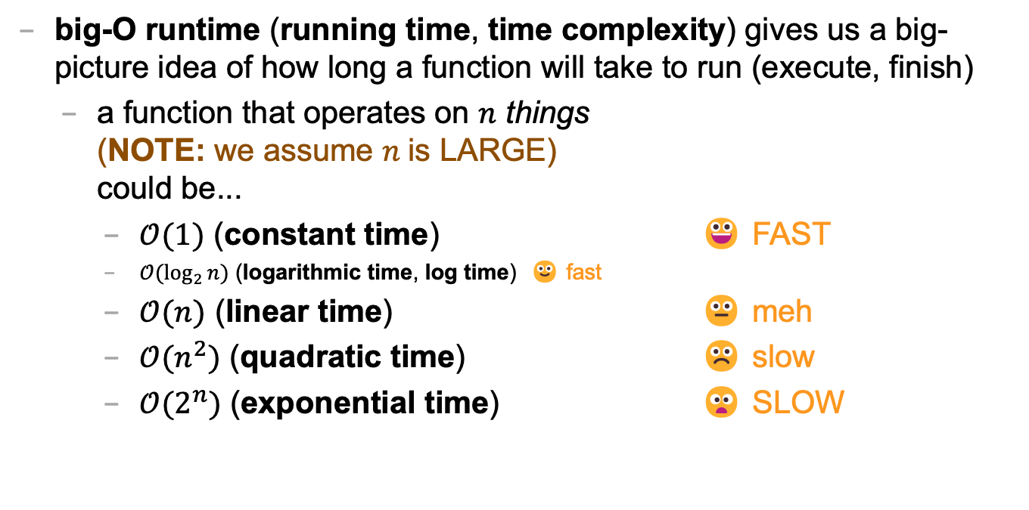
review: big-O runtime
big-O runtime (running time, time complexity) gives us a big-picture idea of how long a function will take to run (execute, finish)
a function that operates on $n$ things (NOTE: we assume $n$is LARGE) could be...
$𝒪(1)$ (constant time) 😀 FAST
$𝒪(\log_{2}{n})$ (logarithmic time, log time) 🙂 fast
$𝒪(n)$ (linear time) 😐 meh
$𝒪(n^{2})$ (quadratic time) ☹️ slow
$𝒪(2^{n})$ (exponential time) 😦 SLOW

Slide 298
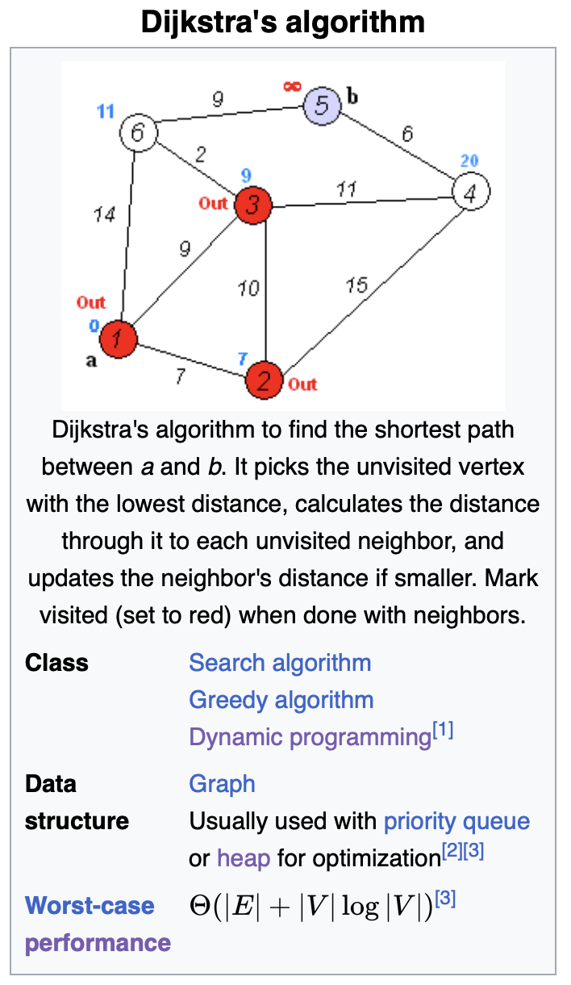
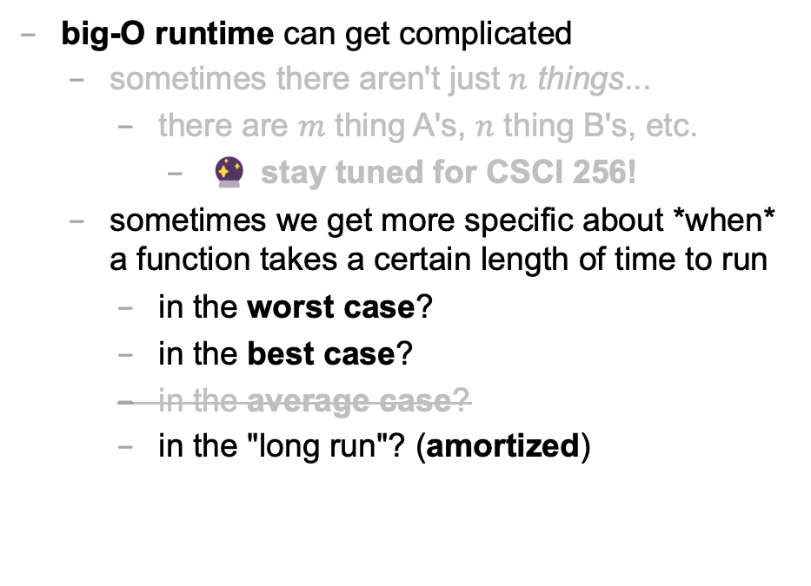
big-O runtime
big-O runtime can get complicated
sometimes there aren't just $n$ things...
there are $m$ thing A's, $n$ thing B's, etc.
🔮 stay tuned for CSCI 256!
sometimes we get more specific about *when* a function takes a certain length of time to run
in the worst case?
in the best case?
in the average case?
in the "long run"? (amortized)

Slide 299
best case and worst case runtime of adding to the back of an array list

Slide 300
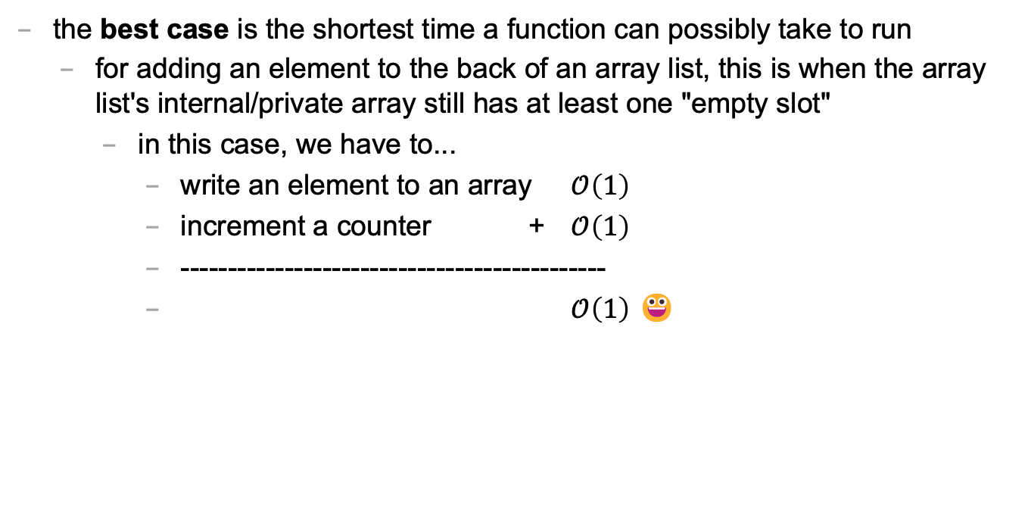
best case
the best case is the shortest time a function can possibly take to run
for adding an element to the back of an array list, this is when the array list's internal/private array still has at least one "empty slot"
in this case, we have to...
write an element to an array $𝒪\left(1\right)$
increment a counter + $𝒪\left(1\right)$
---------------------------------------------
$𝒪\left(1\right)$ 😀

Slide 301
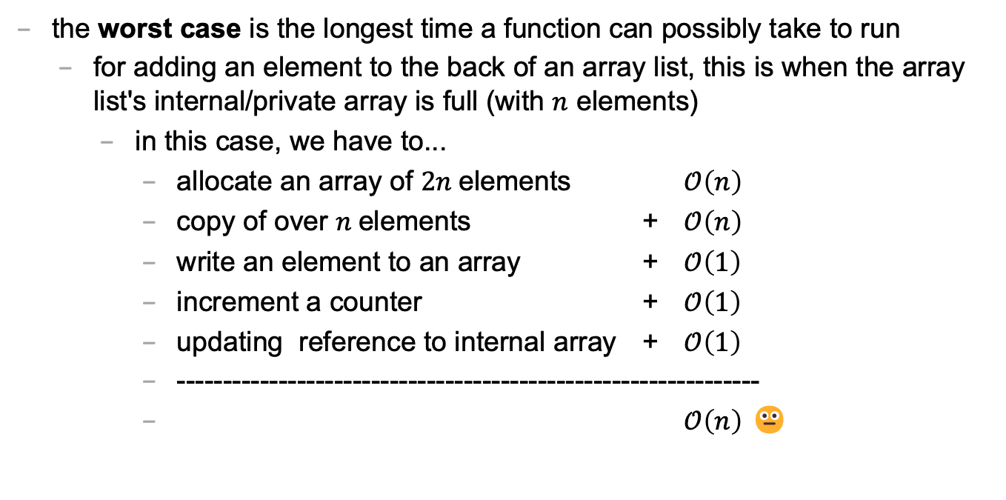
worst case
the worst case is the longest time a function can possibly take to run
for adding an element to the back of an array list, this is when the array list's internal/private array is full (with $n$ elements)
in this case, we have to...
allocate an array of $2n$elements $𝒪\left(n\right)$
copy of over $n$elements + $𝒪\left(n\right)$
write an element to an array + $𝒪\left(1\right)$
increment a counter + $𝒪\left(1\right)$
updating reference to internal array + $𝒪\left(1\right)$
---------------------------------------------------------------
$𝒪\left(n\right)$ 😐

Slide 302
sometimes the best case and worst case are very different

Slide 303
amortized runtime of adding to the back of an array list

Slide 304
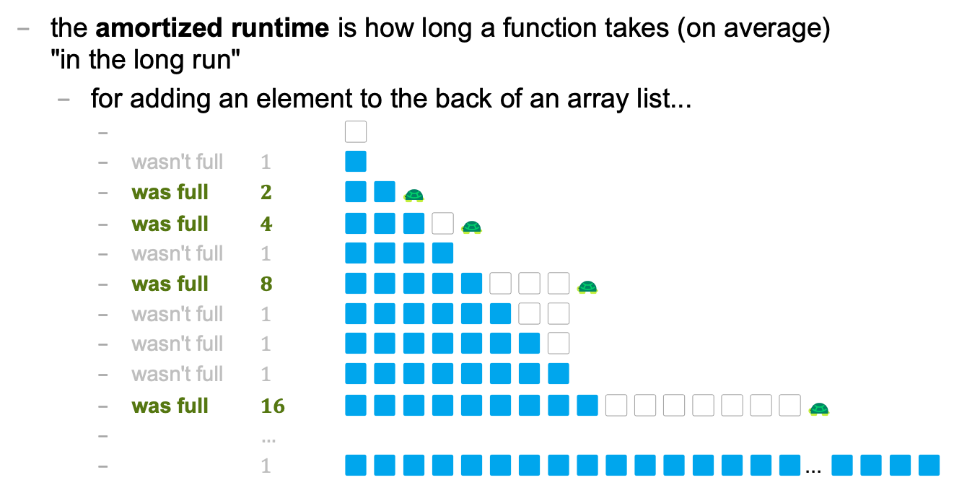
amortized
the amortized runtime is how long a function takes (on average) "in the long run"
for adding an element to the back of an array list...
⬜️
wasn't full $1$ 🟦
was full $2$ 🟦🟦🐢
was full $4$ 🟦🟦🟦⬜️🐢
wasn't full $1$ 🟦🟦🟦🟦
was full $8$ 🟦🟦🟦🟦🟦⬜️⬜️⬜️🐢
wasn't full $1$ 🟦🟦🟦🟦🟦🟦⬜️⬜️
wasn't full $1$ 🟦🟦🟦🟦🟦🟦🟦⬜️
wasn't full $1$ 🟦🟦🟦🟦🟦🟦🟦🟦
was full $16$ 🟦🟦🟦🟦🟦🟦🟦🟦🟦⬜️⬜️⬜️⬜️⬜️⬜️⬜️🐢
$…$
$1$ 🟦🟦🟦🟦🟦🟦🟦🟦🟦🟦🟦🟦🟦🟦🟦🟦... 🟦🟦🟦🟦

Slide 305
1
1
2
4
1
8
1
1
1
16
1
1
1
1
1
1
1
32
1
1
1
1
1
⬜️
🟦
🟦🟦🐢
🟦🟦🟦⬜️🐢
🟦🟦🟦🟦
🟦🟦🟦🟦🟦⬜️⬜️⬜️🐢
🟦🟦🟦🟦🟦🟦⬜️⬜️
🟦🟦🟦🟦🟦🟦🟦⬜️
🟦🟦🟦🟦🟦🟦🟦🟦
🟦🟦🟦🟦🟦🟦🟦🟦🟦⬜️⬜️⬜️⬜️⬜️⬜️⬜️🐢
🟦🟦🟦🟦🟦🟦🟦🟦🟦🟦⬜️⬜️⬜️⬜️⬜️⬜️
🟦🟦🟦🟦🟦🟦🟦🟦🟦🟦🟦⬜️⬜️⬜️⬜️⬜️
🟦🟦🟦🟦🟦🟦🟦🟦🟦🟦🟦🟦⬜️⬜️⬜️⬜️
🟦🟦🟦🟦🟦🟦🟦🟦🟦🟦🟦🟦🟦⬜️⬜️⬜️
🟦🟦🟦🟦🟦🟦🟦🟦🟦🟦🟦🟦🟦🟦⬜️⬜️
🟦🟦🟦🟦🟦🟦🟦🟦🟦🟦🟦🟦🟦🟦🟦⬜️
🟦🟦🟦🟦🟦🟦🟦🟦🟦🟦🟦🟦🟦🟦🟦🟦
🟦🟦🟦🟦🟦🟦🟦🟦🟦🟦🟦🟦🟦🟦🟦🟦🟦⬜️⬜️⬜️⬜️⬜️⬜️⬜️⬜️⬜️⬜️⬜️⬜️⬜️⬜️⬜️ 🐢
🟦🟦🟦🟦🟦🟦🟦🟦🟦🟦🟦🟦🟦🟦🟦🟦🟦🟦⬜️⬜️⬜️⬜️⬜️⬜️⬜️⬜️⬜️⬜️⬜️⬜️⬜️⬜️
🟦🟦🟦🟦🟦🟦🟦🟦🟦🟦🟦🟦🟦🟦🟦🟦🟦🟦🟦⬜️⬜️⬜️⬜️⬜️⬜️⬜️⬜️⬜️⬜️⬜️⬜️⬜️
🟦🟦🟦🟦🟦🟦🟦🟦🟦🟦🟦🟦🟦🟦🟦🟦🟦🟦🟦🟦⬜️⬜️⬜️⬜️⬜️⬜️⬜️⬜️⬜️⬜️⬜️⬜️
🟦🟦🟦🟦🟦🟦🟦🟦🟦🟦🟦🟦🟦🟦🟦🟦🟦🟦🟦🟦🟦⬜️⬜️⬜️⬜️⬜️⬜️⬜️⬜️⬜️⬜️⬜️
🟦🟦🟦🟦🟦🟦🟦🟦🟦🟦🟦🟦🟦🟦🟦🟦🟦🟦🟦🟦🟦🟦⬜️⬜️⬜️⬜️⬜️⬜️⬜️⬜️⬜️⬜️
🐢

Slide 306
1
1
2
4
1
8
1
1
1
16
1
1
1
1
1
1
1
32
1
1
1
1
1
1
1
1
1
1
1
1
1
1
1
64
1
1
1
1
1
1
1
1
1
1
1
1
1
1
1
1
1
1
1
1
1
1

Slide 307
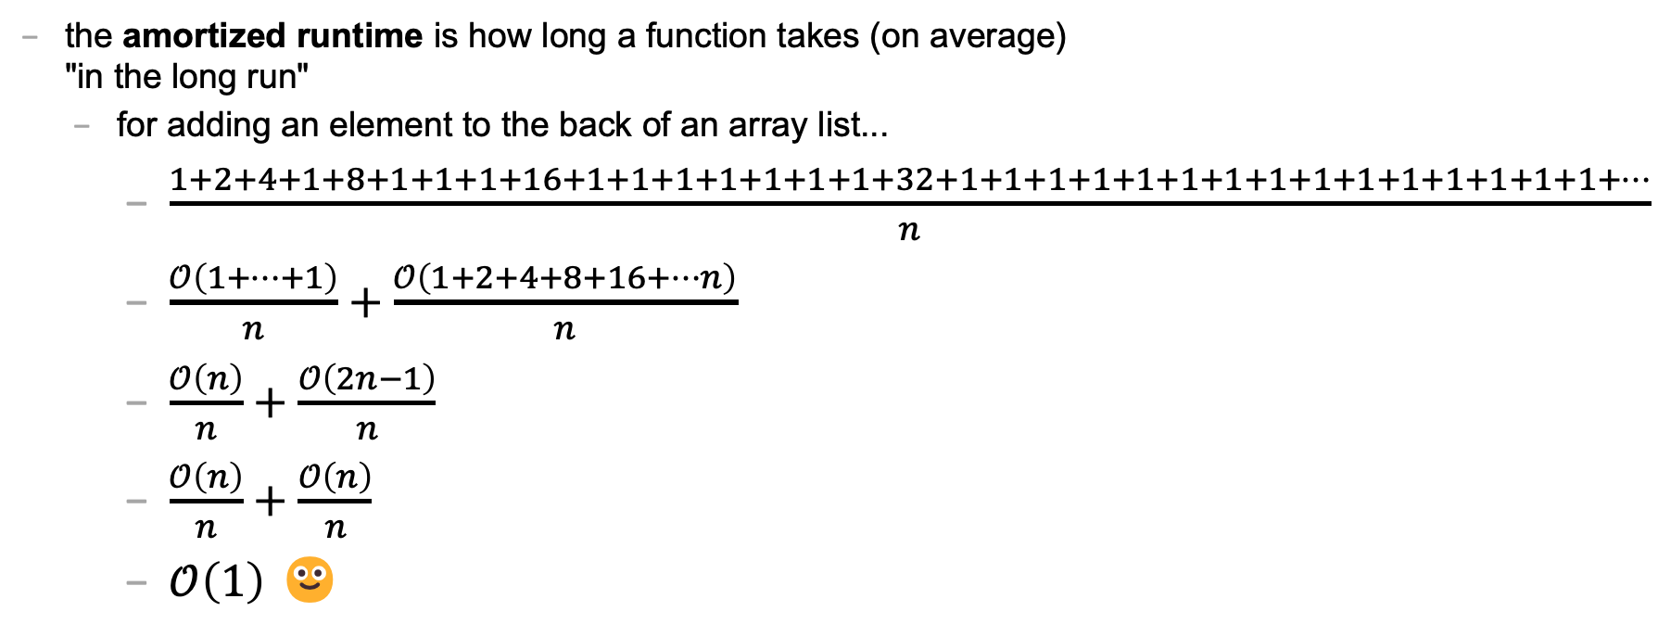
amortized
the amortized runtime is how long a function takes (on average) "in the long run"
for adding an element to the back of an array list...
$\frac{1+2+4+1+8+1+1+1+16+1+1+1+1+1+1+1+32+1+1+1+1+1+1+1+1+1+1+1+1+1+1+1+…}{n}$
$\frac{𝒪\left(1+…+1\right)}{n}+\frac{𝒪\left(1+2+4+8+16+…n\right)}{n}$
$\frac{𝒪\left(n\right)}{n}+\frac{𝒪\left(2n−1\right)}{n}$
$\frac{𝒪\left(n\right)}{n}+\frac{𝒪\left(n\right)}{n}$
$𝒪\left(1\right)$ 🙂

Slide 308
the amortized run time is less "pessimistic" than worst case

Slide 309
the most relevant runtime depends on context 💭 when might worst case be more relevant? 💭 when might amortized be more relevant?

Slide 310
best case and worst case runtime of inserting into the front of an array list

Slide 311

best case and worst cast
the best case of inserting an element into the front of an array list is when the array list's internal array still has at least one "empty slot"
in this case, we have to...
"move over" n elements $𝒪\left(n\right)$
write an element to an array + $𝒪\left(1\right)$
increment a counter + $𝒪\left(1\right)$
the worst case of inserting an element into the front of an array list is when the array list's internal array is full
in this case, we have to...
allocate an array of $2n$elements $𝒪\left(n\right)$
copy of over $n$elements + $𝒪\left(n\right)$
write an element to an array + $𝒪\left(1\right)$
increment a counter + $𝒪\left(1\right)$

Slide 312
lesson?: sometimes best case and worst case are the same

Slide 313
deleting while iterating backwards, grugbrain, comments (including stb), Vim, Kahoot! (including Jim's unpublished Kahoot! op-ed)
choose your own adventure!

Slide 314
https://grugbrain.dev

Slide 315
Week03
TODO: record lecture
Today is...
✨No-Laptop Monday! ✨
🦜🦜🦜
WARMUP
What is a bullet hell?
HW03 preview
functions
classes
HW03 behind the scenes
references
BONUS
Who wrote the game Everyday Shooter?
What is she working on now?
BONUS
What does Touhou 7: Perfect Cherry Blossom's Extra Stage look like? Who wrote this?

Slide 316
but first, something nice

Slide 317
🦉 secret agent owl

Slide 318
🦉 secret agent owl

Slide 319
🦉 secret agent owl

Slide 320
🦉 secret agent owl

Slide 321
HW03 preview 👻

Slide 322
functions

Slide 323
anatomy of a function

Slide 324
anatomy of a function (1/2)
a function is a lil chunk of code you can call from elsewhere
a function takes any number of arguments
... foo(int arg) { ... } // function foo takes an int
a function with a non-void return type must return a value of that type
int bar(...) { ... } // bar returns an int
void baz(...) { ... } // baz doesn't return anything
ReturnType functionName(ArgumentOneType argumentOne, ...) {
...
}

Slide 325
anatomy of a function (2/2)
void drawLine(
double a_x,
double a_y,
double b_x,
double b_y,
Color color) {
...
}

Slide 326
return

Slide 327
return (1/2)
a return statement stops execution of a function and returns the program to where the function was called
some return statements return a value
return 123;
others do not
return;
✨ this can be used to stop running a void-returning function in the middle

Slide 328
return (2/2)
a function with a non-void return type must return a value of that type, regardless of the path taken through the function
Error: missing return statement
static boolean isEven(int n) {
if (n % 2 == 0) {
return true;
}
}

Slide 329
return (2/2)
a function with a non-void return type must return a value of that type, regardless of the path taken through the function
static boolean isEven(int n) {
if (n % 2 == 0) {
return true;
} return false;
}

Slide 330
return (3/2)
a function with a non-void return type must return a value of that type, regardless of the path taken through the function
static boolean isEven(int n) {
return (n % 2 == 0);
}

Slide 331
return (3/2)
a function with a non-void return type must return a value of that type, regardless of the path taken through the function

Slide 332
return (2/2)
a function with a non-void return type must return a value of that type, regardless of the path taken through the function
Error: missing return statement
static boolean isPrime(int n) {
if (n <= 1) { return false; }
for (int i = 2; i <= SQRT(n); ++i) {
if (n % i == 0) { return false; }
}
}

Slide 333
return (2/2)
a function with a non-void return type must return a value of that type, regardless of the path taken through the function
static boolean isPrime(int n) {
if (n <= 1) { return false; }
for (int i = 2; i <= SQRT(n); ++i) {
if (n % i == 0) { return false; }
}
return true;
}

Slide 334
void

Slide 335
void
void is a special return type meaning a function does not return a value
void functions often modify (the objects referenced by) their arguments
static void inPlaceReverse(int[] array) { ... }
// no need to return a reference to array // (user of the function already has one)
in Java, the main method is a void function (it doesn't return anything)
public static void main(String[] arguments) { ... }

Slide 336
the call stack

Slide 337

the call stack
functions can call other functions
the resulting "stack" of function calls is called the call stack
class Main {
static void snap() {
crackle();
}
static void crackle() {
pop();
}
static void pop() {
return;
}
public static void main(String[] arguments) {
snap();
}
}

Slide 338
🤔

Slide 339
[let's see what Eclipse does]

Slide 340
recursion

Slide 341
recursion (1/2)
a recursive function is a function that calls itself
each call must make progress towards a base case (when the function finally returns without calling itself)
✨ when in doubt, try something like zero for your base case
class Main extends Cow {
static int digitSum(int n) {
if (n == 0) {
return 0;
}
return digitSum(n / 10) + (n % 10);
}
public static void main(String[] arguments) {
PRINT(digitSum(256)); // 13
}
}

Slide 342
static int digitSum(int n) {
if (n == 0) {
return 0;
}
return digitSum(n / 10) + (n % 10);
}
return 0;
return digitSum(0) + 2;
return digitSum(2) + 5;
return digitSum(25) + 6;
int a = digitSum(256);

Slide 343
static int digitSum(int n) {
if (n == 0) {
return 0;
}
return digitSum(n / 10) + (n % 10);
}
return 0;
return digitSum(0) + 2;
return digitSum(2) + 5;
return digitSum(25) + 6;
int a = digitSum(256);

Slide 344
static int digitSum(int n) {
if (n == 0) {
return 0;
}
return digitSum(n / 10) + (n % 10);
}
return 0 + 2;
return digitSum(2) + 5;
return digitSum(25) + 6;
int a = digitSum(256);

Slide 345
static int digitSum(int n) {
if (n == 0) {
return 0;
}
return digitSum(n / 10) + (n % 10);
}
return 2;
return digitSum(2) + 5;
return digitSum(25) + 6;
int a = digitSum(256);

Slide 346
static int digitSum(int n) {
if (n == 0) {
return 0;
}
return digitSum(n / 10) + (n % 10);
}
return 2;
return digitSum(2) + 5;
return digitSum(25) + 6;
int a = digitSum(256);

Slide 347
static int digitSum(int n) {
if (n == 0) {
return 0;
}
return digitSum(n / 10) + (n % 10);
}
return 2 + 5;
return digitSum(25) + 6;
int a = digitSum(256);

Slide 348
static int digitSum(int n) {
if (n == 0) {
return 0;
}
return digitSum(n / 10) + (n % 10);
}
return 7;
return digitSum(25) + 6;
int a = digitSum(256);

Slide 349
static int digitSum(int n) {
if (n == 0) {
return 0;
}
return digitSum(n / 10) + (n % 10);
}
return 7;
return digitSum(25) + 6;
int a = digitSum(256);

Slide 350
static int digitSum(int n) {
if (n == 0) {
return 0;
}
return digitSum(n / 10) + (n % 10);
}
return 7 + 6;
int a = digitSum(256);

Slide 351
static int digitSum(int n) {
if (n == 0) {
return 0;
}
return digitSum(n / 10) + (n % 10);
}
return 13;
int a = digitSum(256);

Slide 352
static int digitSum(int n) {
if (n == 0) {
return 0;
}
return digitSum(n / 10) + (n % 10);
}
return 13;
int a = digitSum(256);

Slide 353
static int digitSum(int n) {
if (n == 0) {
return 0;
}
return digitSum(n / 10) + (n % 10);
}
int a = 13;

Slide 354
fin.

Slide 355
recursion (2/2)
a stack overflow error happens when functions call too many functions without returning; these errors are usually caused by broken recursive code
class Main {
static void stackOverflow() {
stackOverflow();
}
public static void main(String[] arguments) {
stackOverflow();
}
}
java.lang.StackOverflowError
at Main.stackOverflow(Tmp.java:3)
at Main.stackOverflow(Tmp.java:3)
at Main.stackOverflow(Tmp.java:3)
at Main.stackOverflow(Tmp.java:3)
at Main.stackOverflow(Tmp.java:3)
at Main.stackOverflow(Tmp.java:3)
at Main.stackOverflow(Tmp.java:3)
at Main.stackOverflow(Tmp.java:3)
at Main.stackOverflow(Tmp.java:3)
at Main.stackOverflow(Tmp.java:3)
at Main.stackOverflow(Tmp.java:3)
at Main.stackOverflow(Tmp.java:3)
at Main.stackOverflow(Tmp.java:3)
at Main.stackOverflow(Tmp.java:3)
at Main.stackOverflow(Tmp.java:3)
at Main.stackOverflow(Tmp.java:3)
at Main.stackOverflow(Tmp.java:3)
at Main.stackOverflow(Tmp.java:3)
at Main.stackOverflow(Tmp.java:3)
at Main.stackOverflow(Tmp.java:3)
at Main.stackOverflow(Tmp.java:3)
at Main.stackOverflow(Tmp.java:3)
at Main.stackOverflow(Tmp.java:3)
at Main.stackOverflow(Tmp.java:3)
at Main.stackOverflow(Tmp.java:3)
at Main.stackOverflow(Tmp.java:3)
at Main.stackOverflow(Tmp.java:3)
at Main.stackOverflow(Tmp.java:3)
at Main.stackOverflow(Tmp.java:3)
at Main.stackOverflow(Tmp.java:3)
at Main.stackOverflow(Tmp.java:3)
at Main.stackOverflow(Tmp.java:3)
at Main.stackOverflow(Tmp.java:3)
at Main.stackOverflow(Tmp.java:3)
at Main.stackOverflow(Tmp.java:3)
at Main.stackOverflow(Tmp.java:3)
at Main.stackOverflow(Tmp.java:3)
at Main.stackOverflow(Tmp.java:3)
at Main.stackOverflow(Tmp.java:3)
at Main.stackOverflow(Tmp.java:3)
at Main.stackOverflow(Tmp.java:3)
at Main.stackOverflow(Tmp.java:3)
at Main.stackOverflow(Tmp.java:3)
at Main.stackOverflow(Tmp.java:3)
at Main.stackOverflow(Tmp.java:3)
at Main.stackOverflow(Tmp.java:3)
at Main.stackOverflow(Tmp.java:3)
at Main.stackOverflow(Tmp.java:3)
at Main.stackOverflow(Tmp.java:3)
at Main.stackOverflow(Tmp.java:3)
at Main.stackOverflow(Tmp.java:3)
at Main.stackOverflow(Tmp.java:3)
at Main.stackOverflow(Tmp.java:3)
at Main.stackOverflow(Tmp.java:3)
at Main.stackOverflow(Tmp.java:3)
at Main.stackOverflow(Tmp.java:3)
at Main.stackOverflow(Tmp.java:3)
at Main.stackOverflow(Tmp.java:3)
at Main.stackOverflow(Tmp.java:3)
at Main.stackOverflow(Tmp.java:3)
at Main.stackOverflow(Tmp.java:3)
at Main.stackOverflow(Tmp.java:3)
at Main.stackOverflow(Tmp.java:3)
at Main.stackOverflow(Tmp.java:3)
at Main.stackOverflow(Tmp.java:3)
at Main.stackOverflow(Tmp.java:3)

Slide 356


Slide 357
classes

Slide 358
anatomy of a class

Slide 359
anatomy of a class (1/2)
class ClassName {
VariableOneType variableOne;
...
FunctionOneReturnType functionOneName(...) { ... }
...
}
a class lets you bundle together data and functions
a class may have any number of variables (fields)
int foo; // objects of this class have an int called foo
a class may have any number of functions (methods)
int bar() { ... } // objects of class have function bar

Slide 360
anatomy of a class (2/2)
class Thing {
// instance variables
double x;
double y;
Color color;
double radius;
// instance methods
void draw() { ... }
...
}

Slide 361
dot

Slide 362
dot
the dot operator is used to access an object's variables and functions
Thing thing = new Thing();
thing.x = 3.0;
thing.y = 4.0;
thing.draw();

Slide 363
terminology

Slide 364
class vs. object (instance of a class)
a class is NOT the same thing as an object
a class is "a blueprint for making objects"
we can make an instance of a class (an object) using the new keyword
this is called "instantiating the class"
Thing thing = new Thing();

Slide 365
[off the record note on OOP (Object Oriented Programming) terminology]

Slide 366
new and constructors

Slide 367
new
the new keyword create a new instance of a class and calls its appropriate constructor
int[] array = new int[5]; // { 0, 0, 0, 0, 0 }
Color color = new Color(1.0, 0.0, 0.0); // (1.0, 0.0, 0.0)
☠️ you don't need new to create a new string
String string = "strings are their own thing";
☠️ you don't need new to create a new array when using {} syntax
int[] array = { 1, 2, 3 };
☠️ new doesn't actually return the object it created; it returns a reference to the object

Slide 368
constructors (1/2)
a constructor is called when an object is created
if the class does not have a constructor, then the default constructor must be called, which takes no arguments and sets all variables to zero
Color color = new Color(); // (0.0, 0.0, 0.0)

Slide 369
constructors (2/2)
a (non-default) constructor is never necessary, but is often convenient
Color color = new Color(1.0, 1.0, 1.0); // (r=1.0, g=1.0, b=1.0)
Color color = new Color(); // (0.0, 0.0, 0.0)
color.r = 1.0; // (1.0, 0.0, 0.0)
color.g = 1.0; // (1.0, 1.0, 0.0)
color.b = 1.0; // (1.0, 1.0, 1.0)

Slide 370
this 🐍 in Python, this is self

Slide 371
this
this is a reference to the instance of the class whose function we're inside of
✨ especially useful inside a constructor
class Color {
...
void shade() {
this.r /= 2;
this.g /= 2;
this.b /= 2;
}
Color(double r, double g, double b) { // constructor
this.r = r;
this.g = g;
this.b = b;
}
}

Slide 372

Week03b
Today is...
Wednesday!
(136 is a rollercoaster
that only goes up)
TODO: record lecture
🦜🦜🦜
HW03 preview
functions
classes (not quite done)
memory FUNdaMENTALs
the stack and the heap
passing arguments to functions
WARMUP
what is 42 in hex?

Slide 373
static (wrapping up last lecture)

Slide 374
static variables and static methods

Slide 375
instance variables vs static variables
an instance variable is part of an instance of a class
a static variable (class variable) is part of the class itself
there is only one, period. (it's a global variable that lives "on the class")
class Thing {
int type;
static int TYPE_BULLET = 1;
...
}
// Thing thing = new Thing();
// thing.type = Thing.TYPE_BULLET;

Slide 376
instance methods vs static methods
an instance method must be called on an instance (object) of a class
a static method (class method) can be called on the class itself
✅ there is no this in a static method
class Thing {
void draw() { ... }; // (non-static method)
static boolean collisionCheck(Thing a, Thing b) { ... }
...
}
// Thing a, b;
// a.draw();
// if (Thing.collisionCheck(...)) { ... }

Slide 377
and now... today's lecture!

Slide 378
☠️ this is the hardest lecture in 136

Slide 379
but learning this stuff is very worth 🙂👍 note: you will likely need to review this lecture a few times (i am sure you will all do this)

Slide 380
but learning this stuff is very worth 🙂👍 note: you will likely need to review this lecture a few times (i am sure you will all do this)

Slide 381
but learning this stuff is very worth 🙂👍 note: you will likely need to review this lecture a few times (i am sure you will all do this)

Slide 382
but learning this stuff is very worth 🙂👍 note: you will likely need to review this lecture a few times (i am sure you will all do this 🥲)

Slide 383
note: i am intentionally breaking these examples into many steps to teach you about memory don't actually code this way! int foo = 7; // <-- Good!

Slide 384
memory FUNdaMENTALs

Slide 385
the two kinds of variables in Java

Slide 386
a variable in Java is either... a primitive or a reference to an Object

Slide 387
primitives (review)

Slide 388
primitive types
in this class, "a variable being a primitive" means that the variable is a boolean, char, double, or int
primitive types are simple
primitive types are small
primitive types are NOT Objects
we will talk about Objects later
examples of Objects: String, MyCoolClass, int[] (array of ints)

Slide 389
boolean, char, double, int
a boolean stores a truth value
true, false
a char stores a character
'\0', 'a', 'Z', '!', '\n'
a double stores a real number
0.0, -0.5, 3.1415926, Double.NEGATIVE_INFINITY
an int stores an integer
0, -1, 4

Slide 390
primitives
some examples of primitives
int a; // a is an int
boolean b; // b is a boolean
char c; // c is a char

Slide 391
references to Objects

Slide 392
references (1/2)
we interact with Object's through references
String string; // string is a reference to a String object
Color color; // color is a reference to a Color object
int[] array; // array is a reference to an int array

Slide 393
references (2/2)
a reference is a memory address ("where the object lives in memory")
a memory address is an integer
a memory address is often written in hexadecimal (hex, base-16, 0...9A...F)
Thing a = new Thing();
// ^ refers to a Thing object at memory address 0x70f806418

Slide 394
null

Slide 395
null (1/2)
a null reference refers to nothing
the actual memory address referred to by null is zero (0x00... in hex)
Thing b = null;
// ^ refers to nothing (memory address 0x000000000)

Slide 396
null (2/2)
Thing[] pool = new Thing[7];
// ^ refers to a Thing[] object at memory address 0x70f805b68
//
// NOTE: the Thing array referred to by pool has 7 entries,
// all zero-initialized (null; memory address 0x000000000)
pool[0] = new Thing();
// pool[0] now refers to a Thing object at memory address // 0x70f8079c0

Slide 397
the stack and the heap (where stuff lives)

Slide 398
overview

Slide 399
let's get more specific than saying "variables live in memory" we divide memory into two parts: the stack and the heap

Slide 400
"the stack"
local variable primitives & references to Objects live here
variables undefined (?) by default (will NOT compile if used)
"the heap"
the actual Objects (including arrays and Strings) live here
Objects are cleared to 0 by default

Slide 401
primitives live on the stack

Slide 402
"the stack"
local variable primitives & references to Objects live here
variables undefined (?) by default (will NOT compile if used)
"the heap"
the actual Objects (including arrays and Strings) live here
Objects are cleared to 0 by default

Slide 403
int a;
int b;
a = 3;
b = a;
a = 7;

Slide 404
int a;
int b;
a = 3;
b = a;
a = 7;
a
?

Slide 405
int a;
int b;
a = 3;
b = a;
a = 7;
a
b
?
?

Slide 406
int a;
int b;
a = 3;
b = a;
a = 7;
a
b
3
?

Slide 407
int a;
int b;
a = 3;
b = a;
a = 7;
a
b
3
3

Slide 408
int a;
int b;
a = 3;
b = a;
a = 7;
a
b
7
3

Slide 409
int a;
int b;
a = 3;
b = a;
a = 7;
a
b
7
3

Slide 410
Objects live on the heap (but references to objects live on the stack)

Slide 411
"the stack"
local variable primitives & references to Objects live here
variables undefined (?) by default (will NOT compile if used)
"the heap"
the actual Objects (including arrays and Strings) live here
Objects are cleared to 0 by default

Slide 412
class Thing {
double x;
double y;
}
Thing a;
a = new Thing();
Thing b;
b = a;
a.x = 3.0;
b.y = 4.0;
a = null;

Slide 413
class Thing {
double x;
double y;
}
Thing a;
a = new Thing();
Thing b;
b = a;
a.x = 3.0;
b.y = 4.0;
a = null;
a
?

Slide 414
class Thing {
double x;
double y;
}
Thing a;
a = new Thing();
Thing b;
b = a;
a.x = 3.0;
b.y = 4.0;
a = null;
a
0xb7
.x
.y
0.0
0.0

Slide 415
class Thing {
double x;
double y;
}
Thing a;
a = new Thing();
Thing b;
b = a;
a.x = 3.0;
b.y = 4.0;
a = null;
a
b
0xb7
?
.x
.y
0.0
0.0

Slide 416
class Thing {
double x;
double y;
}
Thing a;
a = new Thing();
Thing b;
b = a;
a.x = 3.0;
b.y = 4.0;
a = null;
a
b
0xb7
0xb7
.x
.y
0.0
0.0

Slide 417
class Thing {
double x;
double y;
}
Thing a;
a = new Thing();
Thing b;
b = a;
a.x = 3.0;
b.y = 4.0;
a = null;
a
b
0xb7
0xb7
.x
.y
3.0
0.0

Slide 418
class Thing {
double x;
double y;
}
Thing a;
a = new Thing();
Thing b;
b = a;
a.x = 3.0;
b.y = 4.0;
a = null;
a
b
0xb7
0xb7
.x
.y
3.0
4.0

Slide 419
class Thing {
double x;
double y;
}
Thing a;
a = new Thing();
Thing b;
b = a;
a.x = 3.0;
b.y = 4.0;
a = null;
a
b
0x00
0xb7
.x
.y
3.0
4.0

Slide 420
class Thing {
double x;
double y;
}
Thing a;
a = new Thing();
Thing b;
b = a;
a.x = 3.0;
b.y = 4.0;
a = null;
a
b
0x00
0xb7
.x
.y
3.0
4.0

Slide 421
stack variables disappear when they leave scope Objects are garbage collected when nothing refers to them anymore

Slide 422
"the stack"
local variable primitives & references to Objects live here
variables undefined (?) by default (will NOT compile if used)
"the heap"
the actual Objects (including arrays and Strings) live here
Objects are cleared to 0 by default

Slide 423
{
int a;
a = 7;
}
{
int[] b;
b = new int[5];
b[4] = 8;
}

Slide 424
{
int a;
a = 7;
}
{
int[] b;
b = new int[5];
b[4] = 8;
}

Slide 425
{
int a;
a = 7;
}
{
int[] b;
b = new int[5];
b[4] = 8;
}
a
?

Slide 426
{
int a;
a = 7;
}
{
int[] b;
b = new int[5];
b[4] = 8;
}
a
7

Slide 427
{
int a;
a = 7;
}
{
int[] b;
b = new int[5];
b[4] = 8;
}
a
7

Slide 428
{
int a;
a = 7;
}
{
int[] b;
b = new int[5];
b[4] = 8;
}

Slide 429
{
int a;
a = 7;
}
{
int[] b;
b = new int[5];
b[4] = 8;
}

Slide 430
{
int a;
a = 7;
}
{
int[] b;
b = new int[5];
b[4] = 8;
}
b
?

Slide 431
{
int a;
a = 7;
}
{
int[] b;
b = new int[5];
b[4] = 8;
}
b
0xb7
[0]
[1]
[2]
[3]
[4]
0
0
0
0
0

Slide 432
{
int a;
a = 7;
}
{
int[] b;
b = new int[5];
b[4] = 8;
}
b
0xb7
[0]
[1]
[2]
[3]
[4]
0
0
0
0
8

Slide 433
{
int a;
a = 7;
}
{
int[] b;
b = new int[5];
b[4] = 8;
}
b
0xb7
[0]
[1]
[2]
[3]
[4]
0
0
0
0
8

Slide 434
{
int a;
a = 7;
}
{
int[] b;
b = new int[5];
b[4] = 8;
}
0
0
0
0
8

Slide 435
{
int a;
a = 7;
}
{
int[] b;
b = new int[5];
b[4] = 8;
}
0
0
0
0
8
🚛

Slide 436
garbage collector

Slide 437
garbage collector
the garbage collector is like a trash truck that drives around in the heap; when it notices an object that your program no longer has any references to, it frees up that memory for future use
🌊 C does NOT have a garbage collector; in C you free heap-allocated memory yourself by calling free(...)

Slide 438
[review all examples at least one more time]

Slide 439
passing arguments to functions

Slide 440
arguments to functions are passed by value (a copy of the) value of the primitive or (a copy of the) value of the reference

Slide 441
primitives are passed by value

Slide 442
void foo(int a) {
a = 8;
}
void main() {
int a = 7;
foo(a);
}

Slide 443
void foo(int a) {
a = 8;
}
void main() {
int a = 7;
foo(a);
}
main

Slide 444
void foo(int a) {
a = 8;
}
void main() {
int a = 7;
foo(a);
}
a
main
7

Slide 445
void foo(int a) {
a = 8;
}
void main() {
int a = 7;
foo(a);
}
foo
a
main
7

Slide 446
void foo(int a) {
a = 8;
}
void main() {
int a = 7;
foo(a);
}
a
foo
a
main
7
7

Slide 447
void foo(int b) {
b = 8;
}
void main() {
int a = 7;
foo(a);
}
b
foo
a
main
7
7

Slide 448
void foo(int a) {
a = 8;
}
void main() {
int a = 7;
foo(a);
}
a
foo
a
main
7
7

Slide 449
void foo(int a) {
a = 8;
}
void main() {
int a = 7;
foo(a);
}
a
foo
a
main
8
7

Slide 450
void foo(int a) {
a = 8;
}
void main() {
int a = 7;
foo(a);
}
a
foo
a
main
8
7

Slide 451
void foo(int a) {
a = 8;
}
void main() {
int a = 7;
foo(a);
}
a
main
7

Slide 452
void foo(int a) {
a = 8;
}
void main() {
int a = 7;
foo(a);
}
a
main
7

Slide 453
void foo(int a) {
a = 8;
}
void main() {
int a = 7;
foo(a);
}

Slide 454
references are also passed by value

Slide 455
void foo(Thing a) {
a.y = 4.0;
a = null;
}
void main() {
Thing a;
a = new Thing();
a.x = 3.0;
foo(a);
a.y = 5.0;
}

Slide 456
void foo(Thing a) {
a.y = 4.0;
a = null;
}
void main() {
Thing a;
a = new Thing();
a.x = 3.0;
foo(a);
a.y = 5.0;
}
main

Slide 457
void foo(Thing a) {
a.y = 4.0;
a = null;
}
void main() {
Thing a;
a = new Thing();
a.x = 3.0;
foo(a);
a.y = 5.0;
}
a
main
?

Slide 458
void foo(Thing a) {
a.y = 4.0;
a = null;
}
void main() {
Thing a;
a = new Thing();
a.x = 3.0;
foo(a);
a.y = 5.0;
}
a
main
0xb7
.x
.y
0.0
0.0

Slide 459
void foo(Thing a) {
a.y = 4.0;
a = null;
}
void main() {
Thing a;
a = new Thing();
a.x = 3.0;
foo(a);
a.y = 5.0;
}
a
main
0xb7
.x
.y
3.0
0.0

Slide 460
void foo(Thing a) {
a.y = 4.0;
a = null;
}
void main() {
Thing a;
a = new Thing();
a.x = 3.0;
foo(a);
a.y = 5.0;
}
foo
a
main
0xb7
.x
.y
3.0
0.0

Slide 461
void foo(Thing a) {
a.y = 4.0;
a = null;
}
void main() {
Thing a;
a = new Thing();
a.x = 3.0;
foo(a);
a.y = 5.0;
}
foo
a
a
main
0xb7
0xb7
.x
.y
3.0
0.0

Slide 462
void foo(Thing a) {
a.y = 4.0;
a = null;
}
void main() {
Thing a;
a = new Thing();
a.x = 3.0;
foo(a);
a.y = 5.0;
}
foo
a
a
main
0xb7
0xb7
.x
.y
3.0
4.0

Slide 463
void foo(Thing a) {
a.y = 4.0;
a = null;
}
void main() {
Thing a;
a = new Thing();
a.x = 3.0;
foo(a);
a.y = 5.0;
}
foo
a
a
main
0x00
0xb7
.x
.y
3.0
4.0

Slide 464
void foo(Thing a) {
a.y = 4.0;
a = null;
}
void main() {
Thing a;
a = new Thing();
a.x = 3.0;
foo(a);
a.y = 5.0;
}
foo
a
a
main
0x00
0xb7
.x
.y
3.0
4.0

Slide 465
void foo(Thing a) {
a.y = 4.0;
a = null;
}
void main() {
Thing a;
a = new Thing();
a.x = 3.0;
foo(a);
a.y = 5.0;
}
a
main
0xb7
.x
.y
3.0
4.0

Slide 466
void foo(Thing a) {
a.y = 4.0;
a = null;
}
void main() {
Thing a;
a = new Thing();
a.x = 3.0;
foo(a);
a.y = 5.0;
}
a
main
0xb7
.x
.y
3.0
5.0

Slide 467
void foo(Thing a) {
a.y = 4.0;
a = null;
}
void main() {
Thing a;
a = new Thing();
a.x = 3.0;
foo(a);
a.y = 5.0;
}
a
main
0xb7
.x
.y
3.0
5.0

Slide 468
void foo(Thing a) {
a.y = 4.0;
a = null;
}
void main() {
Thing a;
a = new Thing();
a.x = 3.0;
foo(a);
a.y = 5.0;
}
3.0
5.0

Slide 469
void foo(Thing a) {
a.y = 4.0;
a = null;
}
void main() {
Thing a;
a = new Thing();
a.x = 3.0;
foo(a);
a.y = 5.0;
}
3.0
5.0
🚛

Slide 470
Week03c
no Jim office hours today
(i have to catch a train)
🦜
Today is Fun Friday!
🦜
String
HW03 questions
review
WARMUP
what is a string?
🦜
TODO: record lecture

Slide 472


Slide 473


Slide 474


Slide 475
built-in classes (classes that are "built in" to Java)

Slide 476
built-in classes are "special" (they break the rules of other classes in Java)

Slide 477
review: instantiating a class (creating an object)

Slide 478
constructors
// Option A: Use default constructor and initialize using dot
Color color = new Color(); // (r=0.0, g=0.0, b=0.0)
color.r = 1.0; // (r=1.0, g=0.0, b=0.0)
color.g = 1.0; // (r=1.0, g=1.0, b=0.0)
color.b = 1.0; // (r=1.0, g=1.0, b=1.0)
// Option B: Use a custom constructor
Color color = new Color(1.0, 1.0, 1.0); // (r=1.0, g=1.0, b=1.0)

Slide 479
review: array

Slide 480
creating an array (1/2)
you can create a new array by specifying its length inside of square brackets; if you do, the array is zero-initialized (all elements are initially set to zero)
int[] A = new int[8]; // { 0, 0, 0, 0, 0, 0, 0, 0 }
double[] B = new double[1]; // { 0.0 }
boolean[] C = new boolean[2]; // { false, false }
char[] D = new char[4]; // { '\0', '\0', '\0', '\0' }
String[] E = new String[3]; // { null, null, null }

Slide 481
creating an array (2/2)
you can also create a new array by specifying its elements inside of curly braces; if you do, the array's length is the number of elements you specified
int[] array = { 7, 7, 9 }; // new int[3] is implied
NOTE: this syntax can only be used for creation
🙅 NOT okay to do later: array = { 4, 5, 6 };
🙆 OKAY to do later:
array[0] = 4;
array[1] = 5;
array[2] = 6;
boolean[] array = { true };
String[] array = { "hello", "world" };

Slide 482
String

Slide 483
String (1/2)
a String is a sequence of characters
"Hello World", "Foo123"

Slide 484
String (2/2)
you can create a new String by specifying its elements inside of double quotation marks
String string = "Hello";
String has some useful instance methods (see Docs)
PRINT(string.length()); // 5
PRINT(string.charAt(1)); // 'e'
PRINT(string.substring(1, 3)); // "el"

Slide 485
String concatenation (1/2)
+ concatenates two String's
// String foo = "Hello".concat("World"); String foo = "Hello" + "World"; // "HelloWorld"
it also does some conversions for you (very convenient; kind of confusing)
// String foo = "Hello".concat(Integer.toString(2)); String foo = "Hello" + 2; // "Hello2"

Slide 486
String concatenation (2/2)
stringA + foo is the ONLY example of operator overloading in Java
(the * operator just does multiplication)
(the / operator just does division)
...but the + operator does both addition and string concatenation
🐍 Python and 👹C++ let you implement your own operator overloading
(very fun; very confusing)

Slide 487
inside of a String (1/4)
inside of String, there must be a char[]
motivation: as you experienced in HW02, working directly with character arrays is hard / painful
idea: String "wraps up" a char[] into an easy-to-use package

Slide 488
inside of a String (2/4)
if a String is really just a char[]...
...then what does this code actually do? 🧠
String a = "Hello";
String b = "World";
String c = a + b;
PRINT(c);

Slide 489
XStringExample
class XStringExample extends SuperCow {
static class XString {
char[] array;
static XString plus(XString a, XString b) {
XString result = new XString();
// allocates new array that's the sum of both lengths
// O(n) runtime
result.array = new char[a.array.length + b.array.length];
// copies over a
// O(n)
for (int i = 0; i < a.array.length; ++i) { // O(n)
result.array[i] = a.array[i]; // O(1)
}
// copies over b
// O(n)
for (int i = 0; i < b.array.length; ++i) {
result.array[a.array.length + i] = b.array[i];
}
// returning result
// O(1)
return result;
}
}
public static void main(String[] arguments) {
XString a = new XString();
a.array = new char[6];
a.array[0] = 'H';
a.array[1] = 'e';
a.array[2] = 'l';
a.array[3] = 'l';
a.array[4] = 'l';
a.array[5] = 'o';
XString b = new XString();
b.array = new char[5];
b.array[0] = 'W';
b.array[1] = 'o';
b.array[2] = 'r';
b.array[3] = 'l';
b.array[4] = 'd';
XString c = XString.plus(a, b);
PRINT(a.array);
PRINT(b.array);
PRINT(c.array);
}
}

Slide 490
inside of a String (3/4)
if a String is really just a char[]...
...then what does this code actually do? 🧠
.. how many char[]'s are created?
String a = "Hello";
String b = " ";
String c = "World";
String d = "!";
String e = a + b + c + d;
PRINT(e);

Slide 491
interlude
if a String is really just a char[]...
...then what does this code do?
...what is this code's big O runtime? 🧠
int foo = 0;
for (int i = 0; i < n; ++i) { // O(n)
foo += 1; // * O(1)
}
PRINT(foo);

Slide 492
inside a String (4/4)
if a String is really just a char[]...
...then what does this code do?
...what is its big O runtime? 🧠
String scream = "";
for (int i = 0; i < n; ++i) {
scream += "A";
}
PRINT(scream);

Slide 493
questions on HW03?

Slide 494
pool[i] inside of specific updates (don't define enemy1 and enemy2)

Slide 495
why i gave you a player reference

Slide 496
this inside of fireBullet

Slide 497
☕️ the art of coding things in the right order compile and run early, compile and run often

Slide 498
well, let us imagine...

Slide 499

let's imagine...
...you decide to develop $n$ different things at once...
...and then, finally, you compile and run...
...aaaaand you have a bug! 🐛
so...what is the cause of the bug? what code is broken? 🤔
well...i guess it could be any of the $n$ things you just wrote!
and while $𝒪(n)$ possible sources of bugs might seem bad...

Slide 500
...the reality is ✨so much worse✨!

Slide 501

because broken code likes to interact with other broken code, to make✨super bugs✨!

Slide 503

not broken
broken
developing one thing at a time

Slide 504
not broken
A is broken
B is broken
A and B are both broken
developing two things at a time

Slide 505
not broken
A broken
C broken
A and C broken
A and B broken
B broken
B and C broken
A, B, and C broken
developing three things at a time

Slide 506

asymptotic bug-finding time

Slide 507

$$𝒪(2^{n})$$
gl;hf 🙂👍

Slide 508
big lesson
implement code one thing at a time
compile and run and test after implementing every single thing
figuring out the order to do things in is a learned skill!
sometimes i choose the wrong order...
...and then i usually have to start over 🙂👍

Slide 509
this is a learned skill!

Slide 510


in summary

Slide 511


Week02
TODO: record lecture
🦜
NOTE: Jim has jury duty on thu 🎉
🦜
arrays
array examples
swap
array examples that use swaps
WARMUP
Guess how many arrays we used to make this:
https://youtu.be/dadIdXQMBi4
NOTE: an array is a fixed-length sequence of elements, all the same type

Slide 512
how many arrays?
ARRAYS (not counting tiny arrays of 3 double's, which i use to represent points)
NOTE: Counts are very approximate
==========
strings for loading files >5
huge arrays for drawing random stuff (the floor, etc) 2
random stuff in my cow.cpp library (keyboard state, OpenGL objects, etc.) >20
random global variables 1
building the simulation >6
simulation state 3
simulation itself >20
dragon head mesh 7
dragon body mesh 7
dragon mesh 7
sphere mesh 3
cylinder mesh 3
motor configuration 3
arrays that just move data back and forth between C++ <-> unity 8
inverse kinematics >15
physics >10
----------
definitely at least 100; probably less than 1000

Slide 513
arrays

Slide 514
metaphor

Slide 515
an array is like a very organized person's flower planter - one flower per square - the planter can't change size (it is made of artisinal woods or something)

Slide 516
🌻
🌺
🥀
🌹

Slide 517
mental model of an array

Slide 518
mental model of an array
a fixed number of equally-sized boxes, all right next to each other
the array itself lives "in memory"
1 | 5 | 3 | 2 | 7
int[] foo = new int[5];
foo[0] = 1;
foo[1] = 5;
foo[2] = 3;
foo[3] = 2;
foo[4] = 7;

Slide 519
the array itself lives "in memory"
1 | 5 | 3 | 2 | 7

Slide 520

1 | 5 | 3 | 2 | 7

Slide 521
learn about memory and become a real CS pro a couple important questions to ask yourself: https://www.youtube.com/watch?v=BNtcWpY4YLY

Slide 522
arrays

Slide 523
arrays (1/2)
an array is a fixed-length sequence of elements, all of the same type
"an array of 4372 double's"
"an array of 1 int's"
"an array of 64 Student's"

Slide 524
arrays (2/2)
we will often write an array using curly braces
{ 7, 7, 9 } is an array containing 7, 7, and 9
optionally, you can include a comma after the last element
{ 7, 7, 9, }
☠ even though sets from math also use curly braces, Java arrays have nothing to do with sets; in a set, all elements must be unique; in an array, elements do NOT have to be unique

Slide 525
array operations

Slide 526
array operations

Slide 527
creating an array (1/2)
you can create an array by specifying its length (the number of elements); if you do, the array is zero-initialized (all elements are initially set to zero)
int[] A = new int[8]; // { 0, 0, 0, 0, 0, 0, 0, 0 }
double[] B = new double[1]; // { 0.0 }
boolean[] C = new boolean[2]; // { false, false }
char[] D = new char[4]; // { '\0', '\0', '\0', '\0' }
String[] E = new String[3]; // { null, null, null }
[visualize in Eclipse]

Slide 528
creating an array (2/2)
you can also create an array by specifying its elements; if you do, the array's length is the number of elements you specified
int[] array = { 7, 7, 9 }; // new int[3] is implied
NOTE: this syntax can only be used for creation
🙅 NOT okay to do later: array = { 4, 5, 6 };
🙆 OKAY to do later:
array[0] = 4;
array[1] = 5;
array[2] = 6;
boolean[] array = { true };
String[] array = { "hello", "world" };

Slide 529
getting an array's length
after creating an array, you can get (but not set) its length
int[] array = { 7, 7, 9 };
PRINT(array.length); // 3
int[] array = new int[8];
PRINT(array.length); // 8
Error: cannot assign a value to final variable length
array.length = 42;

Slide 530
getting the value of an element of an array
you can get the value of an element of an array using the square brackets and the index of the element
this is also called "accessing the array"
int[] array = { 3, 4, 5 };
int foo = array[0]; // 3
int[] array = { 3, 4, 5 };
int foo = array[42];
java.lang.ArrayIndexOutOfBoundsException: 42

Slide 531
setting the value of an element of an array
you can set the value of an element of an array using the square brackets and the index of the element
int[] array = { 7, 7, 9 };
array[1] = 8;
// { 7, 8, 9 }
int[] array = { 7, 7, 9 };
array[-1] = 1000;
java.lang.ArrayIndexOutOfBoundsException: -1

Slide 532
☠ printing the elements of an array
☠ in Java, you don't simply call System.out.println(array)
instead, you call System.out.println(Arrays.toString(array));
note: this prints with square brackets instead of curly brackets
🤷‍♂️
or just call PRINT(array);
🐄💖✨
(note: also uses square brackets)

Slide 533
iterating over an array

Slide 534
iterating over an array
a for loop can be used to iterate over an array
for (int i = 0; i < array.length; ++i) {
array[i] = ...;
}

Slide 535
[example in Eclipse]

Slide 536
Week02b
🛌
zzz...
arrays
array examples
swap
array examples that use swaps
WARMUP:
On your computer, write an array deep copy from scratch, including test code.
TODO: record lecture

Slide 537
array examples

Slide 538
example: creating an array of the first 100 non-negative integers

Slide 539
example: creating an array of the first 100 non-negative integers [ 0, 1, ..., 99 ]
class Main extends Cow {
public static void main(String[] arguments) {
int[] array = new int[100];
for (int i = 0; i < array.length; ++i) {
array[i] = i;
}
PRINT(array);
}
}

Slide 540
example: (deep) array copy

Slide 541
example: array copy
class Main extends Cow {
public static void main(String[] arguments) {
int[] source = { 3, 4, 5 };
int[] destination = new int[source.length];
for (int i = 0; i < source.length; ++i) {
destination[i] = source[i];
}
PRINT(source);
PRINT(destination);
}
}

Slide 542
☠ example: bad very bad broken array copy

Slide 543
☠ example: bad very bad broken array copy
class Main extends Cow {
public static void main(String[] arguments) {
int[] source = { 3, 4, 5 };
int[] destination = source;
source[0] = 7;
PRINT(source);
PRINT(destination);
}
}

Slide 544
example: circular array
3, 4, 5, 6, 7, 8, 9, 10, 11,

Slide 545
class Main extends Cow {
public static void main(String[] arguments) {
int nextIndex = 0;
int[] circularArray = new int[5];
for (int dataPoint = 1; dataPoint < 100; ++dataPoint) {
// push dataPoint into the circularArray
circularArray[nextIndex] = dataPoint;
// update nextIndex
nextIndex = (nextIndex + 1) % circularArray.length;
}
}
}

Slide 546
example: finding the index (and value) of an array's maximum element

Slide 547
example: finding the index (and value) of an array's maximum element
import java.util.*;
class Main {
public static void main(String[] arguments) {
double[] array = { 1.0, 3.0, -42.0, 1000.0, 99.0 };
int indexOfMaximumElement = -1;
double valueOfMaximumElement = Double.NEGATIVE_INFINITY;
for (int i = 0; i < array.length; ++i) {
if (array[i] > valueOfMaximumElement) {
indexOfMaximumElement = i;
valueOfMaximumElement = array[i];
}
}
System.out.println("array[" + indexOfMaximumElement + "] = " + valueOfMaximumElement);
}
}

Slide 548
multi-dimensional arrays

Slide 549
multi-dimensional arrays

Slide 550
multi-dimensional arrays (arrays of arrays of ...)
multi-dimensional arrays are sometimes really handy
int[][] array = { { 3, 4 }, { 5, 6 }, { 7, 8 } };
PRINT(array);
// [[3, 4], [5, 6], [7, 8]]
PRINT(array[0][1]); // 4
int[][][] array = new int[2][3][4];
array[0][0][0] = 42;
System.out.println(Arrays.toString(array));
// [[[42, 0, 0, 0], [0, 0, 0, 0], [0, 0, 0, 0]], [[0, 0, 0, 0], [0, 0, 0, 0], [0, 0, 0, 0]]]

Slide 551
Week02c
!
juggling club after colloquium today 🤹
🛌
HW01 is being graded
so far only 1 person followed the TODO's... 🥲
(fix for full points back)
Pre-Lab
Post-Lab
arrays
array examples
swap
array examples that use swaps
big O
WARMUP:
How do we swap two numbers...
...in Java?
...in Python?
...in C using XOR and no temporary?
BONUS:
What is the big O runtime of pressing backspace in your text box (n is buffer.length)
TODO: record lecture

Slide 552
swap

Slide 553
🐍 Python swap

Slide 554
🐍 Python swap
a = 0
b = 1
a, b = b, a # Python swap
# a is now 1
# b is now 0

Slide 555
☠️ BAD VERY BAD BROKEN swap

Slide 556
☠️ BAD VERY BAD BROKEN swap
int a = 0;
int b = 1;
{ // BAD VERY BAD BROKEN swap
a = b; // a <- 1
b = a; // b <- 1
}

Slide 557
swap

Slide 558
swap
int a = 0;
int b = 1;
{ // swap
int tmp = a; // tmp <- 0
a = b; // a <- 1
b = tmp; // b <- 0
}

Slide 559
array algorithms that use swaps

Slide 560
reversing an array

Slide 561
out-of-place reverse
we can reverse an array out-of-place using an additional array
static int[] outOfPlaceReverse(int[] array) {
int[] result = new int[array.length];
for (int i = 0; i < array.length; ++i) {
int j = (array.length - 1) - i;
result[i] = array[j];
}
return result;
}

Slide 562
in-place reverse
we can reverse an array in-place using "swaps" (no additional array)
static void inPlaceReverse(int[] array) {
for (int i = 0; i < array.length / 2; ++i) {
int j = (array.length - 1) - i; // "mirror index"
// swap array[i] <-> array[j]
int tmp = array[i];
array[i] = array[j];
array[j] = tmp;
}
}

Slide 563
bubble sort

Slide 564
bubble sort
bubble sort is a simple in-place sorting algorithm that uses swaps
class Main {
public static void main(String[] arguments) {
int[] array = { 2, 4, 1, 6, 0, 3, 5 };
boolean arrayIsSorted;
do {
arrayIsSorted = true;
for (int i = 0; i < array.length - 1; ++i) {
if (array[i] > array[i + 1]) {
arrayIsSorted = false;
// swap
int tmp = array[i];
array[i] = array[i + 1];
array[i + 1] = tmp;
}
}
} while (!arrayIsSorted);
PRINT(array);
}
}

Slide 565
bubble sort
bubble sort is a simple in-place sorting algorithm that uses swaps
boolean arrayIsSorted;
do {
arrayIsSorted = true;
for (int i = 0; i < array.length - 1; ++i) {
if (array[i] > array[i + 1]) {
arrayIsSorted = false;
// swap
int tmp = array[i];
array[i] = array[i + 1];
array[i + 1] = tmp;
}
}
} while (!arrayIsSorted);

Slide 566
big O

Slide 567
big O (math)

Slide 568

big O (1/2)
big O describes a function’s “limiting behavior”
to find a mathematical function’s big O notation...
1. throw away the coefficients
2. find the fastest growing term
3. the function is $𝒪($FASTEST_GROWING_TERM$)$
e.g., $f\left(n\right)=7n^{2}+100n+4732$
1. throw away coefficients to get $n^{2}+n+1$
2. fastest growing term is $n^{2}$
3. $f\left(n\right)$ is $𝒪(n^{2})$

Slide 569


big O (2/2)
what is $f\left(n\right)=77n^{7}+2^{n}$ in big O notation?
$n^{7}+2^{n}$
$2^{n}$ 🧪 is this true?
$𝒪(2^{n})$
what is $f\left(n\right)=100$ in big O notation?
$1$
$1$ 🧠 what does this mean?
$𝒪(1)$
what is $f\left(n\right)=n+log⁡(n)$ in big O notation?
$n+log⁡(n)$
$n$ 🧪 is this true?
$𝒪(n)$

Slide 570
logarithmic growth is the inverse of exponential growth

Slide 571
y = 2^{x}
🧠 solve for x.

Slide 572
y = 2^{x} x = log₂ y

Slide 573

y = 2^{x} x = log₂ y
y
x

Slide 574
y = 2^{x} x = log₂ y
y
x

Slide 575
big O runtime (arrays)

Slide 576

runtime of array operations
arrays are fast!
⏱️ creating an array takes $𝒪(n)$ time, where $n$ is the length of the array
⏱️ getting the value of the i-th element of an array takes $𝒪(1)$ time
⏱️ setting the value of the i-th element of an array takes $𝒪(1)$ time

Slide 577

accessing an array "under the hood"
how Java does array[4], step-by-step:
start at the head (0-th element) of the array 🟦⬛⬛⬛⬛⬛⬛⬛
move over 4 slots (using an $𝒪(1)$ "add") ⬛⬛⬛⬛🟦⬛⬛⬛
return the value of the element in that slot ⬛⬛⬛⬛🟨⬛⬛⬛
we can't actually see Java do this (it's too "low level")
but we *can* see C do it! (stay tuned 🙂)

Slide 578
big O runtime (code)

Slide 579

big-O runtime (1/3)
big-O runtime (running time, time complexity) gives us a big-picture idea of how long a function will take to run (execute, finish)
a function that operates on $n$ things, could be...
$𝒪(1)$ (constant time) 😀 FAST
$𝒪(\log_{2}{n})$ (logarithmic time, log time) 🙂 fast
$𝒪(n)$ (linear time) 😐 meh
$𝒪(n^{2})$ (quadratic time) ☹️ slow
$𝒪(2^{n})$ (exponential time) 😦 SLOW

Slide 580

big O runtime (2/3)
big O runtime is how much time it takes code to run (in the worst case)
time is measured in the number of $𝒪\left(1\right)$(constant time) operations
examples of $𝒪\left(1\right)$ operations:
a + b
c && d
!e
f = g
a += b // NOTE: O(1) + O(1) = O(1)
array[i]

Slide 581

big O runtime (3/3)
example of $𝒪\left(n\right)$ algorithms:
create new array of length n (NOTE: this is a definition)
print array of length n
deep copy array of length n
in-place reverse array of length n
examples of $𝒪\left(n^{2}\right)$ algorithms:
bubble sort array of length n

Slide 582
fun examples

Slide 583


Caaaaaaaaaaaarl
e.g., Imagine a classroom with $n$ students. I want to figure out if any students are named Carl.
I need an ✨Algorithm✨ -- boolean isAnyoneNamedCarl(Student[] students);
What is the big O of the following algorithms?
Algorithm 1: Ask each student, one at a time, “Are you named Carl?”
Algorithm 2: Pass a paper around the room, and have each student write their name on it. Then take the paper, and read through it.
Algorithm 3: The students draw straws one at a time. The student who draws the short straw must leave. On their way out of the room, ask them whether their name is Carl. Repeat this procedure until the room is empty.
Algorithm 4: Play Kahoot. The winner legally changes their name to Carl.

Slide 584
textbox examples

Slide 585
let's say n equals buffer.length

Slide 586
what's the big O of pressing →?

Slide 587
what's the big O of pressing A?

Slide 588
💻 array tutorial

Slide 589
💻 array tutorial

Slide 590
💻 array tutorial
// 🟢 ([5, 4, 7, 0, 7], 7) -> 2
// 🟢 ([5, 4, 7, 0, 7], 3) -> -1
static int findFirstIndexOf(int[] array, int value);
// 🟦 ([1, 3, 3, 2, 3, 4], 3) -> [1, 2, 4]
static int[] removeAllOccurences(int[] array, int value);
// ♦️ [[1, 3], [2, 4, 5], [0, 5]] -> [0, 1, 2, 3, 4, 5, 5]
static int[] mergeArrayOfSortedArrays(int[][] arrays);

Slide 591
Week01
🦜
tips and tricks
operators
control flow
Cow.Java
WARMUP
foo = (2 * 5.0) - 1.0;
what type is foo?
what value is foo?
bar = (3 > foo);
what type is bar?
what value is bar?
char baz = 'A' + ('7' - '5');
what value is baz?

Slide 592
tips and tricks

Slide 593
"hot code replace failed" Eclipse message

Slide 594

if you've been getting this error a bunch...

Slide 595

make sure you are pressing this button after every crash / failed assert (otherwise Eclipse keeps your program running, and will try to "hot swap" your changes into it)

Slide 596
you can also press this button (which, for us, does basically the same thing)

Slide 597
you can also just close Eclipse and reopen it if anything really weird happens 🤷

Slide 598
how to email jim

Slide 599
first, how to email not-jim
Subject Line: Question Regarding The Reading
Email Body:
Dear Prof. Dr. Professorson Ph.D Exquire,
I hope you are having a wonderful afternoon; that the morning sun is shining upon you this fine evening, and that you do not feel the quiet whisper of the all-consuming Void chilling you to your very core.
I am writing because I am unclear on the assigned reading for tomorrow. Your very, very helpful syllabus says to read pages 300 – 500 of Beowulf, however the book is, it seems, much fewer than 500 pages long.
Thank you so much for your help with this matter. I appreciate the time you take in supporting me in my studies—I could not do this without you.
Sincerely,
James Bern
Caltech '15

Slide 600

how to email jim
Subject Line: brew won't install 😡

Slide 601

how to email jim
Subject Line: can't run tic tac toe 😢

Slide 602
this is the fastest way to get your question answered i will not be offended i promise

Slide 603
how to do HW

Slide 604
implement one thing at a time get it working perfectly then, try the next thing

Slide 605

code up the entire homework without ever trying to run it
compile early; compile often

Slide 606

compilers

Slide 607
operators (except for bitwise operators, which we'll do later maybe)

Slide 608
assignment operator

Slide 609
assignment operator
= assigns the value on the right-hand side to the variable on the left-hand side
int i = 0; // 0 ("int i now has the value 0")
double foo = coolFunction();
☠ the assignment operator returns the value it assigned this is usually pretty confusing
boolean b = false;
boolean c = (b = foo());

Slide 610
arithmetic operators

Slide 611
basic arithmetic (number) operators
+ adds two numbers
- subtracts two numbers
* multiplies two numbers
/ divides two numbers
☠ an int divided by an int is an int
int foo = 8 / 2; // 4
int bar = 7 / 2; // 3
Java "throws away the remainder"
- returns the negative of a number
int bar = -7; // -7 ("negative 7" or "minus 7")
int baz = -bar; // 7

Slide 612
modulo
x % y returns the remainder of (x / y) and is read "x modulo y"
int foo = 17 % 5; // 2 ("17 divided by 5 is 3 remainder 2")
☠ % probably doesn't do what you expect for negative numbers; if x can be negative, use MODULO(x, y) instead
5 % 3 // 2
4 % 3 // 1
3 % 3 // 0
2 % 3 // 2
1 % 3 // 1
0 % 3 // 0
-1 % 3 // -1 🤔
MODULO(-1, 3) // 2 🙂👍

Slide 613
modulo

Slide 614
7 % 3
2
R1
3
7
-
6
1

Slide 615
🐍 -7 % 3
☕️ MODULO(-7, 3)
☕️ -7 % 3
-2
R-1
3
-7
-7 - (-6)
= -7 + 6
= -1
+ 3 = 2
-
-6
-1
-1

Slide 616
%
x % y returns the remainder of (x / y) and is read "x modulo y"
int foo = 17 % 5; // 2 ("17 divided by 5 is 3 remainder 2")
☠ % probably doesn't do what you expect for negative numbers; if x can be negative, use Math.floorMod(x, y) instead
5 % 3 // 2
4 % 3 // 1
3 % 3 // 0
2 % 3 // 2
1 % 3 // 1
0 % 3 // 0
-1 % 3 // -1 WAIT WHAT 🤔
MODULO(-1, 3) // 2 🙂👍

Slide 617
MODULO(x, y)
MODULO( 5, 3) // 2
MODULO( 4, 3) // 1
MODULO( 3, 3) // 0
MODULO( 2, 3) // 2
MODULO( 1, 3) // 1
MODULO( 0, 3) // 0
MODULO(-1, 3) // 2
MODULO(-2, 3) // 1
MODULO(-3, 3) // 0
MODULO(-4, 3) // 2
MODULO(-5, 3) // 1
MODULO(-6, 3) // 0
MODULO(-7, 3) // 2

Slide 618
logical operators

Slide 619
logical operators (1/2)
|| returns whether the left-hand side or the right-hand side is true
(true || true) // true
(true || false) // true
(false || true) // true
(false || false) // false
&& returns whether the left-hand side and the right-hand side are true
(true && true) // true
(true && false) // false
(false && true) // false
(false && false) // false
! returns the opposite of a boolean, and is read as "not"
(!true) // false ("not true")
(!false) // true

Slide 620
logical operators (2/2)
// example, step by step
boolean a = (2 + 2 == 5); // false
boolean b = true; // true
boolean c = (a || b); // true
boolean d = !c; // false
// same thing all on one line
boolean d = !((2 + 2 == 5) || true); // false
// equivalent code
boolean d = false;

Slide 621
☠ logical operator short-circuiting
(false && foo()) "lazily" evaluates to false without evaluating foo()
(true || foo()) "lazily" evaluates to true without evaluating foo()

Slide 622
comparison operators

Slide 623
☠ equality (is equal to)
== returns whether the left-hand side is equal to the right-hand side
boolean b = (foo == bar);
if (foo == bar) { ... }
☠ this does NOT work for String's
instead, use (stringA.equals(stringB))
☠ this (usually) does NOT work for double's
instead, use ARE_EQUAL(double1, double2)

Slide 624
is greater than, is less than
> returns whether the left-hand side is greater than the right-hand side
< returns whether the left-hand side is less than the right-hand side

Slide 625
convenient operators (feel free to ignore these for now)

Slide 626
inequality
!= returns whether the left-hand side is not equal to the right-hand side
(left != right) is exactly the same as (!(left == right))

Slide 627
greater than or equal to, less than or equal to
>= returns whether the left-hand side is greater than or equal to the right-hand side
(left >= right) is basically the same as ((left > right) || (left == right)) greater-than or equal
<= returns whether the left-hand side is less than or equal to the right-hand side

Slide 628
arithmetic assignment operators
a += b; // a = a + b;
a -= b; // a = a - b;
a *= b; // a = a * b;
a /= b; // a = a / b;

Slide 629
String concatenation
+ concatenates two String's
// String foo = "Hello".concat("World"); String foo = "Hello" + "World"; // "HelloWorld"
it also does some conversions for you (very convenient, kind of confusing)
// String foo = "Hello".concat(Integer.toString(2)); String foo = "Hello" + 2; // "Hello2"

Slide 630
increment operator
to "increment" means to increase the value of a number by one
i = i + 1;
i += 1;
the pre-increment ++i increments i and returns the new value of i
j = ++i; // i = i + 1;
// j = i;
the post-increment i++ increments i and returns the old value of i
j = i++; // j = i;
// i = i + 1;

Slide 631
decrement operator
to "decrement" means to decrease the value of a number by one
i = i - 1;
i -= 1;
the pre-decrement --i decrements i and returns the new value of i
j = --i; // i = i - 1;
// j = i;
the post-decrement i-- decrements i and returns the old value of i
j = i--; // j = i;
// i = i - 1;

Slide 632
Week01b
🦜
🐝
record lecture
tips and tricks
operators
control flow
Cow.Java
REVIEW
foo = true;
bar = false;
baz = (!(!foo || !bar) && !!foo);
what value is baz?
WARMUP
A) imagine if code didn't have for, while, or functions...
B) imagine if it didn't have if...
could it get the job done?
could it ✨spark joy✨?

Slide 633
control flow

Slide 634
the execution of a Java program starts at the top of main(...) and flows down down down

Slide 635
let's step through this program in our minds, and then in a debugger
class Main extends Cow {
public static void main(String[] arguments) {
double a = 3.0;
double b = 4.0;
double result = SQRT(a * a + b * b);
PRINT(result);
}
}

Slide 636
[visualizing the flow of HW00A in a debugger] 💻👥

Slide 637
functions (preview)

Slide 638
functions (preview)
when a function is called, control flow jumps to the top of the function, flows down through it, and then jumps back to right after the function call
class Main {
static double pythagoreanTheorem(double a, double b) {
return Math.sqrt(a * a + b * b);
}
public static void main(String[] arguments) {
double hypotenuse = pythagoreanTheorem(3.0, 4.0);
System.out.println(hypotenuse);
}
}

Slide 639
ASSERT

Slide 640
ASSERT(condition);
an assert statement crashes the program if its condition is false
ASSERT(false); crashes the program no matter what
class Main {
static double pythagoreanTheorem(double a, double b) {
ASSERT(a > 0.0);
ASSERT(b > 0.0);
return Math.sqrt(a * a + b * b);
}
public static void main(String[] arguments) {
double hypotenuse = pythagoreanTheorem(3.0, 4.0);
PRINT(hypotenuse);
}
}

Slide 641
assert condition; (Java Java)
☠ Java's asserts are actually disabled by default (wat)
you can enable them in Eclipse, but it's easy to forget to do

Slide 642
if and else

Slide 643
if (condition) { body }
an if statement lets a program make a decision (instead of just stepping down down down forever down)
int choice = getIntFromUser();
if (choice == 0) {
System.out.println("The user chose 0. What a fine choice");
}

Slide 644
if (...) { if-body } else { else-body }
the body of an else statement is executed if its corresponding if statement's condition is false
int choice = getIntFromUser();
if (choice == 0) {
System.out.println("The user chose 0. What a fine choice");
} else {
System.out.println("The user did not choose 0.");
System.out.println("How avant-garde!");
}

Slide 645
if (...) { ... } else if (...) { ... } ... else { ... }
if and else statements can be chained together
this is great for decisions with many options
int choice = getIntFromUser();
if (choice == 0) {
...
} else if (choice == 1) {
...
} else if (choice == 2) {
...
} else {
ASSERT(false);
}

Slide 646
while and do...while

Slide 647
while (condition) { body }
a while loop repeats a block of code as long as the condition holds (if the condition is false the first time we see it, we never execute the body)
while (true) { ... } is an infinite loop
while (!gameOver) {
...
if (player.health <= 0) {
gameOver = true;
}
}

Slide 648
do { ... } while (...);
a do...while loop is (sometimes) useful when you know you need to do something at least once (and then potentially a bunch more times)
int choice;
do {
choice = getIntFromUser();
} while (!(0 <= choice && choice <= 2));
int choice = getIntFromUser();
while (!(0 <= choice && choice <= 2)) {
choice = getIntFromUser();
}

Slide 649
for

Slide 650
for (...; condition; ...) { ... } (1/2)
a for loop can be a convenient alternative to a while loop
for (int i = 0; i < n; ++i) {
...
}
{
int i = 0;
while (i < n) {
...
++i;
}
}

Slide 651
for (...; condition; ...) { ... } (2/2)
for loops can be kind of wild (probably stick with simple ones for now)
for (double a = 10.0; (a > 1.01); a = SQRT(a)) {
...
}
for (int j = n - 1, i = 0; (i < n); j = i++) {
...
}
for (;;) {
...
}

Slide 652
break and continue

Slide 653
break
break breaks out of a loop
while (true) {
...
if (player.health <= 0) {
break;
}
}

Slide 654
continue
continue continues to the next iteration of a loop
for (int i = 0; i < chairs.length; ++i) {
if (chairs[i].hasStudentSittingInIt) {
continue;
}
...PRINT student's name...
}

Slide 655
exceptions to the rule that "scope is the same as curly braces"

Slide 656
for (...; ...; ...) { ... }
variables declared inside the parentheses of a for loop are not available outside of the for loop (this is probably the behavior you already expected)
Compile Error: cannot find symbol i
class Main {
public static void main(String[] arguments) {
for (int i = 0; i < 10; ++i) {
...
}
PRINT(i);
}
}

Slide 657
☠ if, else, for, while without braces (1/2)
☠ if you (intentionally or unintentionally) forget your curly braces, then Java will assume you wanted them go around the first statement after the if (...), else, for (...), or while (...)
in this class, i highly recommend always using curly braces
if (choice == 0)
System.out.println("The user chose 0. What a fine choice");
if (choice == 0) {
System.out.println("The user chose 0. What a fine choice");
}

Slide 658
☠ if, for, while without braces (2/2)
if (choice == 0)
PRINT("The user chose 0. What a fine choice");
else
PRINT("The user did not choose 0.");
PRINT("How avant-garde!");
if (choice == 0) {
PRINT("The user chose 0. What a fine choice");
} else {
PRINT("The user did not choose 0.");
} // whoops!
PRINT("How avant-garde!");

Slide 659
Week01c
🦜
🐝
record lecture
tips and tricks
operators
control flow
Cow.Java
story tiiiime ☕️
NOTE: if lab too loud can use other room
REVIEW / WARMUP
1) what is 1234 % 10?
2) what is 1234 / 10?
3) what is 1 / 10?
4) implement int digitSum(int n) { ... }
using a while loop
BONUS: what does this print?
double a = -42.0;
double b = 0 * a;
PRINT(b);
PRINT(b == 0.0);

Slide 660
Java doesn't have a goto
NOTE: gray sections are just for fun; not on the HW; not on the tests

Slide 661
goto

Slide 662
goto label;
a goto "goes to" some label
it turns out loops are just convenient alternatives to goto's
goto's are considered *spooky*👻
while (condition) {
...
}
label BEGINNING_OF_WHILE:
if (!condition) {
goto END_OF_WHILE;
}
...
goto BEGINNING_OF_WHILE;
label END_OF_WHILE:

Slide 663


Slide 664


Slide 665


Slide 666




Slide 667
story time ☕️

Slide 668


Slide 669


Slide 670


Slide 671
{
}
goto fail;

Slide 672
did the bug really happen because they left out the curly braces?

Slide 673


Slide 675
press CTRL+A and then press CTRL+I

Slide 676
🙂👍

Slide 677
Cow.Java

Slide 678
overview during a frame (like a frame of a movie) we update and draw the world

Slide 679

beginFrame()
beginFrame()
beginFrame()
beginFrame()
beginFrame()
beginFrame()

Slide 680
[discussion of update-draw loop]

Slide 681
your best friend

Slide 682

DOCUMENTATION

Slide 683
[examples]

Slide 684
Cow.java examples
rainbow circle example
grid
checkerboard
paint

Slide 685
Week00
Hans the Announcement Parrot
🦜
introduce class
introduce self
take roll
syllabus
type
whitespace
scope
success tips
fix Eclipse installs
NOTE: lecture is recorded and posted ~noon same day
NOTE: Homework00 is due on Monday
NOTE: Help Hours start on Monday

Slide 686
record lecture!

Slide 687
introduce class

Slide 688
what is CS 136?
a computer science major requirement 🎉
a bridge between coding and theory
about how you store data (HINT: in an array)
harder problems
bigger problems
good prep for coding interviews 💸
going beyond "it works" to different measures of "good"
speed 🦔
space 🐘
elegance? ✨

Slide 689
introduce self

Slide 690
[other slide deck]

Slide 691
take roll

Slide 692
take roll
this is the only time i will ever take roll
this is also the only time i will wear a coat 😢
please correct me if i mispronounce your name
if you are not yet enrolled, please fill out the other sheet now

Slide 693
syllabus

Slide 694
syllabus

Slide 695
syllabus
🚌

Slide 696
syllabus
🚌
🪟

Slide 697
the syllabus is online https://github.com/james-bern/CS136/wiki

Slide 698
grading

Slide 699
final grade
final grade is 1/3 homework, 1/3 midterm exam, 1/3 final exam
homework is on an A- (90), A (95), A+ (100) scale
A- is meant to be doable
A is meant to be challenging
A+ is meant to be a growth opportunity 🪴
i will go over some of your homework with you during lab and ask you questions about it 🙂👍
exams are in-person, on-paper, no-notes
questions are either similar to homework, or similar to PracticeExam
"if you understand the (A- and A) homework, the exam should be unsurprising and approachable"

Slide 700
😈 ChatGPT

Slide 701
ChatGPT can do every homework in this class up to an A level 😈 it is impossible for me to prove whether or not you used ChatGPT (people who say otherwise are wronggg)

Slide 702
so, ChatGPT, etc. are "allowed," but...
you are not allowed copy and paste code from anywhere
bad bad very bad don't do it
(unless i gave you the code then it's fine 🙂👍)
you can't use ChatGPT, etc. on exams
😈 "if your coding job can be done by an AI, then it will be done by an AI"

Slide 703
collaboration

Slide 704

😈

Slide 706
Java

Slide 707
Java

Slide 708
☕️

Slide 709
this class is in Java

Slide 710
this class is in Cow.Java

Slide 711
which is basically C

Slide 712
by which I mean Java

Slide 713
type

Slide 714
type

Slide 715
a variable in Java has a type
# okay in Python
foo = 7 # foo is an int
foo = False # now, foo is a boolean
// NOT okay in Java
int foo = 7; // foo is an int
foo = false; // Error: incompatible types:
// boolean cannot be converted to int

Slide 716
declaring and initializing are separate things
// Option A: one line int foo = 7; // declare int foo and initialize it to 7
// Option B: two lines int foo; // declare a variable foo of type int foo = 7; // initialize foo to 7

Slide 717
primitive types

Slide 718
primitive types
in this class, "a variable being a primitive" means that the variable is a boolean, char, double, or int
primitive types are simple
primitive types are small
primitive types are NOT Objects
we will talk about Objects later
examples of Objects: String, MyCoolClass, int[] (array of ints)

Slide 719
boolean, char, double, int
a boolean stores a truth value
true, false
a char stores a character
'\0', 'a', 'Z', '!', '\n'
a double stores a real number
0.0, -0.5, 3.1415926, Double.NEGATIVE_INFINITY
an int stores an integer
0, -1, 4

Slide 720
primitive type Venn diagram
integers
numbers
char
double
boolean
int

Slide 721
char is an integer type
a char is an integer type
each char has a corresponding integer, for example ('a' == 97)
the letters are in order ('a' == 97), ('b' == 98), ('c' == 99)...
the numbers are also in order ('0' == 48), ('1' == 49)...
you can do math with char's
char foo = 'a' + 2; // foo is 'c'
char bar = '0' + 7; // bar is '7'
int baz = '6' - '0'; // baz is 6

Slide 722
zero
each primitive data type has its own notion of what it means to "be zero"
int zero = 0;
double zero = 0.0;
boolean zero = false;
char zero = '\0'; // the "null character"

Slide 723
whitespace

Slide 724
whitespace

Slide 725
whitespace
whitespace includes spaces, tabs, and newlines
🐍 Python does care about whitespace (indentation changes what code does)
☕️ Java does NOT care about whitespace (it cares about curly braces)
🗣️ do you care about whitespace?
some guidelines:
be consistent
make sure your curly braces line up
✨ use Eclipse's auto-indentation feature (see Tut00)! no excuses!
sparks joy | NOT equivalent -- doesn’t spark joy
for (int i = 0; i < 10; ++i) { if (i % 3 == 0) { System.out.println("fizz"); } } | for (int i = 0; i < 10; ++i) { if (i % 3 == 0) { } System.out.println("fizz"); }

Slide 726
scope

Slide 727
scope

Slide 728
scope
a scope is a region of code in which variables live
in Java, a scope is (usually) defined by a pair of curly braces
OUTER_SCOPE { INNER_SCOPE } OUTER_SCOPE
{
int i;
{
int j;
// you CAN use i here 🙆‍♂️
// you CAN use j here 🙆‍♂️
}
// you CAN use i here 🙆‍♂️
// you CANNOT use j here 🙅
}

Slide 729
common scope-related errors

Slide 730
cannot be resolved to a variable
Compile Error: foo cannot be resolved to a variable
class Main extends Cow {
public static void main(String[] arguments) {
if (...) {
int foo = 0;
} else {
int foo = 1;
}
PRINT(foo);
}
}

Slide 731
cannot be resolved to a variable
class Main extends Cow {
public static void main(String[] arguments) {
int foo;
if (...) {
foo = 0;
} else {
foo = 1;
}
PRINT(foo);
}
}

Slide 732
duplicate local variable
Compile Error: duplicate local variable foo
class Main extends Cow {
public static void main(String[] arguments) {
int foo;
if (...) {
int foo = 0;
} else {
foo = 1;
}
PRINT(foo);
}
}

Slide 733
duplicate local variable
class Main extends Cow {
public static void main(String[] arguments) {
int foo;
if (...) {
foo = 0;
} else {
foo = 1;
}
PRINT(foo);
}
}

Slide 735
success tips

Slide 736
success tips (1/3)
establish basic study habits (this might not have been necessary in highschool; it most likely is now)
start homework early! (very hard to code well while stressed)
don't work in a vaccuum
collaborate with your friends / acquaintences / enemies
come to help hours (they are there for you!)
code a lot (ideally, 5+ days per week)
if the homeworks are feeling too hard, talk to me; we have resources!
if the homeworks are too easy, do the A+ / A++; do side projects; just keep coding; code code code code code; COOOOOOOOODE

Slide 737
success tips (2/3)
try to find your own bugs
this is a huge skill; it takes time (and pain) to build
try to answer your own questions (using Google!) ("what does IDE stand for?"; "what does this error message mean?")
this is also a huge skill; it also takes time (and pain) to build
however, if you are stuck (>= 10+ minutes of pain), ASK FOR HELP
there is literally no judgement here; we all have different starting points; my only goal is for all students to get stronger and have fun 🙂👍
and, for what it's worth, i was a mechanical engineering undergrad and my first comp sci course was *terrifying* (though, eventually, fun)

Slide 738
most importantly though

Slide 739

you gotta push the button

Slide 742
come see me if you had trouble with Tut00 otherwise, see you in class on Monday 🌞

Slide 744
☕️ the art of coding things in the right order compile and run early compile and run often

Slide 745
why implement Rule 22 first? why not just skip straight to the general case?

Slide 746
well, let us imagine...

Slide 747
let's imagine...
...you decide to develop $n$ different things at once...
...and then, finally, you compile and run...
...aaaaand you have a bug! 🐛
so...what is the cause of the bug? what code is broken? 🤔
well...i guess it could be any of the $n$ things you just wrote!
and while $𝒪(n)$ possible sources of bugs might seem bad...

Slide 748
...the reality is ✨so much worse✨!

Slide 749
because broken code likes to interact with other broken code, to make✨super bugs✨!

Slide 751
not broken
broken
developing one thing at a time

Slide 752
not broken
A is broken
B is broken
A and B are both broken
developing two things at a time

Slide 753
asymptotic bug-finding time

Slide 754
$$𝒪(2^{n})$$
gl;hf 🙂👍

Slide 755
big lesson
implement code one thing at a time
compile and run and test after implementing every single thing
this is a learned skill!
how i would actually implement the automata homework
make the array
print the array as an array
print the array as a string
update the array once using Rule 22 and print the result
wrap the printing and update in a for loop
implement code to handle all rules and test it on Rule 22
test it on the other rules

Slide 756
this is a learned skill!

Slide 757
in summary

Slide 758
colloquium

Slide 759
where is everyone?

Slide 760


San Diego 🌞🏝️🏄‍♀️🌮

Slide 761
we have snacks!

Slide 762
wait till the end 🍪

Slide 763
wait till the end 🥲

Slide 764
🥲

Slide 765
🍪

Slide 766
odd.

Slide 767
announcements

Slide 768
juggling club is after colloquium 🤹‍♀️

Slide 769
juggging club after colloquium 🤹‍♀️
juggling
is
colloquium
club
after

Slide 770
note: alumnus Rich Ward '89 sent us juggling clubs! they are fun and purple and gold

Slide 771


Slide 772


Slide 773
note: alumnus Rich Ward '89 sent us juggling clubs! they are fun and purple and gold

Slide 774
note: in unrelated news, the Registered Student Organization known as the Williams Juggling Club is now the Ward Juggling Club ✨

Slide 775
:D

Slide 776
any other announcements?

Slide 777
speaker

Slide 778
Hannah Gommerstadt
🥾
🥾
Position: Assistant Professor of Computer Science at Vassar
Research: Programming Languages; Concurrent Data Structures
Teaching: Compilers, Functional Programming, Discrete Math
Hobbies: Hiking

Slide 779
int a = 5; int b=8;

Slide 780
ANNOUNCEMENTS today is No Laptop For the First Half of Lecture Monday!
today is Prof. Bill Jannen Is Visiting LEC-02 Monday!
WARMUP long, long, ago, many people owned a large, physical book called a ✨Dictionary✨
- what was it used for?
- did you know there were different kinds of dictionaries?
TODAY maps (dictionaries, tables)

Slide 781
record LEC-01

Slide 782
HashMap<String, String> dictionary;
// {Dog=A cute, four-legged mammal, ...}
HashMap<String, String> englishToSpanishDictionary;
// {Gato=Cat, Perro=Dog, ...}
HashMap<String, ArrayList<String>> rhymingDictionary;
// {Dog=[Bog, Cog, Frog], ...}

Slide 785
maps

Slide 786
map interface

Slide 787
map
a pair is two things
a map (dictionary, table) stores key-value pairs
a map is used to lookup a key's value
a map in Java's standard library is HashMap<KeyType, ValueType>
HashMap<String, ArrayList<String>> rhymingDictionary;

Slide 788
let us imagine...

Slide 789
you have a three week long road trip planned to Bennington, but your prized parrot Hans is deathly afraid of driving it's time to put Hans in the bird kennel

Slide 790
🤵
🦜
map.put("Hans", 🦜)

Slide 791
you return invigorated from a lovely trek to Bennington it's time to get Hans from the bird kennel

Slide 792
here is Hans
🤵
Hans
squack
🦜
map.get("Hans")

Slide 793
HashMap<String, Bird>
🤵

Slide 794
map interface
// Put (add, insert) a new key-value pair into the map. // NOTE: Can also be used to update a key's value. void put(KeyType key, ValueType value);
// Get (lookup) a key's value in the map. ValueType get(KeyType key);
// Get the (unordered) set of all keys. // NOTE: Use this to iterate through all keys. // for (KeyType key : map.keySet()) { ... } Set<KeyType> keySet();

Slide 795
motivating example

Slide 796
Pokémon
there are 151 Pokémon
each has its own number
Bulbasaur
Ivysaur
Venusaur
Charmander
...

Slide 797
number → name
1 → "Bulbasaur"
2 → "Ivysaur"
3 → "Venusaur"
4 → "Charmander"
...

Slide 798
number → name (Option I)
String[] names = { "Bulbasaur", "Ivysaur", ... };
int number = ...;
String name = names[number – 1]; // NOTE: Bulbasaur is #1

Slide 799
number → name (Option II)
String[] _names = { "Bulbasaur", "Ivysaur", ... };
String getName(int number) {
return _names[number – 1];
}
int number = ...;
String name = getName(number);

Slide 800
number → name (Option I)
String[] names = { "Bulbasaur", "Ivysaur", ... };
int number = ...;
String name = names[number – 1]; // NOTE: Bulbasaur is #1

Slide 801
number → name (Option III)
String[] names = { "", "Bulbasaur", "Ivysaur", ... };
int number = ...;
String name = names[number];

Slide 802
lesson: if you're mapping from A → B, and A is something like 0, 1, 2, 3, ... ...then you can just use an array 🙂👍

Slide 803
buuut, if you're mapping from A → B, and A is nothing like 0, 1, 2, 3, ... ...then you're going to want a map 🗺️

Slide 804
name → number
🗺️ solve this problem using a
HashMap<KeyType, ValueType>
"Bulbasaur" → 1
"Ivysaur" → 2
"Venusaur" → 3
"Charmander" → 4
...
// Put (add, insert) a new key-value pair into the map. // NOTE: Can also be used to update a given key's value. void put(KeyType key, ValueType value);
// Get (look up) a key's value in the map. ValueType get(KeyType key);
what data structures will you need?
how will you set them up?
how will you use them?

Slide 805
name → number
// data structures
HashMap<String, Integer> numberFromName;
// setup
String[] names = { "Bulbasaur", "Ivysaur", ... };
numberFromName = new HashMap<>();
for (int i = 0; i < names.length; ++i) {
// Bulbasaur = 1
numberFromName.put(names[i], i + 1);
}
// usage
String name = ...;
int number = numberFromName.get(name);

Slide 806
let's implement numberFromName TODO (Jim): use keySet() method in test code

Slide 807
PokemonExample
import java.util.*;
class PokemonExample {
public static void main(String[] arguments) {
// setup
HashMap<String, Integer> numberFromName = new HashMap<>();
String[] names = { "Bulbasaur", "Ivysaur", "Venusaur", ... };
for (int number = 0; number < names.length; number++) {
numberFromName.put(names[number], number + 1);
}
// usage
for (String name : numberFromName.keySet()) {
System.out.println(name + " -> " + numberFromName.get(name));
}
}
}
Mewtwo -> 150
Raichu -> 26
Arbok -> 24
Kabuto -> 140
Charmander -> 4
Charmeleon -> 5
Shellder -> 90
Fearow -> 22
Kangaskhan -> 115
Mankey -> 56
Dodrio -> 85
Vaporeon -> 134
Golem -> 76
Marowak -> 105
Pikachu -> 25
Raticate -> 20
Kadabra -> 64
Primeape -> 57
Venomoth -> 49
Magikarp -> 129
Pidgeotto -> 17
Slowbro -> 80
Gastly -> 92
Magneton -> 82
Jolteon -> 135
Metapod -> 11
Diglett -> 50
Eevee -> 133
Caterpie -> 10
Goldeen -> 118
Abra -> 63
Blastoise -> 9
Magnemite -> 81
Pinsir -> 127
Machoke -> 67
Graveler -> 75
Meowth -> 52
Staryu -> 120
Gengar -> 94
Moltres -> 146
Dragonite -> 149
Golbat -> 42
Persian -> 53
Dugtrio -> 51
Onix -> 95
Hypno -> 97
Machop -> 66
Victreebel -> 71
Krabby -> 98
Jynx -> 124
Seadra -> 117
Rhydon -> 112
Jigglypuff -> 39
Machamp -> 68
Psyduck -> 54
Rapidash -> 78
Pidgey -> 16
Horsea -> 116
Poliwrath -> 62
Omastar -> 139
Clefairy -> 35
Exeggutor -> 103
Farfetch'd -> 83
Clefable -> 36
Oddish -> 43
Weedle -> 13
Gloom -> 44
Vileplume -> 45
Vulpix -> 37
Slowpoke -> 79
Lickitung -> 108
Golduck -> 55
Tentacruel -> 73
Weezing -> 110
Zapdos -> 145
Doduo -> 84
Haunter -> 93
Poliwhirl -> 61
Squirtle -> 7
Omanyte -> 138
Wigglytuff -> 40
Arcanine -> 59
Hitmonlee -> 106
Kabutops -> 141
Sandshrew -> 27
Venusaur -> 3
Kakuna -> 14
Tangela -> 114
Ekans -> 23
Wartortle -> 8
Venonat -> 48
Muk -> 89
Articuno -> 144
Electrode -> 101
Electabuzz -> 125
Cubone -> 104
Nidoran♀ -> 29
Magmar -> 126
Nidoran♂ -> 32
Dewgong -> 87
Tauros -> 128
Mr. Mime -> 122
Koffing -> 109
Starmie -> 121
Bulbasaur -> 1
Gyarados -> 130
Nidoqueen -> 31
Seel -> 86
Mew -> 151
Alakazam -> 65
Nidoking -> 34
Drowzee -> 96
Seaking -> 119
Rattata -> 19
Sandslash -> 28
Tentacool -> 72
Grimer -> 88
Ponyta -> 77
Exeggcute -> 102
Ditto -> 132
Flareon -> 136
Growlithe -> 58
Beedrill -> 15
Nidorina -> 30
Ivysaur -> 2
Cloyster -> 91
Kingler -> 99
Nidorino -> 33
Scyther -> 123
Dratini -> 147
Spearow -> 21
Charizard -> 6
Hitmonchan -> 107
Paras -> 46
Aerodactyl -> 142
Parasect -> 47
Butterfree -> 12
Snorlax -> 143
Weepinbell -> 70
Zubat -> 41
Chansey -> 113
Lapras -> 131
Voltorb -> 100
Dragonair -> 148
Ninetales -> 38
Bellsprout -> 69
Rhyhorn -> 111
Porygon -> 137
Geodude -> 74
Pidgeot -> 18
Poliwag -> 60

Slide 808
maps in other languages

Slide 809
🐍 Python has a built-in map (dictionary)
numbers = {}
numbers['Bulbasaur'] = 1
numbers['Ivysaur'] = 2
print(numbers['Bulbasaur']) # 1
print(numbers) # {'Bulbasaur': 1, 'Ivysaur': 2}
# Map + Dynamic type = hmm...
map = {}
map[True] = False
map['Jim'] = 3
map[-1] = map
print(map) # {True: False, 'Jim': 3, -1: {...}}

Slide 810
🥰 Lua's only data structure is a map (table)
why?
how?
what about like...arrays?
names = {}
names[1] = "Bulbasaur" -- okay fine, Lua has strings too
names[2] = "Ivysaur"
print(names[1]) -- Bulbasaur

Slide 812
ANNOUNCEMENTS
today is Prof. Bill Is Visiting LEC-02 Laptop Wednesday! WARMUP what is 7 % 3 ?
- ✏️do it on paper
- ☕️do it in Java (java means coffee)
- 🐍 do it in Python (a python is a kind of snake)
what is (-7) % 3 ?
- ✏️do it on paper
- ☕️do it in Java
- 🐍 do it in Python TODAY hash maps

Slide 813
record LEC-01

Slide 814
let's learn someting upsetting 🙂👍

Slide 815
7 % 3
2
R1
3
7
-
6
1

Slide 816
🐍 -7 % 3
☕️ Math.floorMod(-7, 3)
☕️ -7 % 3
-2
R-1
3
-7
-7 - (-6)
= -7 + 6
= -1
+ 3 = 2
-
-6
-1
-1

Slide 817
%
x % y returns the remainder of (x / y) and is read "x modulo y"
int foo = 17 % 5; // 2 ("17 divided by 5 is 3 remainder 2")
☠ % probably doesn't do what you expect for negative numbers; if x can be negative, use Math.floorMod(x, y) instead
5 % 3 // 2
4 % 3 // 1
3 % 3 // 0
2 % 3 // 2
1 % 3 // 1
0 % 3 // 0
-1 % 3 // -1 WAIT WHAT 🤔
Math.floorMod(-1, 3) // 2 🙂👍

Slide 818
Math.floorMod(x, y)
Math.floorMod( 5, 3) // 2
Math.floorMod( 4, 3) // 1
Math.floorMod( 3, 3) // 0
Math.floorMod( 2, 3) // 2
Math.floorMod( 1, 3) // 1
Math.floorMod( 0, 3) // 0
Math.floorMod(-1, 3) // 2
Math.floorMod(-2, 3) // 1
Math.floorMod(-3, 3) // 0
Math.floorMod(-4, 3) // 2
Math.floorMod(-5, 3) // 1
Math.floorMod(-6, 3) // 0
Math.floorMod(-7, 3) // 2

Slide 819
hash maps

Slide 820
hash map
a hash map (hash table) is a great way to implement a map
hash map are implemented using an array and a hash function
hash maps are FAST
put(key, value) is $𝒪\left(1\right)$ 😀 FAST
get(key) is $𝒪(1)$ 😀 FAST
there are many different "flavors" of hash maps
separate chaining (today)
linear probing (friday)
and so much more!

Slide 821
hash function

Slide 822
hash function
a hash function takes some data and returns an int called the data's hash code (hash, hash value)
this is called "hashing" the data
🚨 a hash function MUST be deterministic
given the same data, a hash function MUST return the same value
a hash collision (hash clash) happens when two different pieces of data have the hash code
a good hash function has very few collisions

Slide 824
hash function
all Java objects have a (fine) built-in hash function called hashCode()
hashCode() can be negative!
System.out.println( "Hans".hashCode()); // 2241694
System.out.println( "Gary".hashCode()); // 2212033
System.out.println("Kahoot".hashCode()); // -2054990942
System.out.println("Kahoot".hashCode()); // -2054990942

Slide 825
hash function
often, you want to turn a hash code into an index
✨ Math.floorMod(object.hashCode(), array.length)
System.out.println(Math.floorMod( "Hans".hashCode(), 10)); // 4
System.out.println(Math.floorMod( "Gary".hashCode(), 10)); // 3
System.out.println(Math.floorMod("Kahoot".hashCode(), 10)); // 8
System.out.println(Math.floorMod("Kahoot".hashCode(), 10)); // 8

Slide 826
separate chaining

Slide 827
separate chaining
separate chaining is one way of implementing a hash map
key-value pairs are stored in an array of buckets
one good choice of bucket is an array list
ArrayList<KeyValuePair> bucket;
in practice, you don't have to use an array list; you can use linked lists, binary search trees, or some mixture of the two (this is actually what Java does)

Slide 828
previously, on Hans the Parrot

Slide 829
you have a three week long road trip planned to Bennington, but your prized parrot Hans is deathly afraid of driving it's time to put Hans in the bird kennel

Slide 830
🤵
🦜
map.put("Hans", 🦜)

Slide 831
you return invigorated from a lovely trek to Bennington it's time to get Hans from the bird kennel

Slide 832
here is Hans
🤵
Hans
squack
🦜
map.get("Hans")

Slide 833
HashMap<String, Bird>
🤵

Slide 834
now, let us imagine again...

Slide 835
in a thrilling twist, it turns out that the Bennington trip was secretly cover for Agent Hans's corporate espionage of the bird kennel (rumor had it they were keeping the birds in buckets 🤨) it's time to get Hans back to the hideout

Slide 836
🐧🦉
🦜
🐤
🪣
🪣
🐦
🦆🐓🦃
🪣
🪣
🪣
Joe Kahoot Cheep Hans Doug Io Gary Max
0
1
2
3
4
👮

Slide 837
is this Hans?
buckets[bucketIndex].get(i).key.equals("Hans")?
🐧🦉
🦜
🐤
🪣
🪣
🐦
🦆🐓🦃
🪣
🪣
🪣
Joe Kahoot Cheep Hans Doug Io Gary Max
0
1
2
2
3
4
👮
which bucket is Hans in?
Math.floorMod("Hans".hashCode(), buckets.length)
map.get("Hans")

Slide 838
// Bucket[] buckets ArrayList<KeyValuePair>[] buckets;

Slide 839
ArrayList<KeyValuePair>[] buckets;
to construct the hash map
create a new buckets array
iterate through the array and create a new (empty) bucket in each slot

Slide 840
ArrayList<KeyValuePair>[] buckets;
to put a key-value pair into the hash map
// NOTE: hashCode() can be negative bucketIndex = Math.floorMod(key.hashCode(), buckets.length)
// update value if key in the map iterate through that bucket
if you find a key-value pair with matching key...
update its value
return;
if you did NOT find any key-value pair with matching key
add the key-value pair to the bucket

Slide 841
ArrayList<KeyValuePair>[] buckets;
to get a key's value from the hash map
// NOTE: hashCode() can be negative bucketIndex = Math.floorMod(key.hashCode(), buckets.length)
// return value if key in the map iterate through that bucket
if you find a key-value pair with matching key...
return its value
if you did NOT find any key-value pair with matching key
return null;

Slide 842
ANNOUNCEMENTS
today is an important Colloquium! 2:35 in Wege (TCL 123)
also juggling club after colloquium :)
🦉 today is Kahoot Friday! today is also No Blazer Friday :(
WARMUP last class, i said that hash maps have O(1) put and O(1) get
why is this sus? 🤨 list as many reasons as you can
TODAY more hash maps

Slide 843
record LEC-01

Slide 844
what happens when we call get(key)?

Slide 845
is this Hans?
buckets[bucketIndex].get(i).key.equals("Hans")?
🐧🦉
🦜
🐤
🪣
🪣
🐦
🦆🐓🦃
🪣
🪣
🪣
Joe Kahoot Cheep Hans Doug Io Gary Max
0
1
2
2
3
4
👮
which bucket is Hans in?
Math.floorMod("Hans".hashCode(), buckets.length)
map.get("Hans")

Slide 846
step 1: hashing the key (in our specific case, where key is a String and we use key.hashCode())

Slide 847
hashing the key (our specific case, where key is a String and we use key.hashCode())
// hash the key (not including the Math.floorMod) hash = 0 foreach character in string hash *= 31 hash += character return hash
🤨 this is O(numberOfCharactersInString)
but, if we assume all strings are less than, say, 64 characters... (assume a constant time hash function)
O(1) 😀

Slide 848
getting (a reference to) the correct bucket (our specific case, where bucket is an unsorted ArrayList<KeyValuePair>)
// get the bucket int bucketIndex = Math.floorMod(hash, buckets.length); ArrayList<KeyValuePair> bucket = buckets[bucketIndex];
O(1) 😀

Slide 849
searching the bucket for the key (our specific case, where bucket is an unsorted ArrayList<KeyValuePair>)
// find a key-value pair in the bucket with matching key // (or conclude no such pair exists)
foreach pair in bucket if (key matches pair.key): return pair.value return null
🤨 this is actually O(numberOfPairsInBucket)
assume a lot of buckets...
assume a good hash function...
do a lot of math...
O(1) 😀

Slide 850
🤨 also what about resizing the hash map?! that has to be O(n) !

Slide 851
resizing is O(1) amortized runtime 🙂🤨

Slide 852
REVIEW: amortized
the amortized runtime is how long a function takes (on average) "in the long run"
for adding an element to the back of an array list...
$\frac{1+2+4+1+8+1+1+1+16+1+1+1+1+1+1+1+32+1+1+1+1+1+1+1+1+1+1+1+1+1+1+1+…}{n}$
$\frac{𝒪\left(1+…+1\right)}{n}+\frac{𝒪\left(1+2+4+8+16+…n\right)}{n}$
$…$
$\frac{𝒪\left(n\right)}{n}+\frac{𝒪\left(n\right)}{n}$
$𝒪\left(1\right)$ 🙂
we can make a similar argument for a hash map

Slide 853
lesson: there is a lot of subltety hiding in the seemingly simple statement "hash maps are O(1)" buuut, in an interview, still probably just say O(1) 🙂👍

Slide 854
Tutorial: hash map with separate chaining (using array list buckets)

Slide 856
open addressing

Slide 857
a hash map with separate chaining used an array of buckets of key-value pairs put(key,value) hash key to find bucketIndex add (key, value) to buckets[bucketIndex]

Slide 858
a hash map with open addressing just uses an array of key-value pairs (slots) put(key, value) hash key to find slotIndex if slots[slotIndex] is full, try slots[slotIndex + 1] if slots[slotIndex + 1] is full, try slots[slotIndex + 2] if slots[slotIndex + 2] is full, try slots[slotIndex + 3] ... put (key,value) in first empty slot

Slide 859
get(key) is interesting hash key to find slotIndex is key in slots[slotIndex]? if yes, return slot.value; is key in slots[slotIndex + 1]? if yes, return slot.value; is key in slots[slotIndex + 2]? ... give up if you hit a null (empty) slot map does NOT contain key → return null;

Slide 860
open addressing -- deleting an entry
deletion must be handled (very) carefully!
BAD broken approach: delete an entry by making it null
array: [ ..., ???, notNull, notNull, deleteMe, notNull, notNull, ???, ... ]
array: [ ..., ???, notNull, notNull, null, notNull, notNull, ???, ... ]
but later...what if we call get and null is in the middle?
array: [ ..., ???, initialCollision, notNull, null, notNull, notNullKeyValuePairWeAreActuallyLookingFor, ???, ... ]
then we return null instead of notNullKeyValuePairWeAreActuallyLookingFor.value!
lazy solution: mark newly empty slot; slot.usedToBeFull = true;
good solution: swap the rightmost contiguous notNull entry into newly empty slot
array: [ ..., ???, notNull, notNull, deleteMe, notNull, notNull, ???, ... ]
array: [ ..., ???, notNull, notNull, notNull, notNull, null, ???, ... ]

Slide 861
note: these slides described a specific kind of open addressing called linear probing open addressing is a strategy for resolving collisions linear probing is just one way of doing open addressing

Slide 862
🦉 would you fancy a Kahoot?

